Slide 1
Counter Reformation
SWBAT: Identify the actions the Catholic Church made to try and stop the protestant reformation.
Homework: None
Do Now: You are the pope of the Catholic Church during the Reformation. You want to bring people back to the faith and you want to stop Protestantism from spreading. What do you do?

Slide 2
The Catholic Church Responds
Eventually, it became clear that the Reformation started by Luther was not going to stop or decrease in popularity.
Now the church has to wrestle with the following questions:
1. How do we fix the church’s problems from within to bring people back to the church?
2. How do we stop Christian sects from spreading and multiplying?
The church starts what becomes known as the Counter Reformation
Counter- against.
Has a 4 part plan to gain back control.

Slide 3
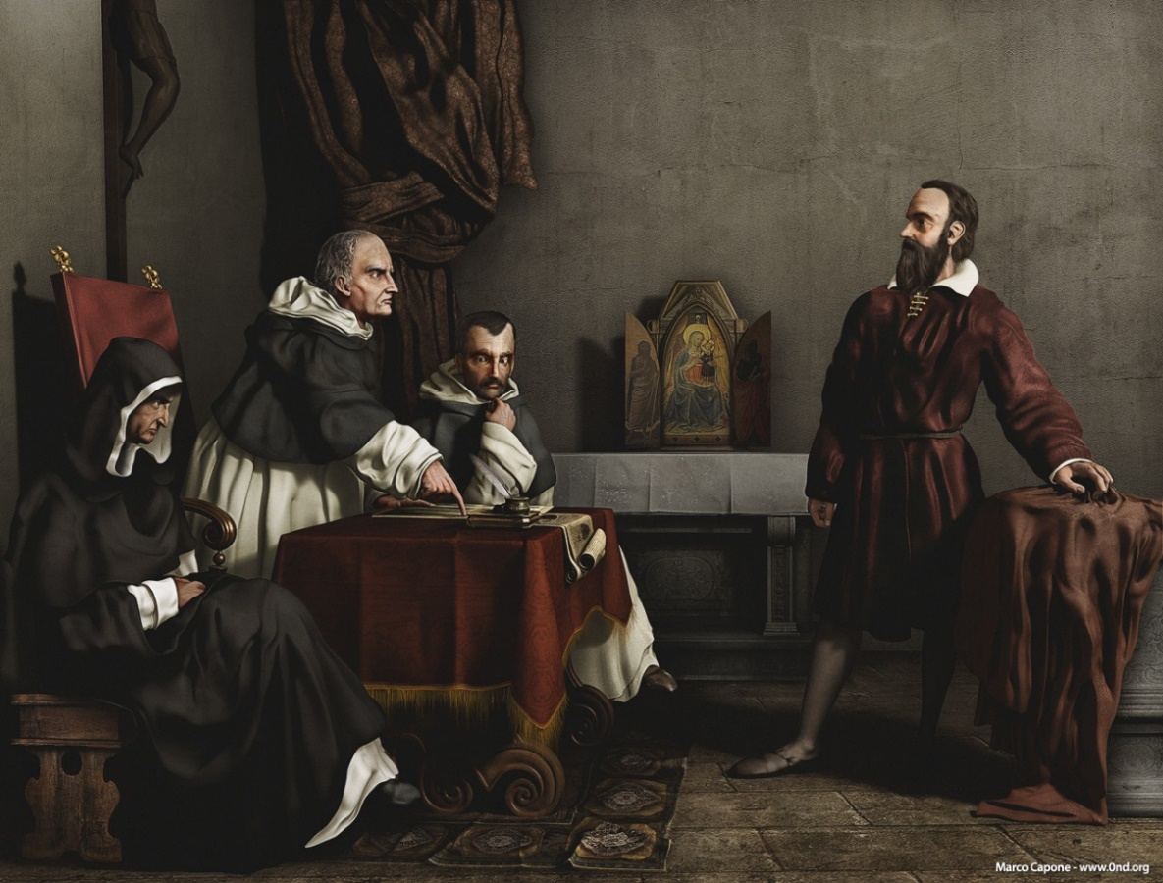
Tactic One: Inquisition
Was responsible for bringing to trail individuals accused of committing offences like:
Practicing Protestantism
Sorcery and witchcraft
Immorality
Blasphemy
Would bring people like Galileo to trial.

Slide 4
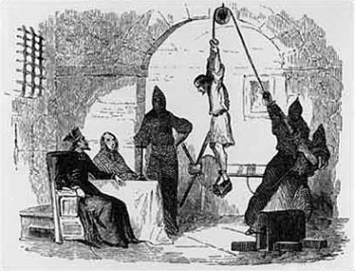
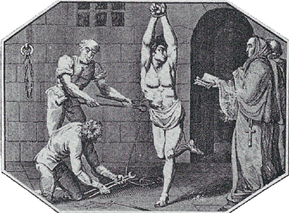
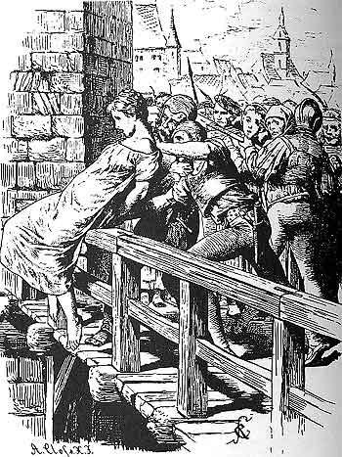
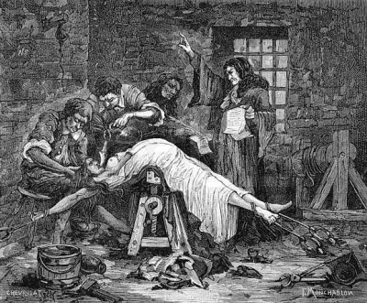
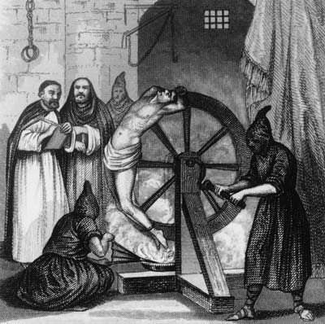

Slide 5
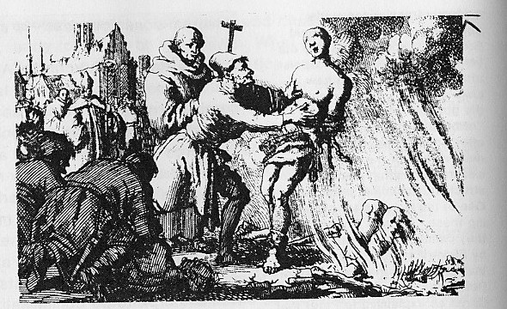
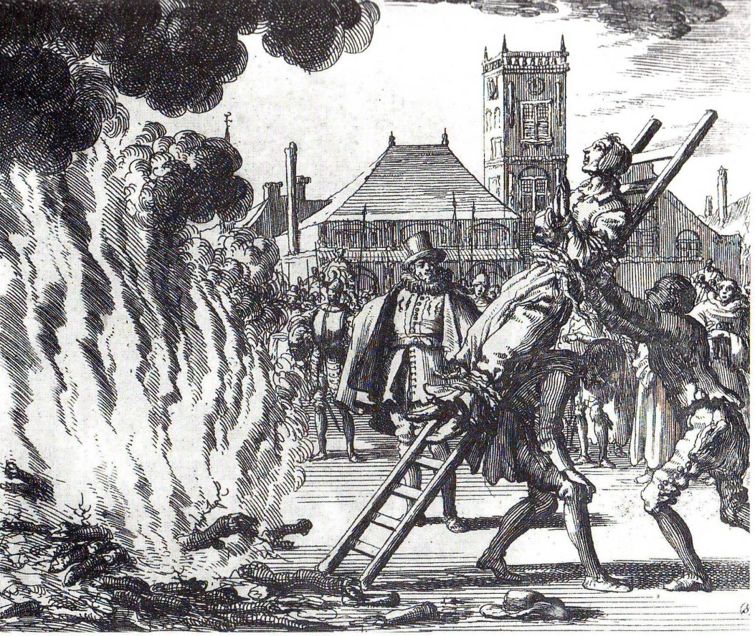
The End Result

Slide 6
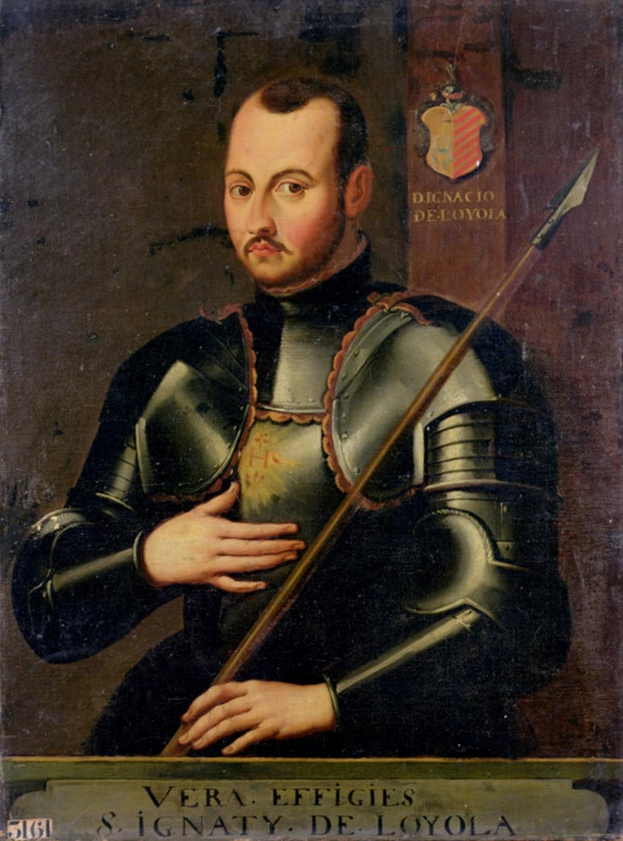
Tactic Two: Spread Catholicism elsewhere
In 1534 a monk named Ignatius of Loyola founded the Jesuits.
Went on missions as far as China and Japan to spread Catholicism.
Also founded some of Europe’s best universities.
Created a mix of religious doctrine and high educational standards.
Outcome? Created young, educated men who supported the church.

Slide 7
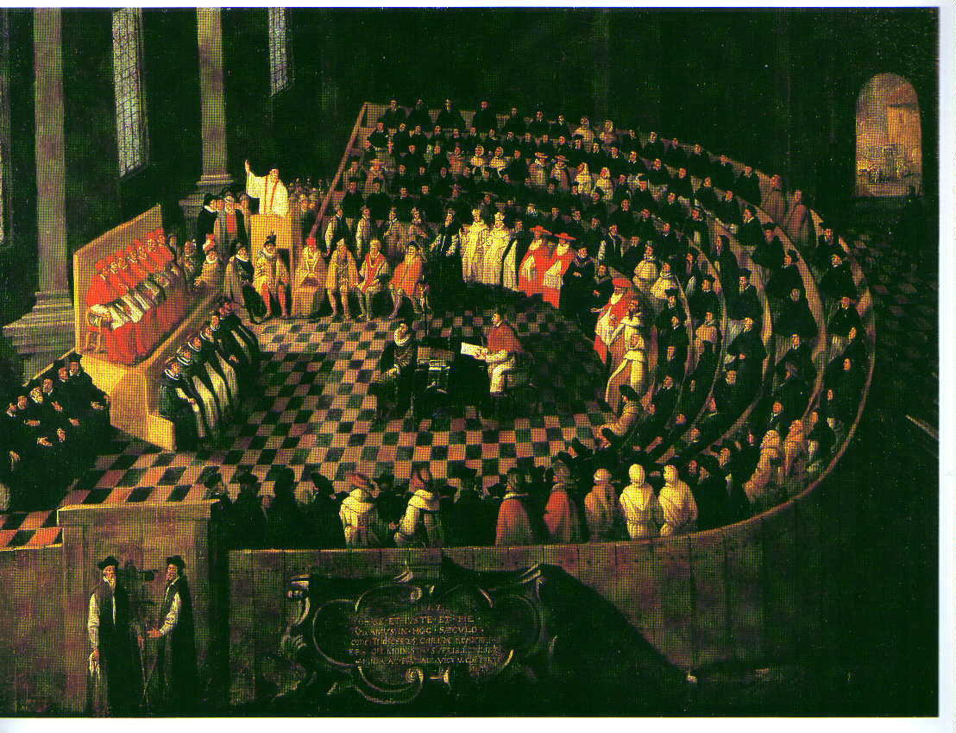
Tactic Three: Council of Trent
Pope Paul III understood that church doctrine had to be clearly defined if attacks on Protestantism would be successful.
The Council of Trent was designed to define official church positions on matters of church doctrine.
The Council wanted to:
Fix the selling of indulgences
Have higher behavior expectations
Go over the importance of confession
Maintained the need for ceremonies and splendor

Slide 8
Question:
You’ve been hearing about a scandalous new book series on Facebook, Twitter, and from friends. Suddenly, the school places a ban on the book. Do you…?
Read the books anyway?
Listen to the rules and avoid the books?
OR

Slide 9
Tactic Four: Establishment of the Index of Forbidden Books
Read the following info sheet and answer the questions as you go.
You do not need to write in complete sentences.
What does this list suggest about the role of the printing press?
How successful do you think this list was in preventing Catholics from reading the books on the list?

Slide 10
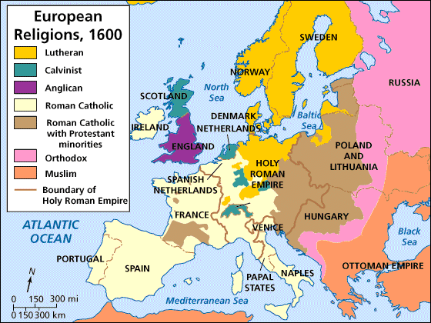
Protestantism’s Popularity
Despite attempts by the Catholic Church, the support for Protestantism continued to grow.
By the end of 1600, Protestantism was the major religion in:
England Denmark
Scotland Norway
Switzerland Sweden
Germany Finland
Netherlands

Slide 11
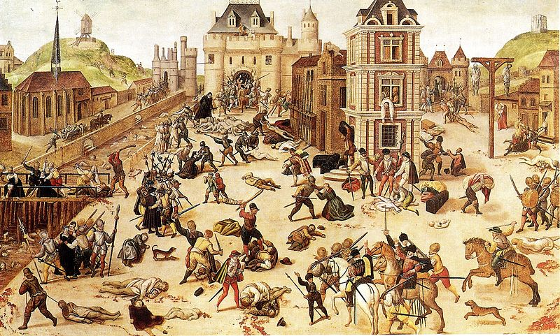
Results in France
France, a staunchly Catholic country, was a battle ground over religion.
French Calvinists, named Huguenots, faced extreme persecution.
Example: at the wedding of Catholic Princess Margot and Protestant Henry IV, the Protestant wedding guests were massacred in the St. Bartholomew's Day Massacre.
However, King Henry IV, a Protestant who married into the French royal family (and was never supposed to become king), felt bad for the Huguenots.
In response, he passed the Edict of Nantes, which allowed French Calvinists to practice their faith without persecution.

Slide 12
Results of the Religious Upheaval
Led to devastating wars over religion in France, Germany, Switzerland and the Netherlands.
Led to a renewed interest in education.
Led to the creation of strong national governments.

