Slide 1
Discovery of the New World
SWBAT: identify the consequences of Columbus’ “discovery” of the New World.
Homework: Study for vocab quiz tomorrow.
Do Now: Fill in the “K” part of your KQL chart. What do you know about Columbus?

Slide 2
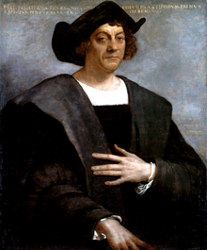
Who was Columbus?
Is an Italian from Genoa, Italy.
How might this affect him?
Like many others, he understood that the world was not flat.
Goal: to find a shorter way to the Far East.
Why? Constantinople was taken by the Muslim Turks, and Europeans were looking for an alternate trade route to the East to avoid the Ottoman Empire.
Notes:
Was Genoese.
Sailed on trading vessels and became an expert navigator.
Believed in a route West that would bring him to Asia.

Slide 3
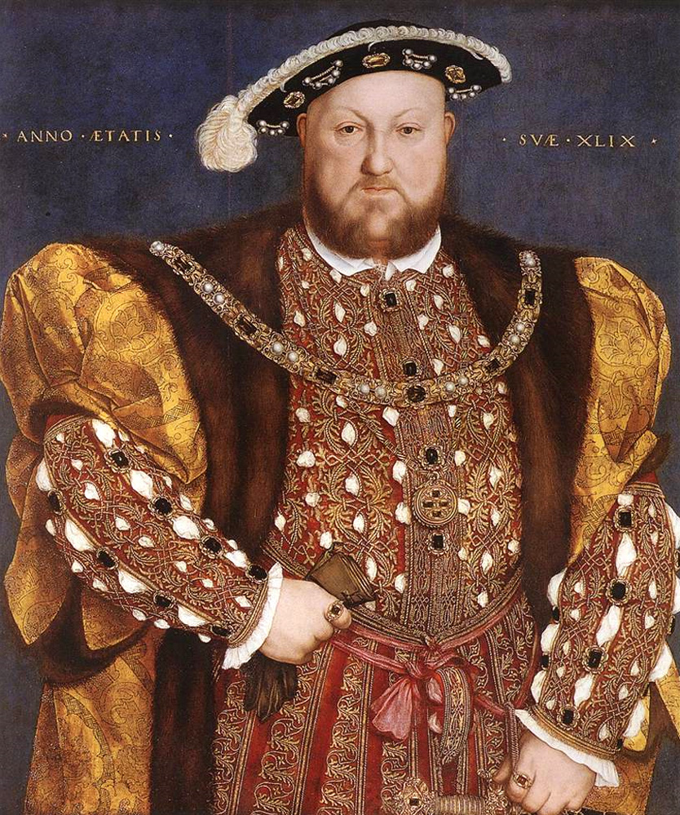
But where to start?
Before he could go anywhere, he had to find a financial backer for his trip.
He asks many of the monarchs of Europe:
King John II of Portugal
Kingdoms of Venice and Genoa
King Henry VIII of England
King Ferdinand and Queen Isabella of Spain
All turn him down.
Why? He grossly underestimates the amt. of time he thinks it will take to get there.
King Henry VIII

Slide 4
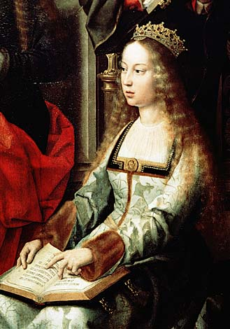
Columbus finds a backer
Columbus is about to give up, until he finally comes up with an angle.
Promises Queen Isabella and King Ferdinand of Spain to bring Catholicism to the East.
Sets sail August, 1492 on 3 ships:
Nina, Pinta, and Santa Maria
Queen Isabella of Castile and Aragon

Slide 5
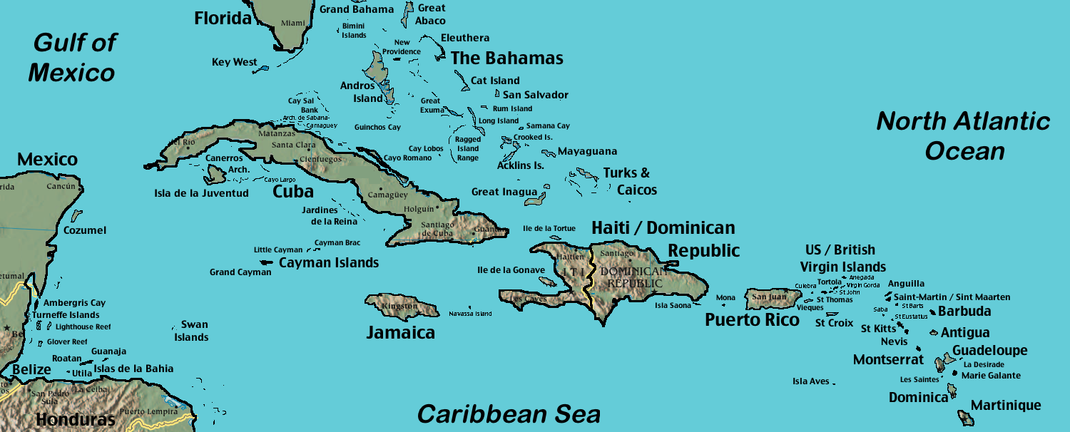
First Voyage West
See land October 12, 1492.
End up in the Bahamas and Columbus calls it San Salvador.
Notes:
2 months later, they reached the Bahamas, naming it San Salvador.
Would also explore modern day Cuba, Haiti, and Dominican Republic.
After 3 months, he returns home leaving 40 men in the Carribbean and bringing with him 10-25 captives, of which 7-8 survive.

Slide 6
Columbus’ Arrival
Read the journal entry from Columbus’ arrival in San Salvador.
Answer the questions that follow in complete sentences.
Fill in the “Q” portion of your KQL chart.

Slide 7
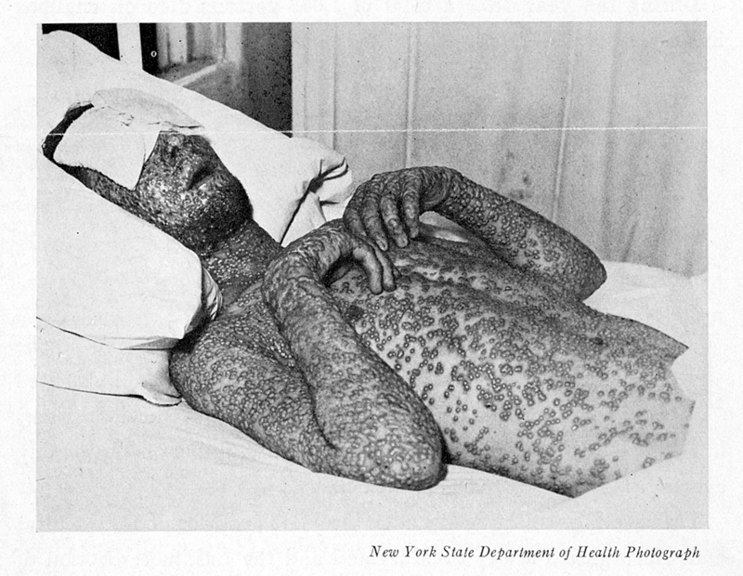
Other Impacts of Columbus’ Journey
Columbian Exchange
Europeans were introduced to potatoes, tomatoes, beans and corn.
Native Americans were introduced to horses.
Diseases like smallpox, flu, measles, and chicken pox killed many.
90% of the native population died mid-1500.
Because so many natives die, Spanish start importing Africans to replace the native population.

Slide 8
What have you learned?
Fill in the “L” portion of you KQL chart.

Slide 9
Extra Discussion
Do you think it is acceptable given what you know about Columbus to have so many things named after him?
Columbia University
Columbus, Ohio (or, New Jersey)
District of Columbia

