Slide 1
English Civil War
SWBAT: identify the causes and result of the English Civil War.
Homework: Vocab
Do Now: Write a personal ad for Charles I using the homework from last night. How would he describe himself? What are some of his accomplishments? What might he be looking for in a woman? This needs to be done on a separate sheet of paper and should be at minimum 5 sentences in length. Some will be asked to present their ad and these will be collected.

Slide 2
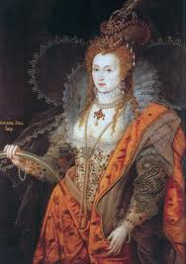
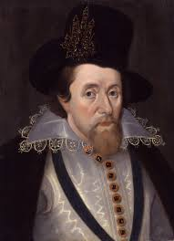
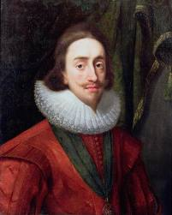
The English have a new king…and new problems
Elizabeth I
James I
Charles I

Slide 3
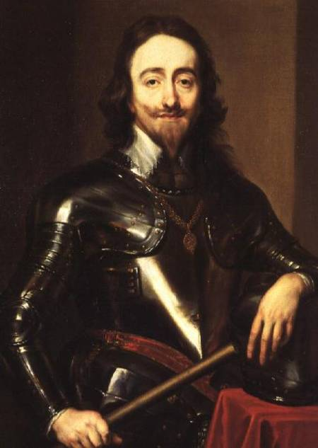
Who is Charles I? And why is he a problem?
Son of James I
Believed in the divine right of kings.
Married to a French Catholic princess.
Charles fought for power with the Parliament of England
He wanted more and more money while Parliament sought to curb his royal allowance.

Slide 4
The event leading to war
Ireland was in rebellion.
Parliament needed a big army to put down the rebellion, however, they didn’t trust the king to lead it and decided Parliament would lead the army instead.
Charles led his troops to the House of Commons (parliament) to arrest some of his opponents.
Neither side would compromise leading to the civil war.

Slide 5
The two sides…
Cavaliers Roundheads
Supporters of the King | Supporters of Parliament
Leader: Charles I | Leader: Oliver Cromwell
Groups who supported: Anglicans Roman Catholics Nobles Opponents to Parliament’s reforms | Groups who supported: Puritans Other non-Anglican Protestants

Slide 6
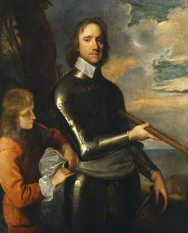
Oliver Cromwell
Puritan leader in charge of Parliament’s troops.
Created the New Model Army
was a military force based on a person’s ability rather than on their position within society.
if you were good enough, you could be an officer in it.
the removal of this social obstacle meant that the New Model Army was open to new ideas and social class meant nothing.

Slide 7
Cromwell is Victorious
The New Model army was faster, better outfitted, and more-disciplined and easily defeated Charles’ army.
Charles flees to Scotland and rallied troops there to fight Cromwell.
Cromwell crushes Charles for the second time in Scotland. Charles is taken prisoner.
The question becomes: what do they do with the king?

Slide 8
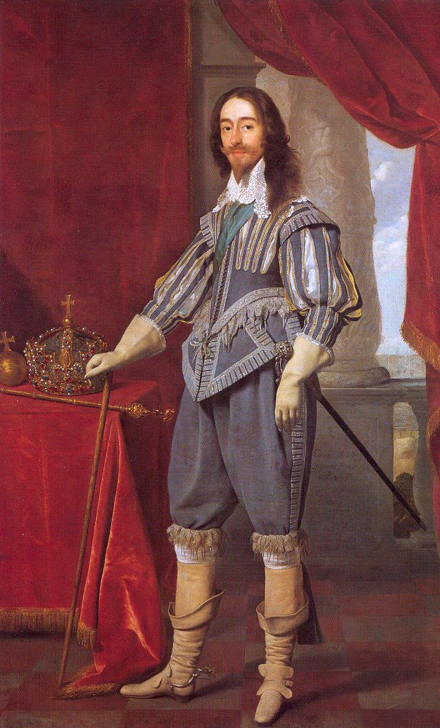
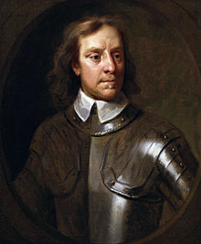
How would you describe Cromwell’s portrait to the left? What do you see?
How does this compare to Charles I’s portrait to the right?
Why do you think Cromwell wanted the artist to show him in this way?

Slide 9
Cromwell takes control
Est. the Rump Parliament and forces the king’s supporters out.
Rump meaning leftover.
Abolished the monarchy and the House of Lords.
Proclaimed England a commonwealth.
Oliver Cromwell becomes Lord Protector of England instead of king.

Slide 10
So, what happens to Charles?
“Whereas Charles Stuart, King of England, is and stands convicted, attained, and condemned of high treason and other high crimes; and sentence upon Saturday last was pronounced against him by this by this Court to be put to death by the severing of his head from his body; Of which sentence execution yet remain to be done; These are therefore to will and require you to see the said sentence executed In the open street before Whitehall upon the morrow being the 13th day of this month of January between the hours of 10 in the morning and 5 in the afternoon of the same day with full effect.”

Slide 11
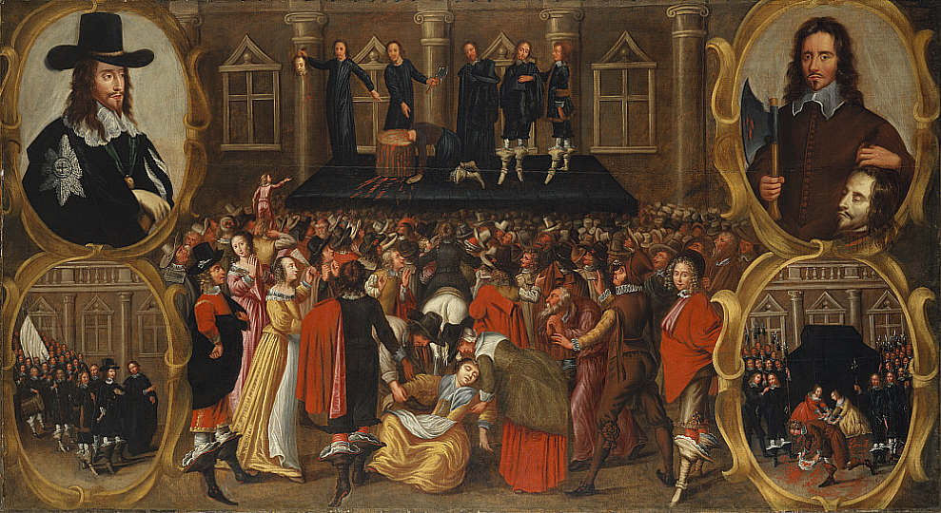
“Execution of Charles I”
Notes:
This painting, probably based on eye-witness accounts and contemporary engravings, records the execution of Charles I on 30 January 1649 at Whitehall, after a long and bitter civil war. The inset pictures on the left show Charles as he appeared at his trial, and below, Charles walking to the scaffold. Those on the right show the moments immediately after the execution: the axeman holds up Charles's severed head while spectators hurry to dip their handkerchiefs in royal blood. The central image, with the swooning woman, hints at a parallel with Christ's crucifixion.

Slide 12
Cromwell’s Commonwealth
Acted as a military dictator.
Aimed to bring a representative form of government to England.
The Instrument of Government was the 1st constitution of Europe and ruled that landowners would elect people to represent them.
Was very unpopular.
Cromwell did not get along well with Parliament and dissolved it.
Sound familiar??
After Cromwell’s death in 1658, his son failed to maintain power and England restored the monarchy.

Slide 13
Exit Slip
Imagine you are part of the royal family in another European country and Twitter exists. How would you feel upon hearing about the execution of Charles I? Write a tweet in 120 characters or less. Hashtags are encouraged, but not mandatory.

