Slide 1
16th Century Explorers
SWBAT: identify Cortes and Pizarro and their effects on the Aztec and Inca Empires respectively.
Homework: None
Do Now: Study for vocab quiz.

Slide 2
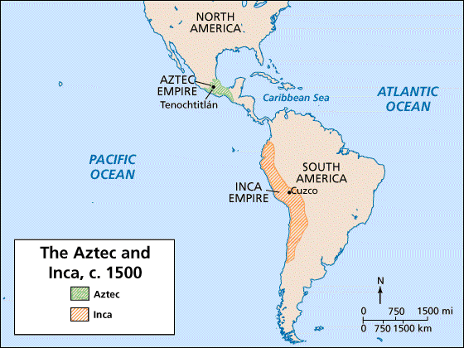

Slide 3
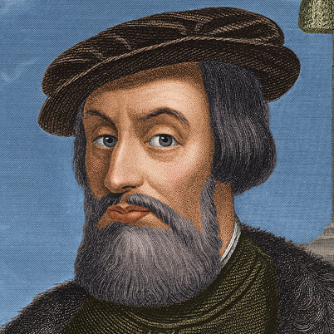
Hernan Cortes
Living in Cuba when he hears rumors about a city of gold in the middle of what is today Mexico.
With a small group of men, he sets sail.
Becomes what we call today a conquistador, or Spanish explorer.
On the Mexican coast he meets a Mayan princess, la Malinche.
Interprets.
Reveals Aztec weaknesses.
Notes:
People don’t like the Aztecs. The Aztecs would go battle other groups of Indians, win, and then make sacrifices to the gods. Also heavy tax burdens.

Slide 4
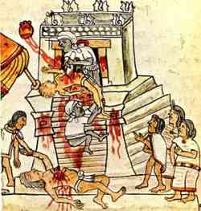
What are those weaknesses?
A lot of local tribes really dislike the Aztecs.
Why?
Aztecs were powerful and had managed to take over large parts of Mexico.
The people they conquered were either:
A. taxed heavily.
B. used for human sacrifices to the Gods.
C. both
These tribes were willing to help Cortes if it meant bringing an end to the powerful Aztecs.

Slide 5
Montezuma II and the Aztecs
Montezuma, king of the Aztecs, is aware of Cortes, and sends gold.
Hopes to make an alliance, not start a war.
The gold only increases Cortes’ desire for more gold.
With army of enemies, Cortes captures Montezuma.
Lets him pretend to be king.
Cortes leaves putting his lieutenant in charge.

Slide 6
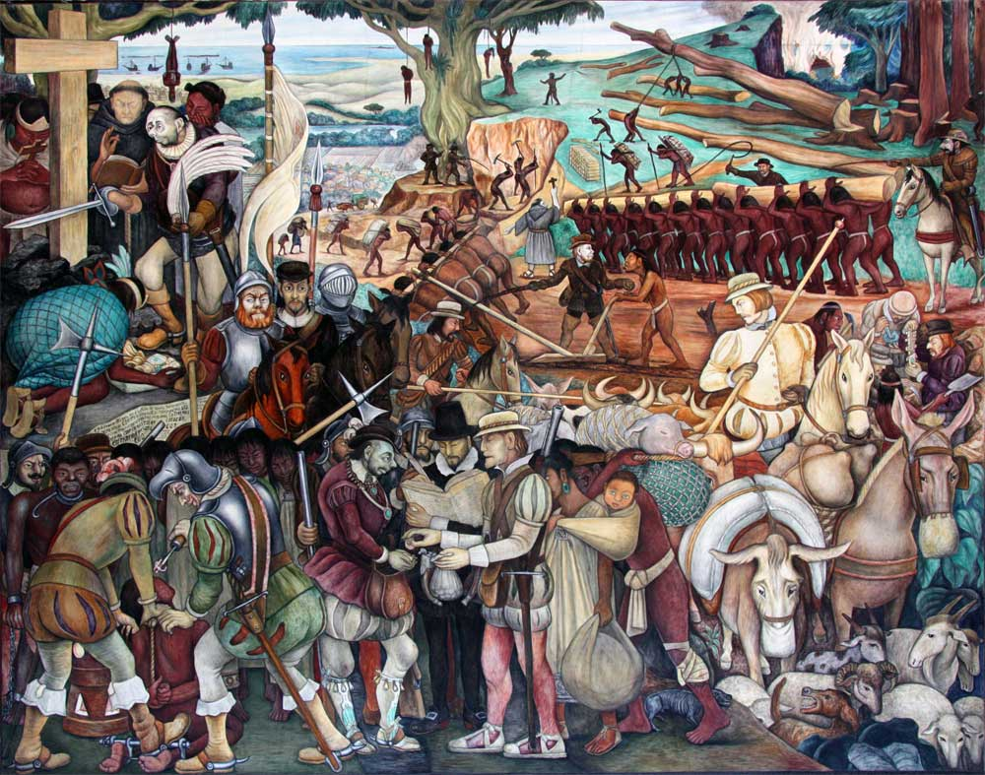
The Conquest or Arrival of Hernan Cortes in Veracruz by Diego Rivera

Slide 7
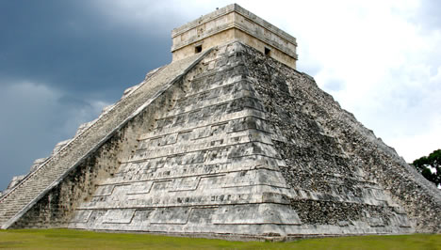
End of the Aztecs
Cortez returns to a capital in chaos.
Asks Montezuma to calm his people.
Montezuma is killed.
Spanish take control.

Slide 8
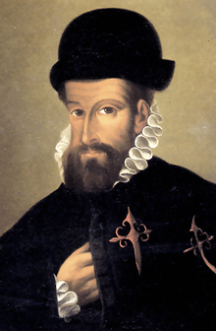
Pizarro and the Inca
Reports of Peru's riches and Cortés's success in Mexico intrigued another explorer, Francisco Pizarro.
The Inca Empire was one of the strongest in South America and it took three attempts before Pizarro could successfully establish a base on the mainland.
Like the Aztecs, the Incans would face a similar situation.

Slide 9
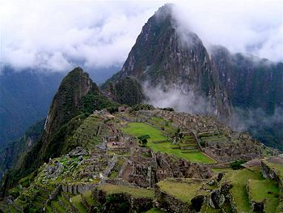
Pizarro and the Inca- Primary Source Analysis
Read the account provided and answer the questions that follow.

Slide 10
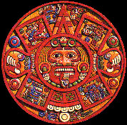
The Impact on Indian Culture
Tried to rid Indians of their culture.
Tore down temples, destroyed their art, restructured their towns.
Indians realized that in order to preserve their customs, they would need to incorporate Spanish culture into their own.
Eventually, a new culture emerged blending the two together.

Slide 11
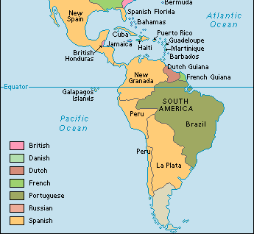
Exit Slip- The Map
By the end of 1590, most of the New World was already claimed by Spain and Portugal.
What affect do you think this had on other nations during the same period?

