Slide 1
Fall of Napoleon
SWBAT: identify the mistakes Napoleon made towards the end of his reign and their consequences.
Homework:
CP: Study guides are due on Thursday.
Core: None.
Do Now: Think back to Thursday- what made Napoleon a good leader? How did he gain the respect and love of the people?

Slide 2
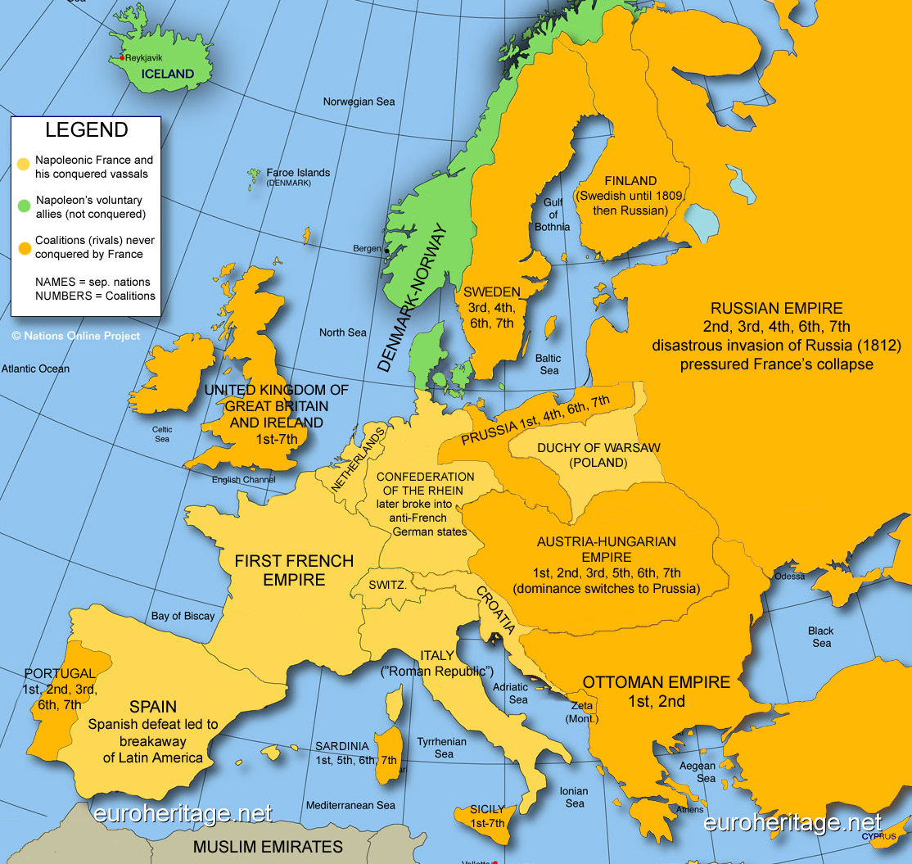
Straining Tensions
Napoleon’s ultimate goal was to invade and conquer Britain.
Step 1 of that plan? The Continental System.
Napoléon ordered a blockade of the British Isles and forbade the French Empire and its allies from trading with Britain.
The British responded with a blockade against the French.

Slide 3
Increased Nationalism
Without intending to, the French increased feelings of nationalism in the people they conquered.
Nationalism: the love of one's country rather than one's native region.
In France the Revolution, as well as the Declaration of the Rights of Man, made people think of their country and ideals as things worth fighting for.
Now these same feelings of loyalty and patriotism appeared among the people Napoléon had conquered.
In some places this increased opposition to French rule.
Over time, the armies of Napoléon's opponents' grew stronger.

Slide 4
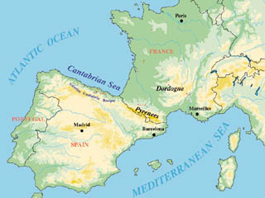
Napoleon Captures the Iberian Penninsula
In 1807 Portugal refused to follow the Continental System because its economy depended upon trade with Great Britain.
Napoléon responded by sending his armies into Portugal and driving out its king.
He also conquered Spain and forced the Spanish king to step down.
Napoléon then made his brother Joseph king of Spain.

Slide 5
Spain Revolts
The Spanish people revolted against this foreign rule in 1808.
The British sent an army to help the Spanish and Portuguese people rise up against the French.
This war, known as the Peninsular War, lasted from 1808 to 1814.
During this time Napoléon still controlled Spain's government, but the war drained France's military resources.
In 1813 the Spanish, with British help, finally drove out Joseph Bonaparte.
The revolt in Spain, and this new constitution, show the influence of the ideas of the French Revolution.
Also marked the first of Napoleon’s defeats.

Slide 6
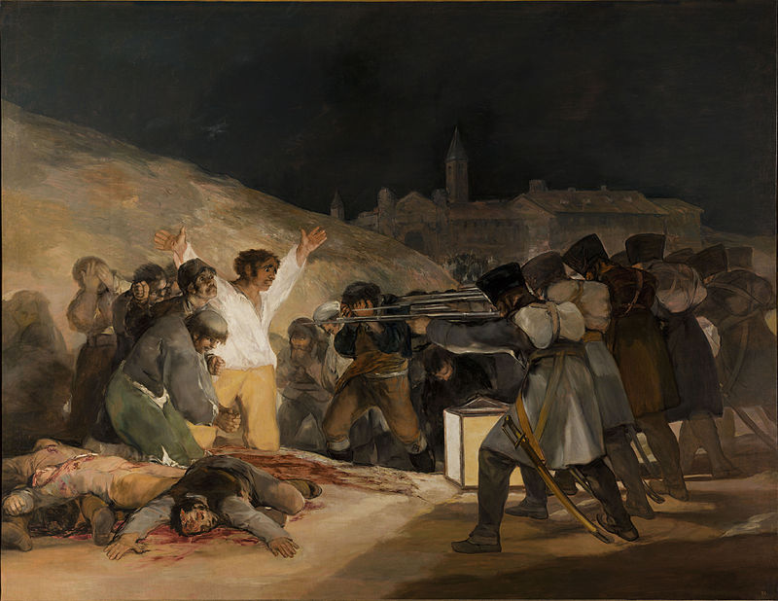
Francisco Goya,
The Third of May,
1808

Slide 7
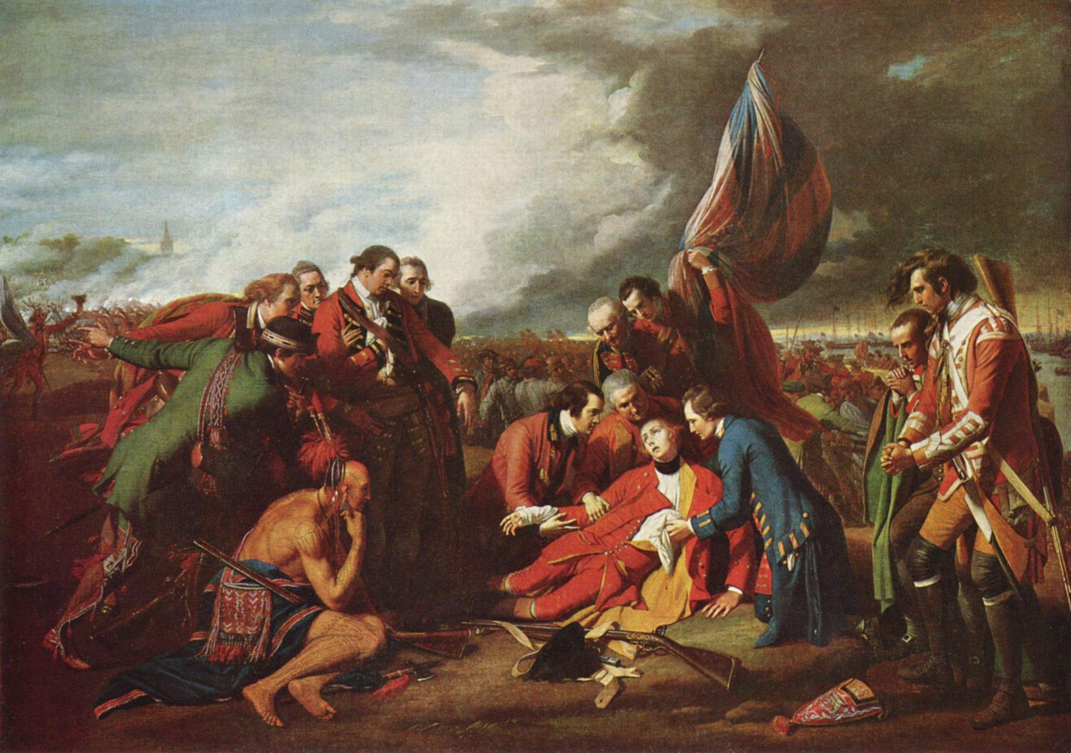
Benjamin West
The Death of General Wolfe, 1770

Slide 8
Russia
Czar Alexander I of Russia was alarmed by Napoléon's domination of Europe.
Moreover, Russia had long depended on trade with Great Britain for manufactured goods.
In 1812 the czar began trading again with Great Britain.
Because the blockade was Napoléon's only way of striking at the British, he was angry that Russia, an ally of France, would openly ignore it.
He decided to invade Russia, and he called on all parts of his empire to supply soldiers.

Slide 9
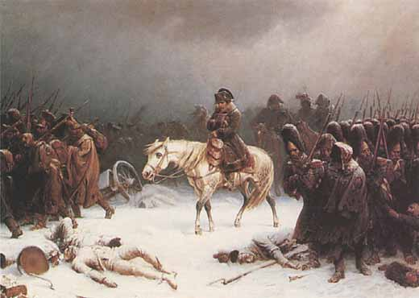
Napoleon’s invasion of Russia
Read the article “All for the want of a Winter Horseshoe” and answer the questions that follow.

Slide 10
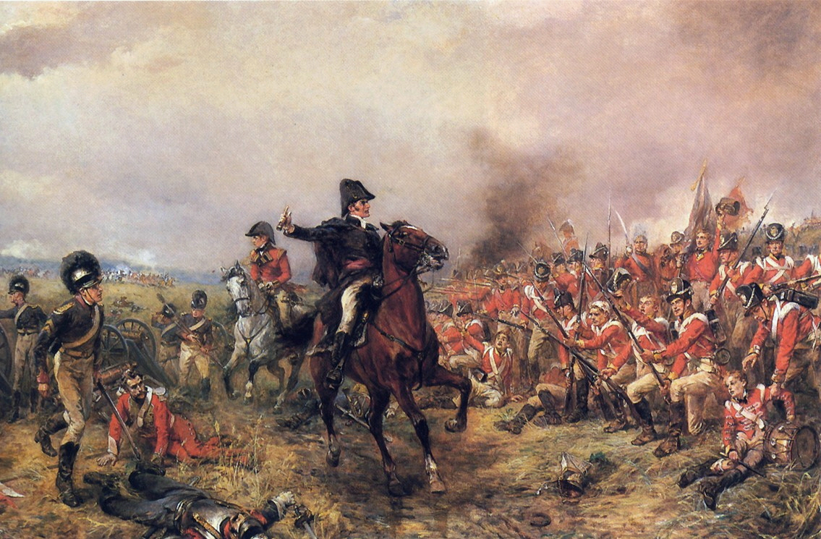
Napoleon’s Downfall
Monarchs in western Europe took advantage of Napoléon's defeat in Russia.
Prussia, Austria, and Great Britain joined Russia in a final alliance to crush France.
Remember- most of Napoleon’s army had be lost in Russia, so these troops were newer, less experienced, and poorly trained.
In October 1813 Napoléon's army met these allied forces in Leipzig in Saxony.
Napoléon retreated into France. The allies captured Paris in March 1814.

Slide 11
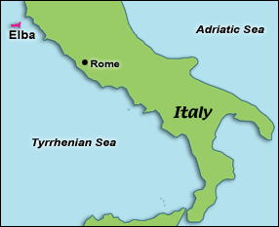
Exile
Napoléon agreed to give up all claims to the throne for himself and his family. The allies gave him a pension and allowed him to retire to the island of Elba.
The allies wanted to make sure that France would no longer disrupt Europe's affairs.
Restored the Bourbon monarchy.
Louis XVIII, the brother of Louis XVI, came to the throne.
France again had a king.

Slide 12
The Hundred Days
During 1814 and early 1815, the restored king and his family made many enemies among the French people.
Learning of this discontent, Napoléon escaped from Elba and landed in France on March 1, 1815.
Louis XVIII sent soldiers to capture Napoléon. Napoléon met them saying, "If there be one among you who wishes to kill his Emperor, he can. I come to offer myself to your assaults."
The soldiers' resistance disappeared, and Napoléon led the army into Paris on March 20, beginning a period called the Hundred Days.
Frightened, Louis XVIII fled into exile. Napoléon once again ruled France.

Slide 13
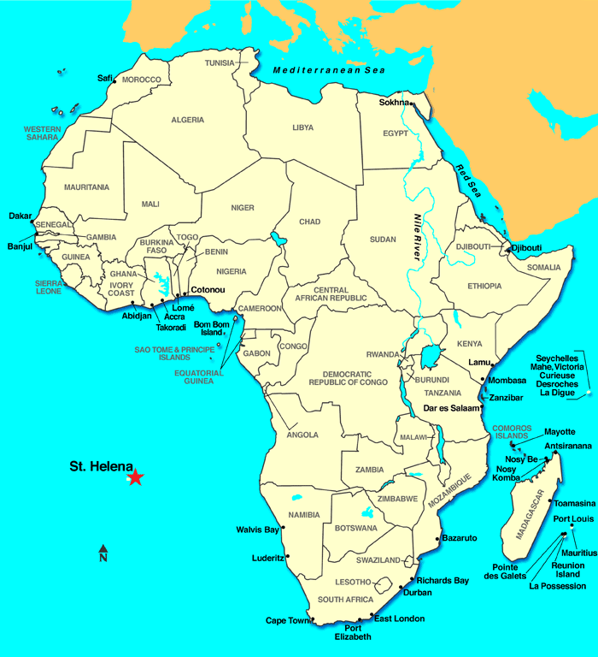
Napoleon’s Exile- for real this time
Napoléon hoped that disputes among his opponents would keep them from opposing his return, but he was wrong.
Prussia, Great Britain, and the Netherlands sent armies toward France. Napoléon assembled an army to stop them.
On June 18, 1815, the allied and the French armies met at Waterloo.
The British and their Prussian allies dealt Napoléon his final defeat. Napoléon gave up the throne, and the Bourbon monarchs once again took power.
Napoléon was sent to St. Helena where he lived under constant guard. In 1821 Napoléon died there.

Slide 14
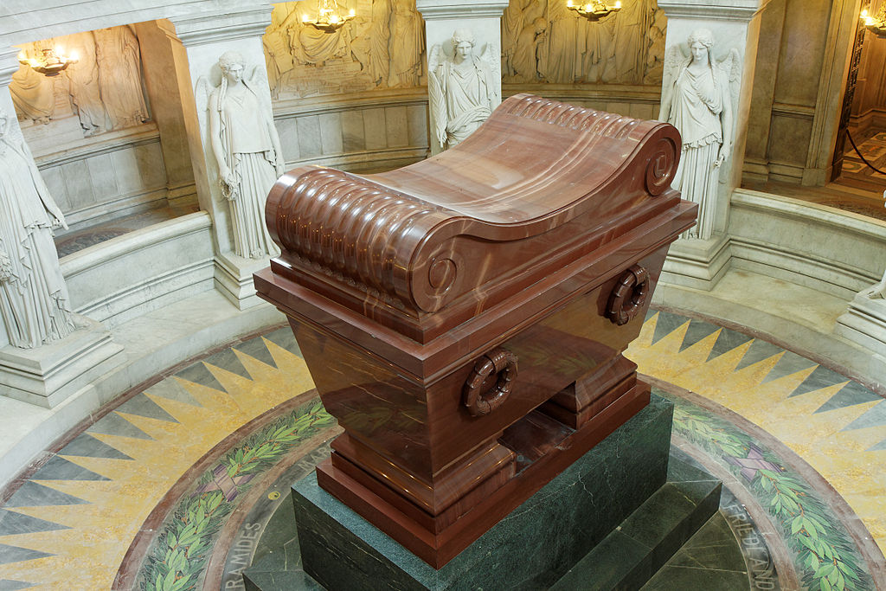
Napoleon’s Legacy
As the years passed, Napoléon's legend grew.
People forgot his failures and remembered his glories and victories.
Napoléon and his achievements came to be memorialized in French literature and art.
In 1840 the British allowed the French to bring Napoléon's remains back to Paris, where they lie to this day.

