Slide 1
Latin Americans Win Independence
SWBAT: describe the effect the American and French Revolutions had on Latin American independence movements.
Homework: Answer the last section of each chart for Brazil and Mexico.
Do Now: Let’s review: What does it mean to be a liberal? What does it mean to be a conservative?
Haiti, Brazil, Venezuela, and Mexico

Slide 2
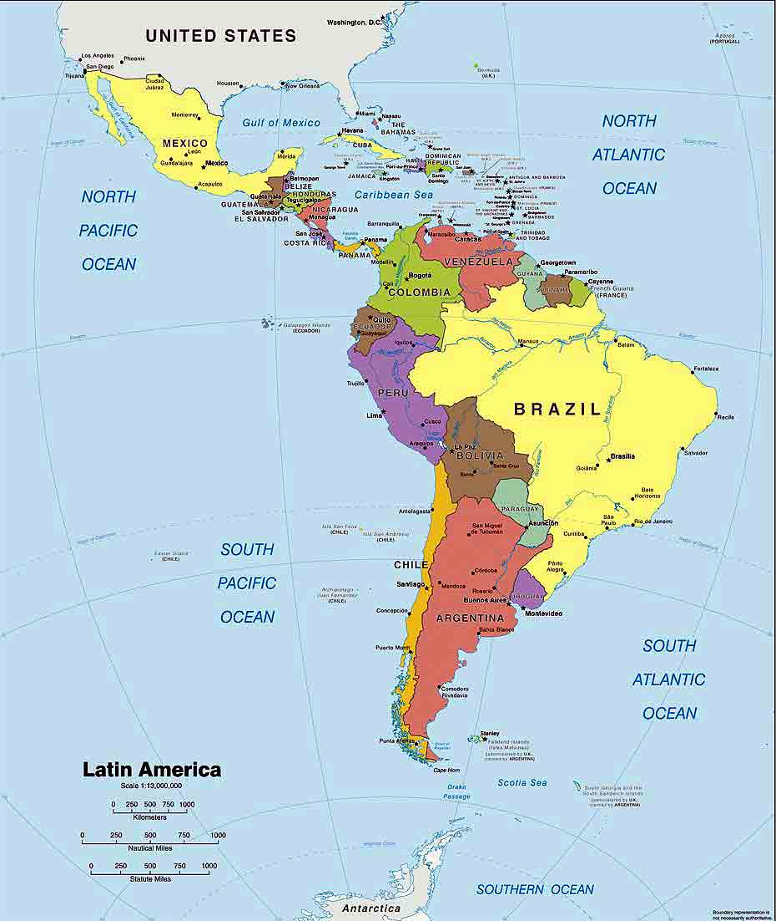
Enlightenment ideals spread west
The success of the American Revolution and the attempt by the French at revolution along with Enlightenment ideals slowly found their way across the Atlantic.
Liberty, equality, and democratic rule were all things that were popular, but Latin American countries did not enjoy.
In Latin America, most of the population resented European colonial powers.
But why?

Slide 3
Strict Class System
Like the French estate system, the Latin American class system was equally ridged.
Dictated not only people’s place, but the jobs available to them.
The class system worked as follows:
Peninsulares: born in Spain. Only group allowed to hold office.
Creoles: Spaniards born in Latin America. Could not hold office, but could rank up in the army.
Mestizos: mixed Europeans/Indian ancestry.
Mulattos: mixed European/African ancestry.
Indians: natives to Latin America.
Peninsulares
Creoles
Mestizos
Mulattos
Indians

Slide 4
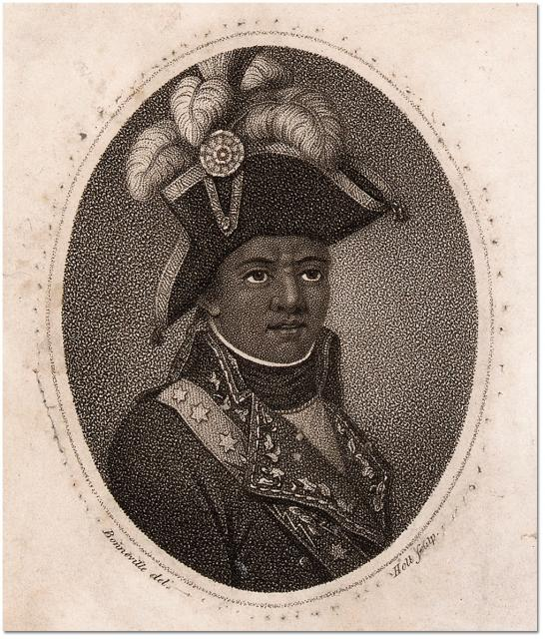
Revolution in Haiti
Haiti was the first location to try and put Enlightenment principles into action.
~500,000 enslaved Africans worked on French plantations and outnumbered their masters significantly.
To keep slaves in their “place”, masters used brutal methods to keep them powerless.
While the French Revolution was taking place, slaves rose up against their masters.
In August, 1791 100,000 enslaved Africans rose in revolt.
A leader named Toussaint L’Ouverture rose with the slaves and by 1801, had taken control of the entire island and freed all the slaves.

Slide 5
French Resistance
In 1802, 30,000 French troops landed in Haiti to remove Toussaint from power.
Toussaint agreed to halt the revolution if the French would end slavery.
The French agreed.
The French then accused Toussaint of plotting another uprising and arrested him.
Toussaint's lieutenant Jean-Jacques Dessalines took his place and on Jan. 1, 1804, the colony was declared independent.
Haiti was the first black colony to free itself from European control.

Slide 6
Creoles Lead Independence
Even if they couldn’t hold office, the creoles were the least oppressed group of those born in Latin America. They were also the best educated.
Many came from families that could afford to send the children to European schools and universities.
When they returned, they brought Enlightenment ideals back with them.
Creoles in Mexico, Brazil, and Venezuela would be responsible for leading uprising in these nations.

Slide 7
Independence movements begin
In 1808, Napoleon put his brother on the throne of Spain.
While many in Latin America supported King Ferdinand II, many felt no allegiance to a French king.
At the same time, Locke’s idea that the power of gov’t comes from the people, the people realized that because they no longer supported the monarchy, they had the right to break away.
By 1810, Latin America erupted in revolution.

Slide 8
Closing
What seem to be the common denominators across all 4 country’s independence?

