Slide 1
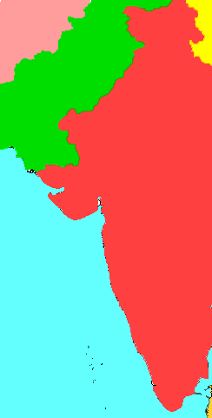
Mughal Empire
SWBAT: identify the differences between Christianity and Hinduism.
Homework: Rough Drafts (3 PRINTED COPIES) due on Tuesday!!!
Do Now: Imagine for a second that you live on the border of 2 different regions with two different religious beliefs. Which religion would you follow? What factors would you consider when making your decision?
You live here.

Slide 2
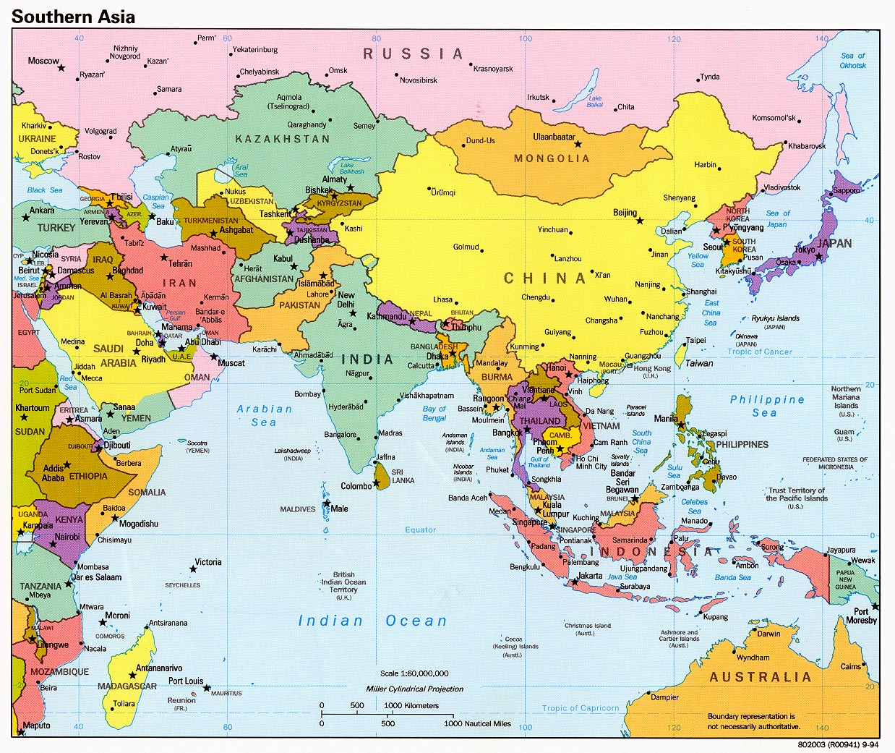
Where is the Mughal empire?
Occupies modern-day India

Slide 3
Beginning of the Mughal Empire
During the 1300s Turkish Muslims controlled India.
By the 1500s the power of the Delhi sultans had been greatly weakened. Indian warrior princes called Rajputs began to challenge them.
The internal weakness of the sultanate drew the attention of India's powerful neighbors, and left India open to Mongol attack.

Slide 4
Babur
The attack came from a young leader known as "Babur the Tiger."
Babur had tried to build an empire in central Asia, but the Uzbek people had driven him out. Babur then focused on India.
In 1526 he attacked the Sultanate of Delhi. A major battle took place at Panipat, a town north of Delhi. Babur was greatly outnumbered, but he won the battle, as he described in his autobiography.
After the victory at Panipat, Babur occupied Delhi and the surrounding region. This territory became the core of the Mughal Empire.

Slide 5
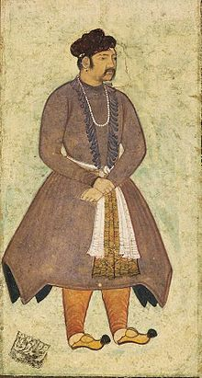
Akbar
Babur's grandson, Akbar, was the greatest Mughal emperor. He took the throne at the age of 13 and reigned from 1556 to 1605.
Akbar gained support for his government in various ways.
He married a Rajput princess and gave other Rajputs government positions.
Fixed the tax system.
When the harvest was poor, the tax did not have to be paid. In a good harvest, the villagers could keep anything above the tax level.
Perhaps most importantly, Akbar was tolerant of all religions.
He repealed the special tax that non-Muslims had been forced to pay.

Slide 6
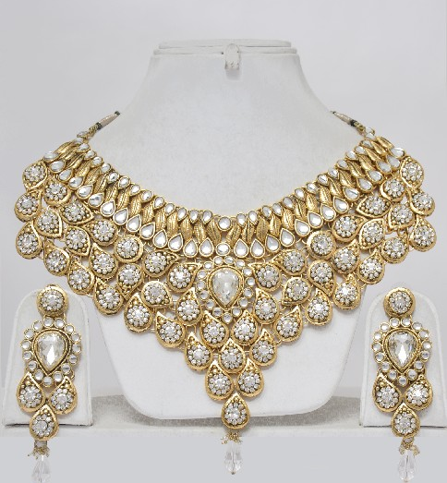
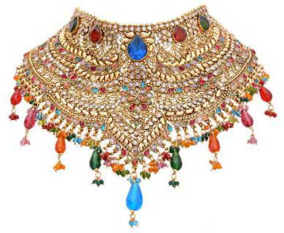
Economy and Trade
During Akbar's reign the economy improved.
The empire's wealth and resources, and its location along the sea routes to Asia, attracted European traders.
India had impressive quantities of jewels and gold.
The climate allowed the peasants to grow a variety of crops and allowed more than one harvest a year.
European travelers thought India's rulers lived in greater luxury than their European kings. India's cities, such as Agra and Delhi, were filled with beautiful buildings and monuments. The Mughal cities seemed much larger than any in Europe.

Slide 7
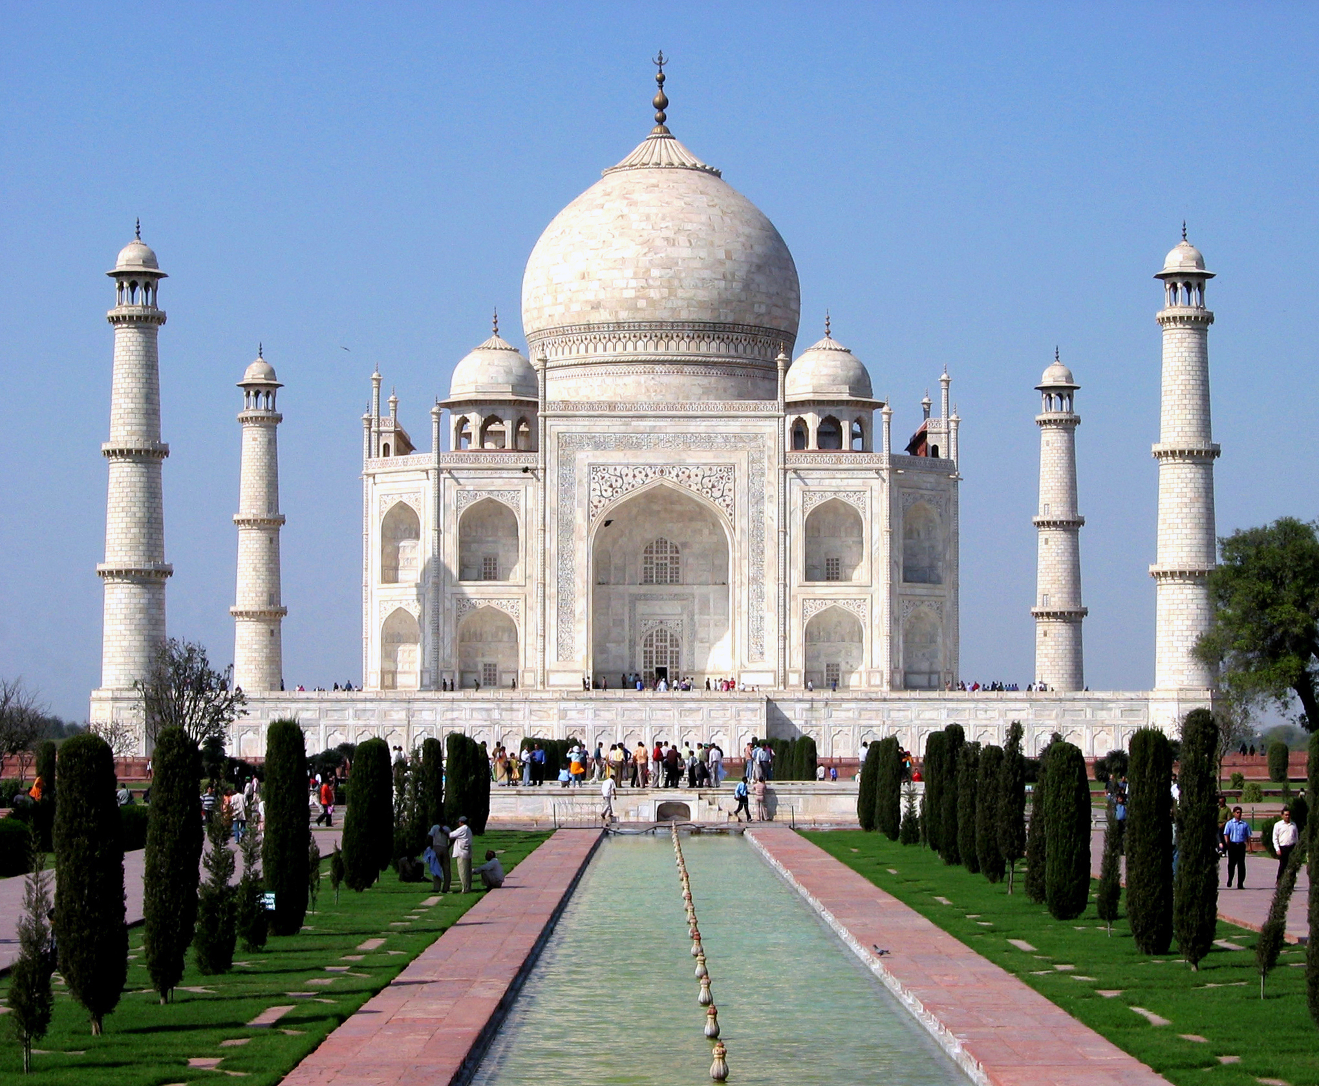
Shah Jahan
The Mughal Empire was at its height during the reign of Shah Jahan.
1628-1658
Best known for building the Taj Mahal.
A tomb for his wife Mumtaz Mahal.
In his 30 year reign, Shah Jahan:
Moved the capital to Delhi.
Expanded the empire.
Put down several rebellions.
The Mughals were also engaged in military campaigns against Persia.
Their huge armies were very expensive to maintain.
To meet his expenses, Shah Jahan increased taxes.
Many people suffered under this terrible burden.

Slide 8
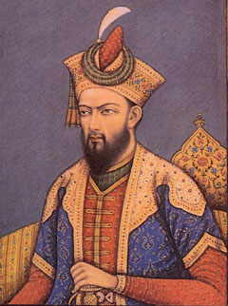
Aurangzeb
Son of Shah Jahan.
Killed his brother, imprisoned his father, and proclaimed himself emperor.
Devout Sunni Muslim and persecuted all other faiths in the empire.
Restored the tax on non-Muslims.
Insisted on strict following of Sharia law.
Destroyed Hindu temples
Made dancing and drinking illegal.
Put down a riot over religion with elephants.
Mughal empire weakens after this time.

Slide 9
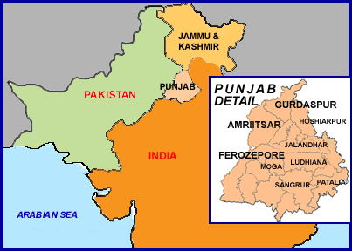
Sikhism
Under the Mughals, a blending of Hindu and Muslim cultures occurred.
In the 1500s an Indian mystic named Nanak tried to unite the Hindu and Muslim religions.
Out of Nanak's teaching arose a new religion—the Sikh faith.
This faith called for devotion to one God, a lack of idols, and a less rigid social system.
This faith is the fifth largest religion in the world.
As we watch the video, fill in the definitions as we go. Be prepared to discuss.
http://www.youtube.com/watch?v=9FUp87aYclY

