Slide 1
Napoleonic Era
SWBAT: identify the positive contributions napoleon made to the French Gov’t.
Homework: Finish Facebook page for homework if left unfinished in class.
CP: Projects are pushed back to Dec. 22. This is a Monday.
Do Now: Read the biography on Napoleon and answer the questions that follow.

Slide 2
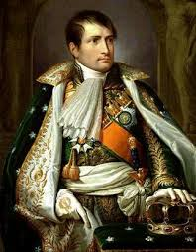
Question Review
What was Napoleon doing during the French Revolution?
What made Napoleon a military genius?
Napoleon is considered to be a military genius, but was his army always successful? Explain.

Slide 3
Weaknesses of the Directory
When we last left off, the National Convention dissolved itself and was replaced with the Directory.
Governed France for four years.
Neither radicals nor conservatives were pleased with it.
The economy improved somewhat but peasants, workers, and poor people still suffered.
The five directors quarreled among themselves and were weak, corrupt rulers.
When crowds protested, the directors used the army to stop the unrest.
The Directory was soon as unpopular as the Old Regime had been.
Its failure paved the way for a military dictatorship in France.

Slide 4
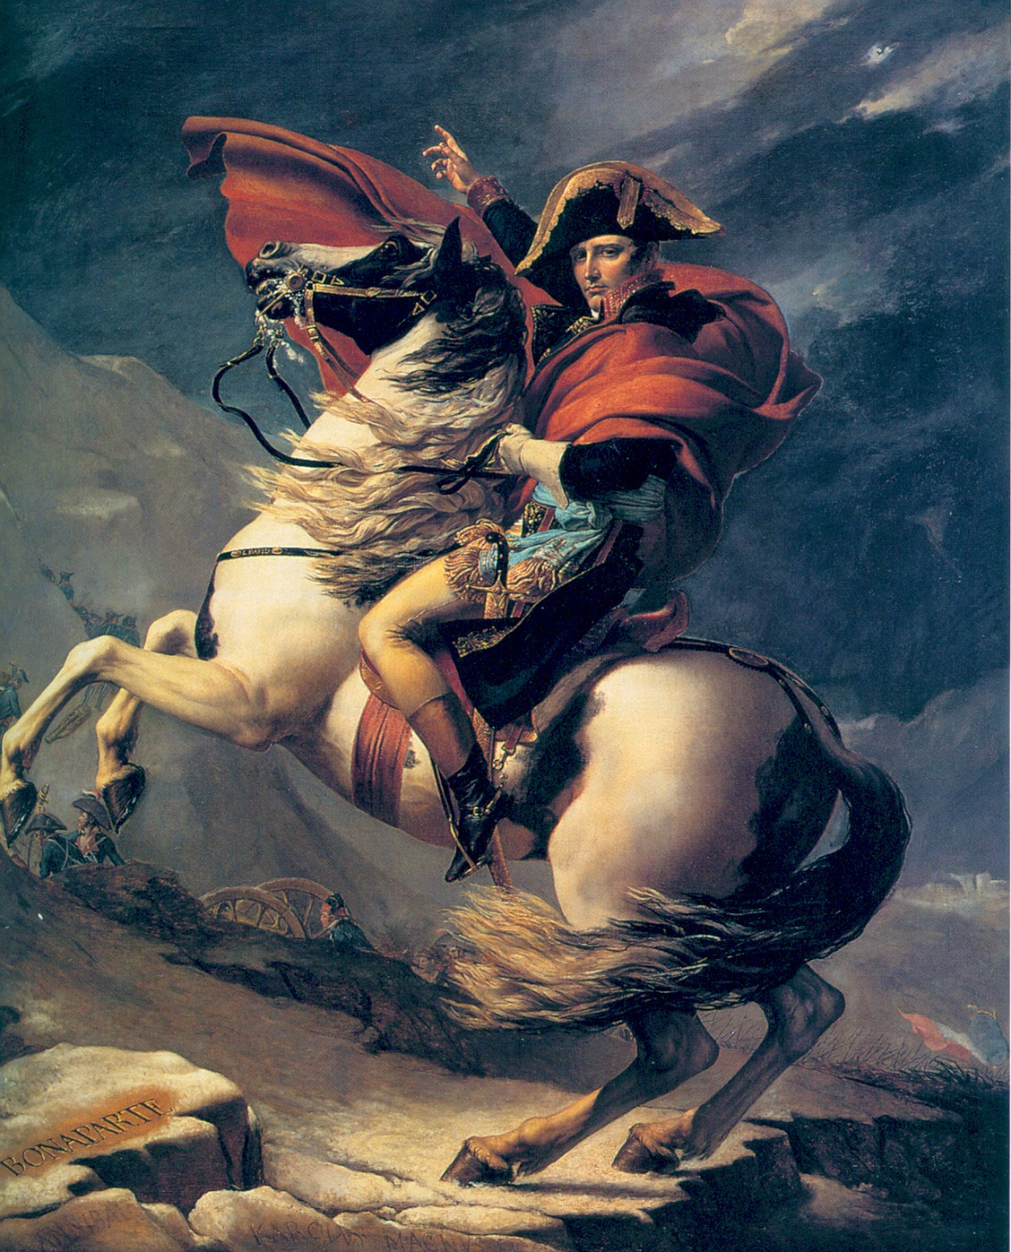
Napoleon
Napoleon has already established himself as a war hero and military genius.
People in France were worried that because the Directory was so unpopular, people might try to restore the monarchy.
Fearing that royalists might seize control, they developed a plan to overthrow the government and put Napoléon in power.
These supporters wanted France to be stable because they feared losing the property and power they had gained during the Revolution.

Slide 5
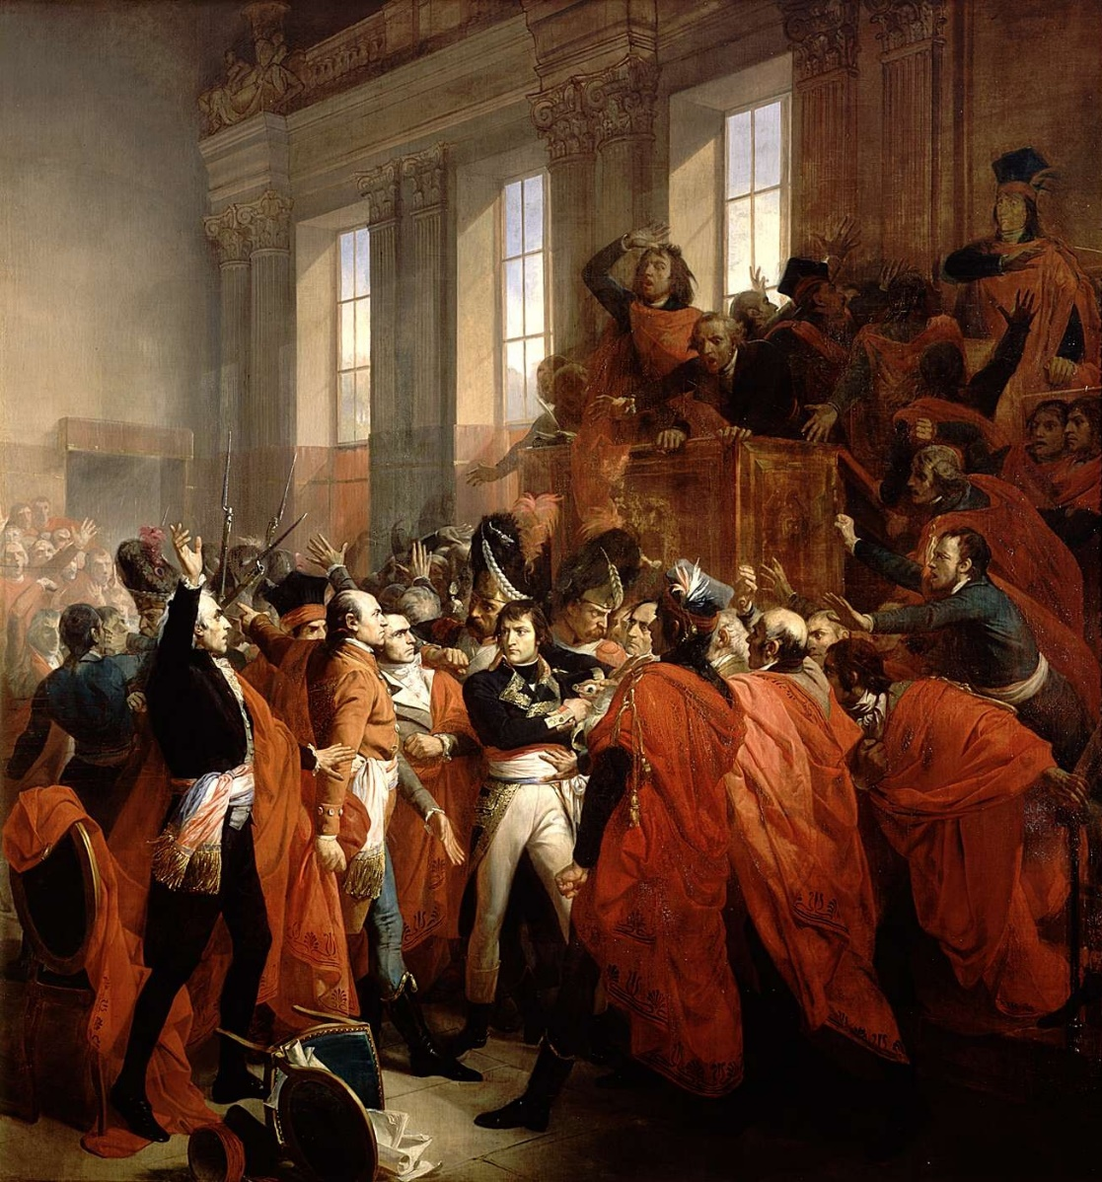
The Coup d'état
In 1799 armed troops surrounded the legislature and forced most of its members to leave.
Those who stayed turned the government over to Napoléon and his fellow plotters.
Although Napoléon's government kept the form of a republic, the coup d'état of 1799 made him dictator of France.
The period from 1799 to 1814 is known as the Napoléonic Era.

Slide 6
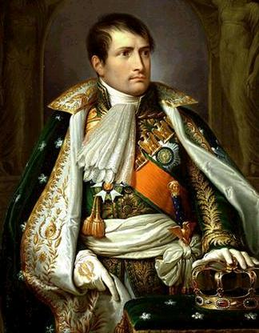
Acceptance
The people of France accepted Napoléon's dictatorship.
What does it mean if someone is a dictator?
Why do they accept him?
Many people wanted stability after the years of chaos.
He respected the ideals of the Declaration of the Rights of Man and did not restore any feudal practices.

Slide 7
Napoleon’s Unlimited Power
Napoléon reorganized the government to give himself unlimited power.
The first five years of Napoléon's rule were called the Consulate.
The government was headed by three consuls with Napoléon as First Consul.
Only Napoleon could propose new laws.
All the Consulate's legislative bodies could do was approve or reject Napoléon's decisions.
Napoléon also had full command of the army and navy.
Had the power to appoint or dismiss most officials.

Slide 8
Napoleon makes positive Governmental Changes
Under Napoléon's direction scholars organized all French law into a system called the Napoléonic Code.
Forbade privileges based on birth.
Allowed freedom of religion.
Specified that government jobs should go to the most qualified.
Napoléon established the Bank of France to act as a central financial institution and stabilized the economy.
He also put into effect the system of mandatory public education planned by the National Convention.

Slide 9
The Church
The leaders of the French Revolution had strained relations between the French government and the Roman Catholic Church.
In 1801 Napoléon ended this conflict by reaching an agreement with the pope called the Concordat.
Recognized that most French citizens were Catholic, but it still allowed religious freedom.
Most important, the church gave up claims to the property that the government had seized and sold during the Revolution.

Slide 10
Napoleon the Emperor
Napoléon's supporters wanted to make his power permanent and hereditary.
In a public vote in 1804, the French people voted to declare France an empire.
Napoléon would become Emperor Napoléon I and his wife became Empress Joséphine.
Even invited the pope to come to the ceremony to crown them both.
However, something interesting happens at the ceremony...

Slide 11
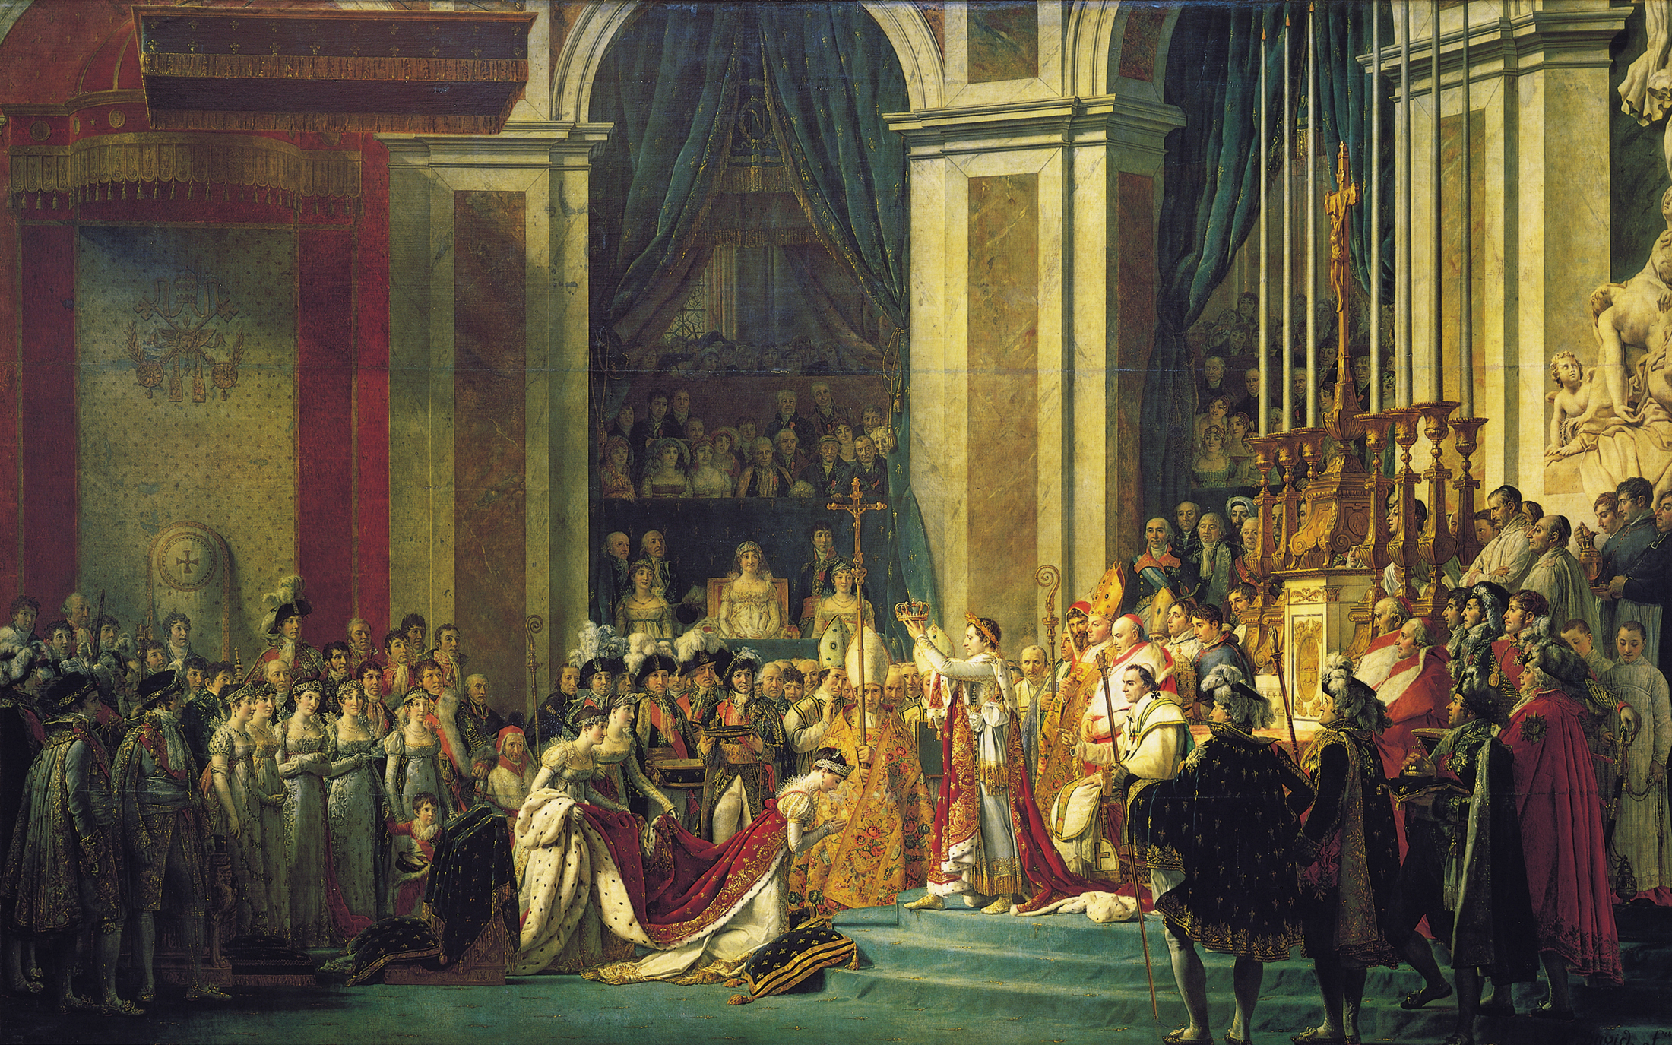
The Coronation of Napoleon,
1805–07
Jacques-Louis David

Slide 12
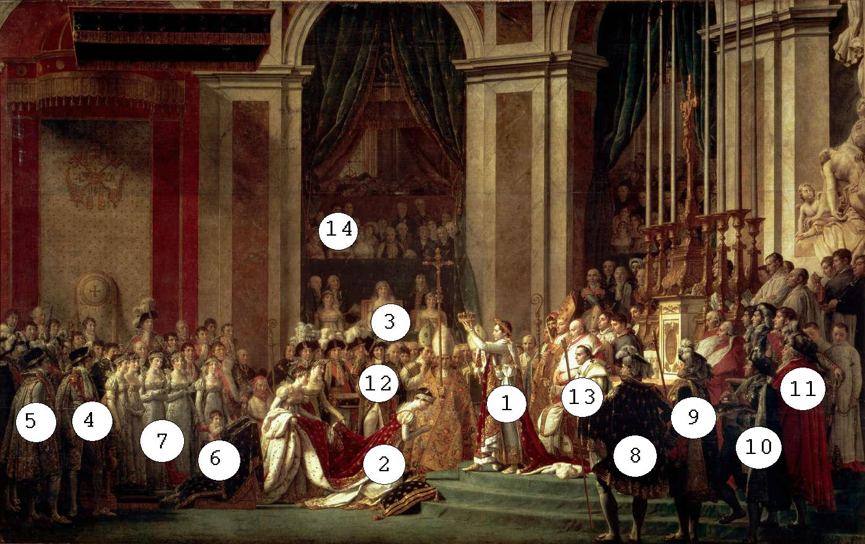
Identification of Key Figures:
Napoleon
Josephine
Napoleon’s mom
Joseph Bonaparte, brother and eventually king of Spain and Naples.
13. Pope Pius VII
14. Jacques Louis
David.

Slide 13
Napoleon’s Power
By 1809 Napoléon dominated Europe.
The empire extended far beyond France's old borders.
Forced Austria and Prussia to sign peace treaties that benefited France, and Russia allied itself with France.
Directly ruled the Netherlands and Spain.
Abolished the Holy Roman Empire and unified the northern Italian states into the Kingdom of Italy, under his control.
Napoléon secured his power by placing members of his large family as monarchs of the countries he conquered.
This would later prove to be a problem.

Slide 14
Activity
Using the biography you read at the beginning of class and your notes, you are going to create a Facebook page for Napoleon.
This was shared with you on the drive. You need to go to file: make a copy. This will let you edit the presentation.
Make sure you:
Insert a picture.
Provide a status update where indicated.
Insert text anywhere you see parenthesis.
If this is unfinished in class, it’s homework.
Make sure it goes in the French Revolution folder on your drive.

