Slide 1
Introduction to Nationalism
SWBAT: define “nationalism”.
Homework: Vocab is due tomorrow.
Do Now: Start filling out the “Bonds that create a Nation-state” worksheet.

Slide 2
Activity 1: Nation-state Worksheet

Slide 3
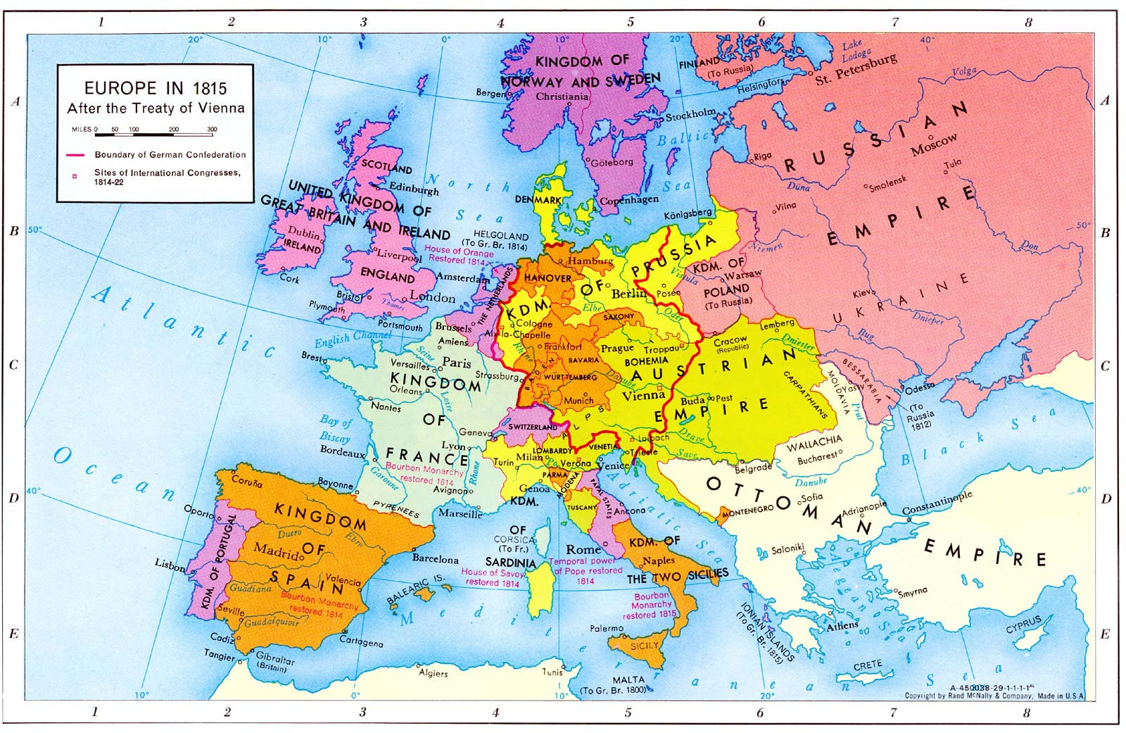
Europe- 1815
When a nation has its own gov’t, it’s called a nation-state.
A nation-state has definite borders that are protected and a unique culture exists within those limits.
In 1815 Europe, only four nation-states existed- France, England, Portugal and Spain.
Many of the other areas of Europe were ruled by large empires encompassing different groups of people.
Nationalism would change this is a matter of a few decades.

Slide 4
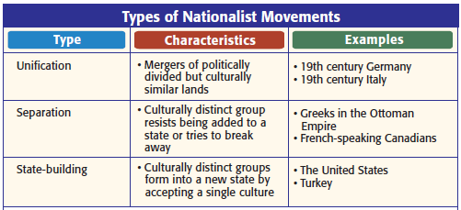
Nationalism
The belief that people’s greatest loyalty should not be to a king or an empire but to a nation of people who share a common culture and history.
And there are three kinds of nationalism…

Slide 5
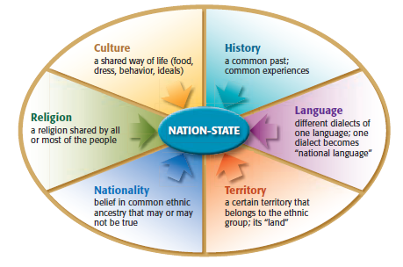
What does “common culture and history” mean?

Slide 6
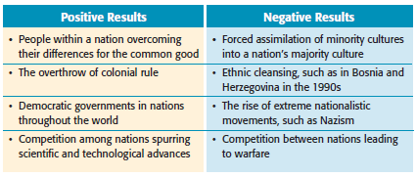
Nationalism’s Results…
Nationalism can often times be a unifying force that brings people together, but it can also highlight differences among pre-existing groups leading to devastating consequences.

Slide 7
Activity #2
Read the three examples provided on your worksheet. Decide whether or not it is an example of nationalism and explain your reasoning.

