Slide 1
Origins of the Industrial Revolution
SWBAT: explain why the industrial revolution occurred in Great Britain.
Homework: vocab.
Do Now: Find a partner sitting next to you. Interview them using the questions you picked up from the back of the room. Do Part II on your own.

Slide 2
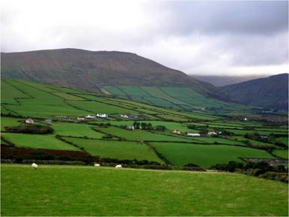
Before the Industrial Revolution
Before the 1600s:
Most European villagers worked their own plots of land in order to grow food for their families.
Also used common public lands for grazing animals such as sheep and cattle.
In the 1500s and 1600s common lands in England began to be fenced off into individual plots.
At the same time, smaller landholdings were being combined into more efficient, larger holdings.
This is called the enclosure movement.
Wealthy landholders benefited from this movement, while many small landowners lost their lands and their traditional livelihood.

Slide 3
The Enclosure Movement’s Effect
The enclosure movement had several effects.
Former small-plot owners were forced to become tenant farmers or move to the cities.
Also, with the common lands vanishing, farmers no longer had to get permission from other villagers to try new farming methods, which led to new inventions and methods.
I.e. seed drill that made it possible to plant seeds in straight rows and crop rotation.
Some of these improvements were very expensive. Only wealthy farmers could afford them.
By the 1800s many farm workers, replaced by machines and forced off the land, were moving to the cities. They formed a huge labor force.

Slide 4
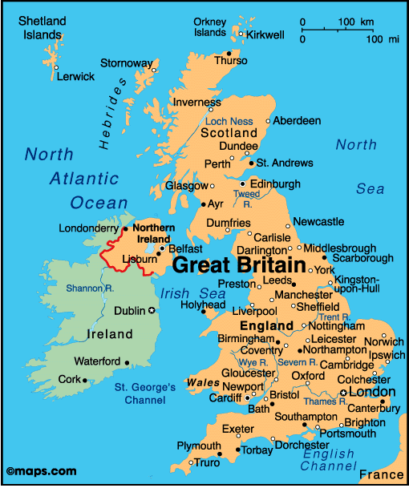
What is the Industrial Revolution?
An era of rapid industrial development known as the Industrial Revolution followed the Agricultural Revolution.
1760-1840.
Started in Great Britain which had a favorable combination of needed factors- land, labor, and capital.
These 3 are known as the factors of production.
What are some things you notice about GB geographically that might lend itself to starting a new, industrial era?

Slide 5
Why Great Britain?
Land: natural resources.
GB has a rich supply of coal and iron ore, waterways.
Labor: workers.
GB had a population boom during the Industrial Revolution and migration to urban centers made finding workers easy.
Capital: tools, machinery, equipment, and inventory used in production. Also means money.
GB had people with the means to purchase these things and invest in business.

Slide 6
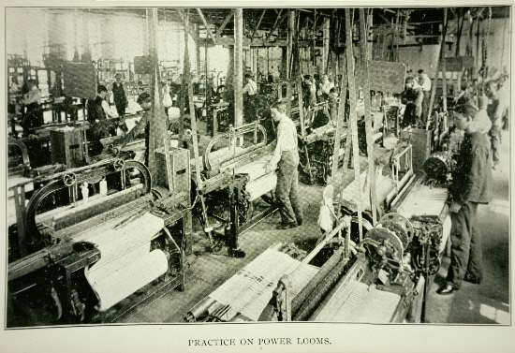
Inventions and Innovations
The Industrial Revolution could not have existed had it not been for new technology that allowed for factories with mass production capabilities to exist.
Prior to the 1700s, it would take people days to spin thread and make clothes.
Automatic machinery aka mechanization allowed machines to do all the work with record breaking timing.
Mechanized loom, spinning jenny, and cotton gin.

Slide 7
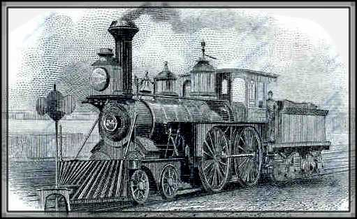
More inventions, more innovations
Getting goods to market could also be time consuming and costly.
The invention of the steam engine was used to speed transportation, both on land and water.
In about 1814 English engineer George Stephenson perfected a steam locomotive that ran on rails.
Railways soon were being built all over the world.
American engineer Robert Fulton was the first to build a profitable steamboat allowing faster transportation on rivers.

Slide 8
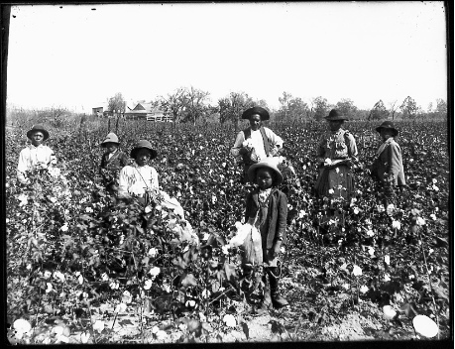
Effects of Inventions and Innovations
The effects of mechanization would have a profound effect on the garment industry.
As supply increased, the price of cotton cloth went down. As a result, demand increased and so did the need for more raw cotton.
Most of it came from the southern United States, making it the cotton-producing center of the world.
As production soared, so did the profits made by using slave labor to plant and pick cotton.
Cotton gin had the unintended side effect of helping to expand slavery in the United States.
Additionally, as a result of mechanization, new factories sprang up all over England.

Slide 9
The Industrial Revolution outside of Britain
The Industrial Revolution was slow to pick up outside of Britain.
I.e. France was in the middle of the French Revolution, Napoleon, and then the reestablishment of the monarchy.
Belgium and Prussia would make attempts at industrializing, but would not become as successful.
The only other country that could have posed a threat to Britain’s monopoly was the United States.
To prevent this, GB forbade engineers, mechanics, and toolmakers from leaving the country.

Slide 10
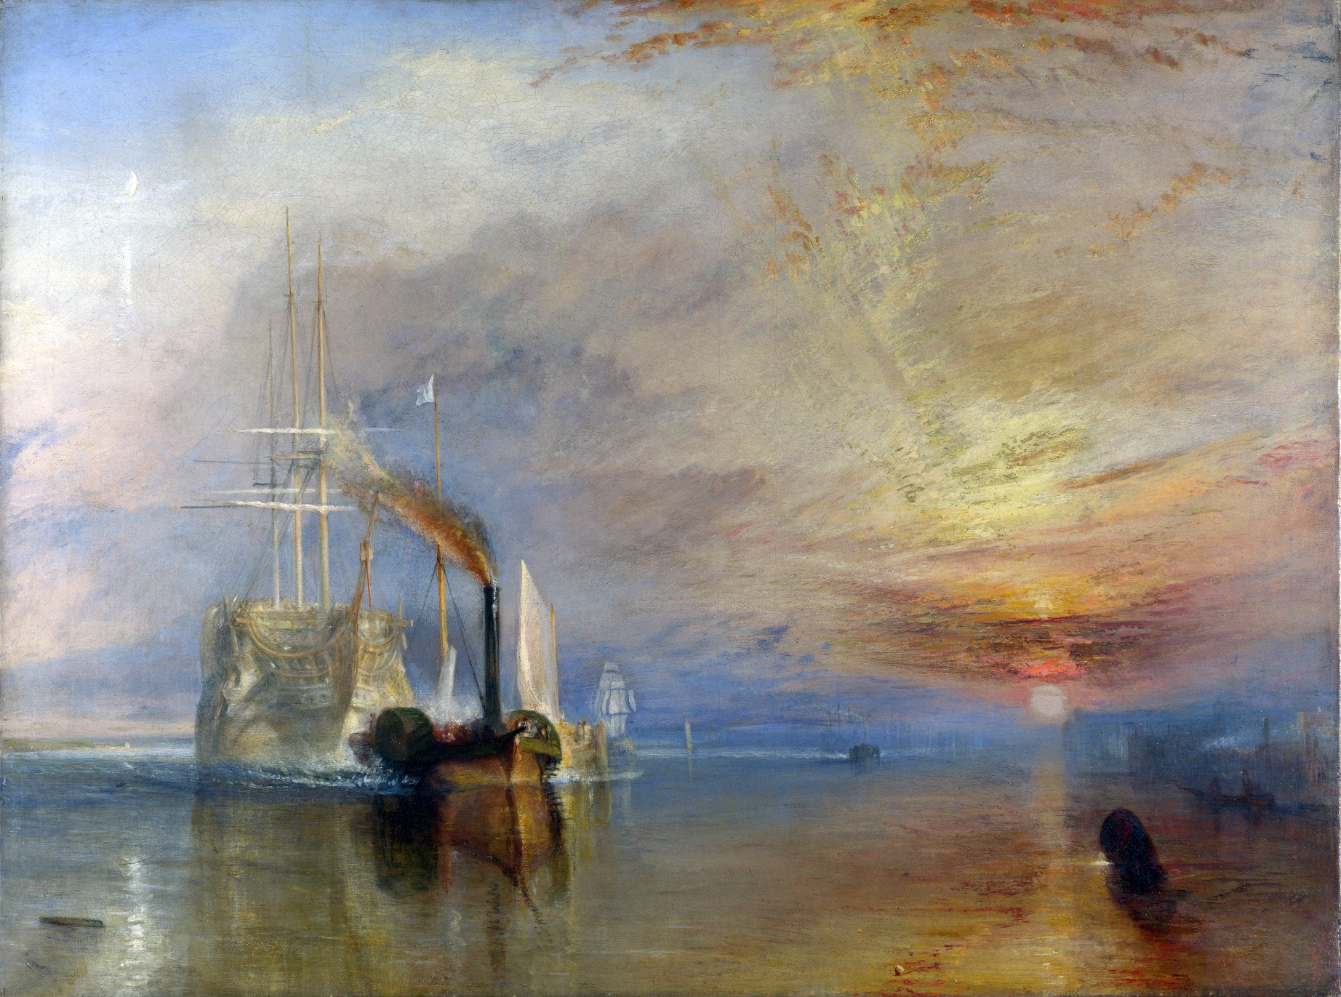
The Birth of a New Age
The Fighting Temeraire tugged to her last berth to be broken up
J. M. W. Turner, 1838

Slide 11
Start on the vocab

