Slide 1
Reign of Terror
SWBAT: explain if the actions of the Committee of Public Safety supported its purpose.
Homework: “Do you really stay conscious after being decapitated?” article and questions. Vocab/French Revolution quiz on Wednesday.
Do Now: Read and answer the questions in the bio on Jean Paul Marat.

Slide 2
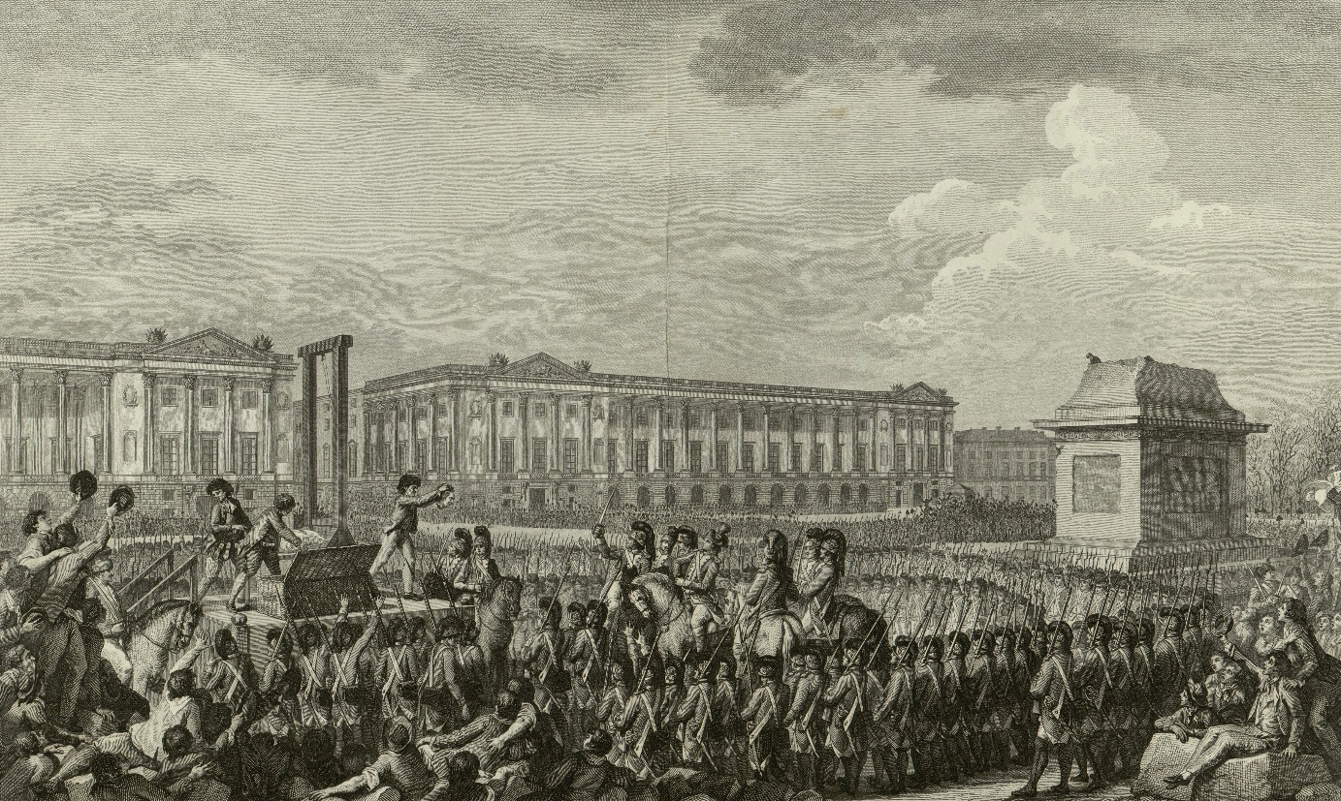
Where we left off…
The Jacobins rise up and take control of the Commune, Paris’ municipal gov’t.
Abolished the Legislative Assemble and est. the National Convention in 1792.
Declared the end of the monarchy and the beginning of the republic.
Brought Louis XVI on charges with plotting against the security of the nation.
Was found guilty and executed.
Execution of Louis XVI in Place de la Revolution, 1793

Slide 3
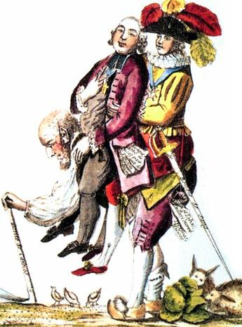
Concerns for Revolutionaries Grows
After the execution of the king, paranoia set in that counterrevolutionaries were going to try and stop the revolution.
One example of a counterrevolutionary group would be the Catholic Church.
Why do you think that is?
What would be another example of a potential counterrevolutionary group?

Slide 4
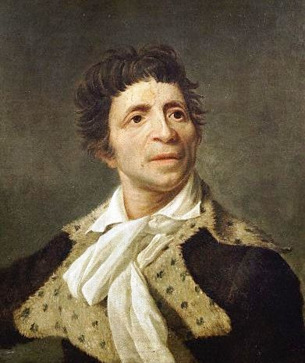
Fears Become Substantiated
In July, 1793 extremist revolutionary journalist Jean Paul Marat was assassinated by counterrevolutionary Charlotte Corday as he sat in his bathtub treating eczema.

Slide 5
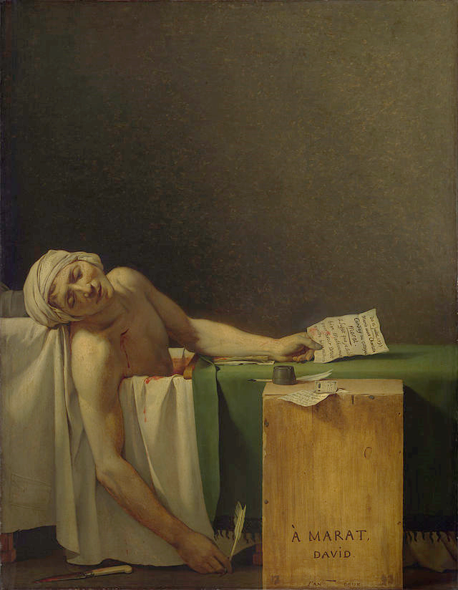
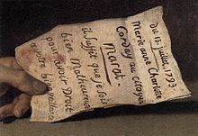
Jacques Louis David “The Death of Marat” 1793
"Given that I am unhappy, I have a right to your help"

Slide 6
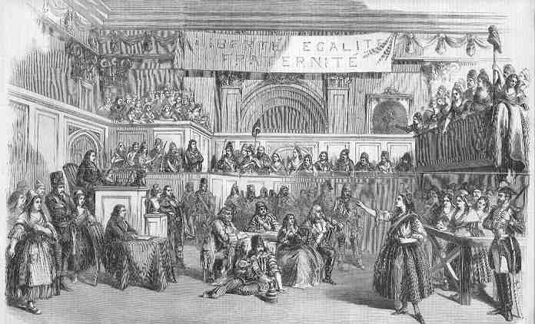
Committee of Public Safety
The death of Marat confirmed the paranoia of counterrevolutionaries.
Leads to the creation of something new.
In Sept. 1793, the Committee of Public Safety, headed by Maximilian Robespierre, took over the National Convention.
The goal: to make sure that the enemies of the French Revolution did not roll back the gains that had been achieved during the Revolution.
Enemies included:
Royalty and royalists both abroad and within France.
The wealthy.
Counterrevolutionaries.

Slide 7
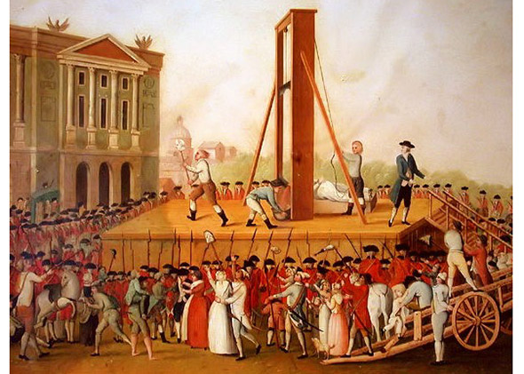
Reign of Terror
The fear of counterrevolutionaries along with the advance of foreign armies on French soil produced the climate necessary for the most violent stage of the revolution.
Lead to the Reign of Terror.
Policy through which the state used violent repression to crush resistance to the government.
Marked by mass executions of "enemies of the revolution".
The guillotine (called the "National Razor") becomes the symbol of the revolutionary cause.

Slide 8
The Reign of Terror in Action
Watch the clip from A Tale of Two Cities and answer the questions in your notes.
1. What is the blonde woman accused of doing? What is her occupation?
2. Describe the behavior of the people in the streets and in the crowd. How are they acting?
3. From what you’ve seen in the clip, how does the guillotine work?

Slide 9
From the Execution Record, 1793
Questions:
1. Let’s review: who were the enemies of the revolution?
2. How would you describe the people being executed (i.e. what estate do they belong, etc.)?
3. What do their crimes suggest about the Committee of Public Safety?
4. Do they seem to fit our list of enemies? Explain.
A) - Jean-Baptiste Henry, aged 18, tailor, convicted of having sawn down a tree of liberty, executed 6th September, 1793.
B) - Marie Plaisant, seamstress, convicted of having exclaimed that she was an aristocrat and that she did not care a fig for the nation, condemned to death and executed the same day.
C) - Henriette Francoise Marboeuf, aged 55, convicted of having hoped for the arrival of the Austrians and Prussians and of keeping food for them, condemned to death and executed the same day.
D) - Francois Bertrand, aged 37, pub owner, convicted of having provided the defenders of the country with sour wine, condemned and executed the same day.

Slide 10
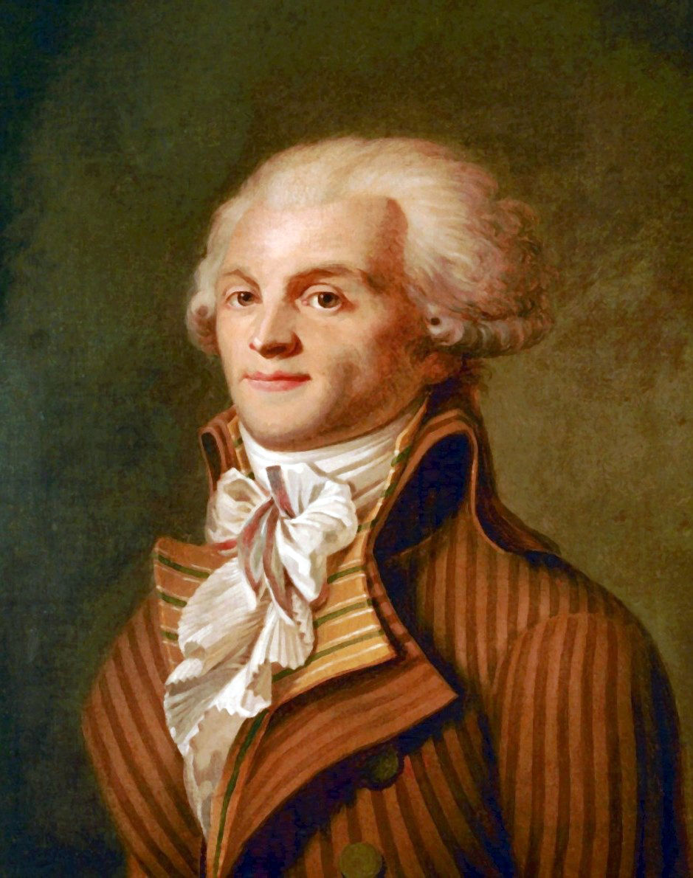
End of the Terror
In Spring, 1794, France was winning the war against Austria. Danton, one of the orchestrators of the Reign of Terror, made it clear he thought the revolution had met its goals and should be relaxed.
Robespierre put Danton to death.
Danton’s death scares Robespierre’s supporters who then in turn put him to death by guillotine.
Robespierre’s death marks the end of the Reign of Terror.

Slide 11
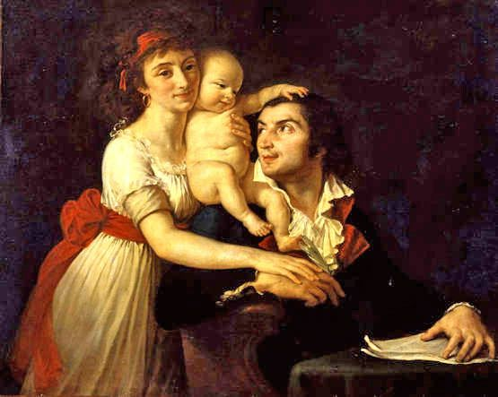
The Final Toll
The Reign of Terror last ~15 months.
The death toll ranged in the tens of thousands, with 16,594 executed by guillotine in Paris and another 25,000 in executions across France.
Camille Desmoulins and wife Lucile with son Horace. Orchestrators of the storming of the Bastille. The couple was executed. Painted by Jacques-Louis David. 1792.

Slide 12
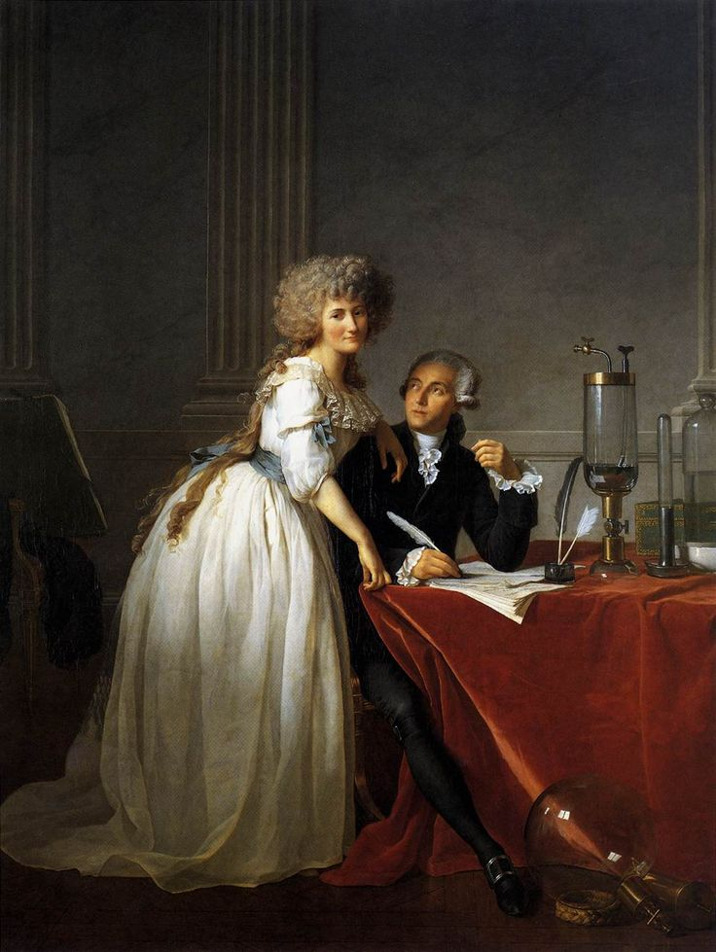
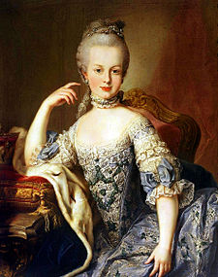
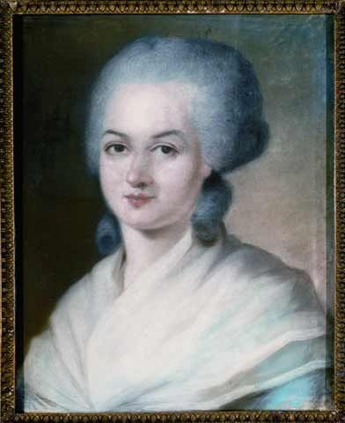
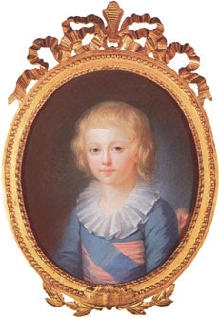
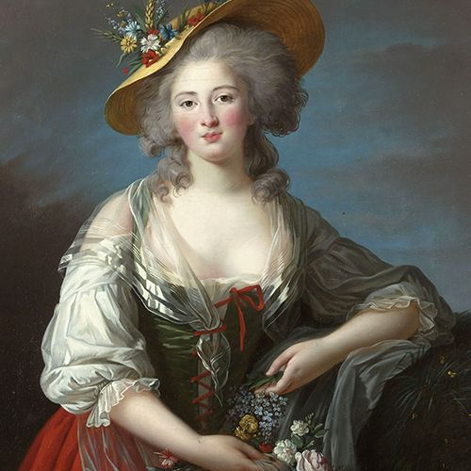
Victims of the Revolution
Left: Antoine Lavoisier (father of modern chemistry) and wife.
Bottom: Prince Louis XVII
Marie Antoinette
Top: Olympe de Gouges
Right: Madame Élisabeth, Louis VXI’s sister

Slide 13
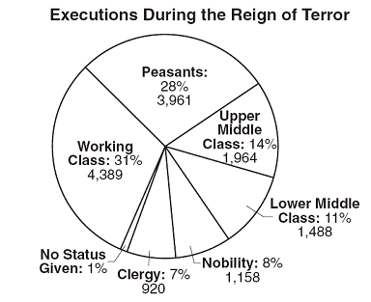
The Victims
Looking at the chart to the right, what made up a majority of the victims of the Reign of Terror?
Did the actions of the Committee of Public Safety support its original purpose?

Slide 14
The National Convention- it did do some good things
Opened schools and supported mandatory education.
Abolished slavery in French colonies.
Est. the metric system.
Completed a new constitution creating a government call the Directory.
Est. a 2 house legislature.
The upper house chose members of the executive branch, called the directors.
However, only property owning men could vote.

Slide 15
Exit Discussion
The title of the engraving to the right is: "Cest affreux mais nécessaire”- It is dreadful, but necessary.
First, what are we looking at?
Second, what does this mean?

