Slide 1
The American Revolution
SWBAT: identify Enlightenment ideals and beliefs in America’s founding documents.
Homework:
Core: None. Vocab quiz on Friday.
CP: Checklist and questions. Vocab and geography quiz Friday. Study guide is due on Monday.
Do Now: What do you remember about the Revolutionary War from previous US history classes? Consider: people, places, events, and ideas.

Slide 2
Beginnings of Trouble- the Seven Years War (French and Indian War)
Struggles for supremacy in the New World between Great Britain and France had been waging for decades.
Hostilities intensified in the early 1750′s as both English and French settlers had attempted to colonize land in the Ohio River Valley, near present day Pittsburgh, Pennsylvania.
The English settlers, who had moved northwest from Virginia, and French settlers, who had moved east from the Great Lakes, or south from Canada, each thought they owned the rights to the land.
Result: War
French and Indians vs. British and Americans.
British ultimately win, gaining all French land up to the Mississippi River.

Slide 3
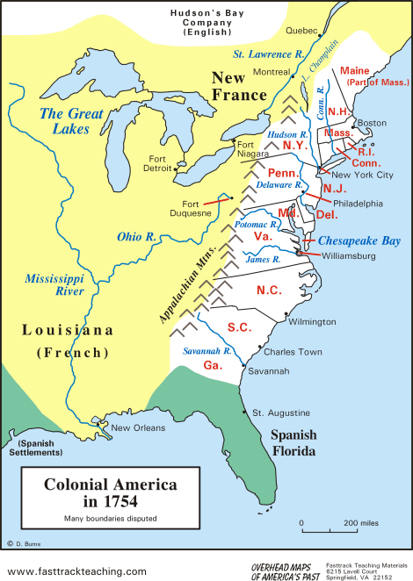
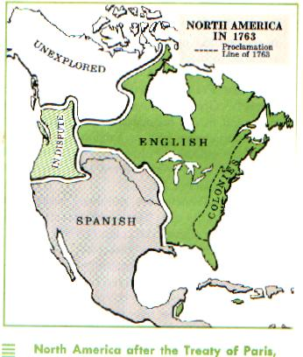
Land Exchange
1754
1763

Slide 4
After the Treaty of Paris
As a result of the British victory, France was effectively expelled from the New World.
England also issued the Proclamation of 1763, which restricted settlement west of the Appalachian Mountains in an attempt to appease Indians who had developed positive relations with France.

Slide 5
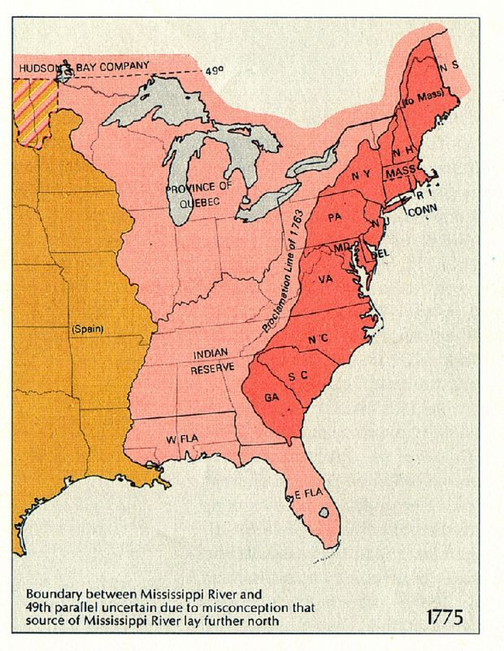

Slide 6
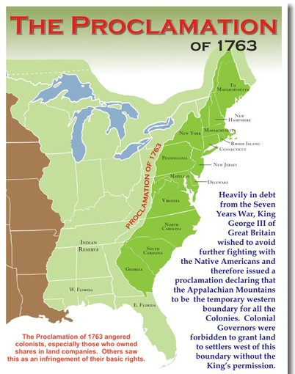
Question:
If you were a colonist who fought with the British during the Seven Years War, how would you feel with the passing of the Proclamation of 1763?

Slide 7
Another Problem: the Cost of War
War is expensive and cost G.B. a ton of money.
G.B. believed since it had defended the colonists, the colonists should have to repay the Crown.

Slide 8
Military Expenses
Tax Revenue
Millions of Pounds
Year

Slide 9
So what should G.B. do if they need money??

Slide 10
Tax what?
Sugar Act: taxed sugar and molasses.
Stamp Act: taxed paper products like newspapers, legal papers, and playing cards.
Colonists were upset about the taxes/policies the British were implementing.
Why? No Taxation without Representation.

Slide 11
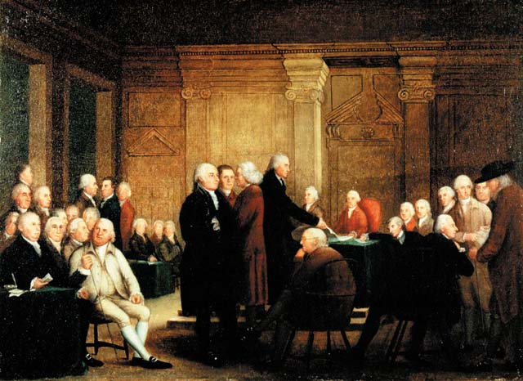
Why is this a big deal?
THE ENLIGHTENMENT!
The idea that government exists to protect and serve the people has really taken root in America.
By not allowing colonists representation in Parliament and taxing the colonies without their consent, colonists see GB as backwards and anti-progressive.

Slide 12
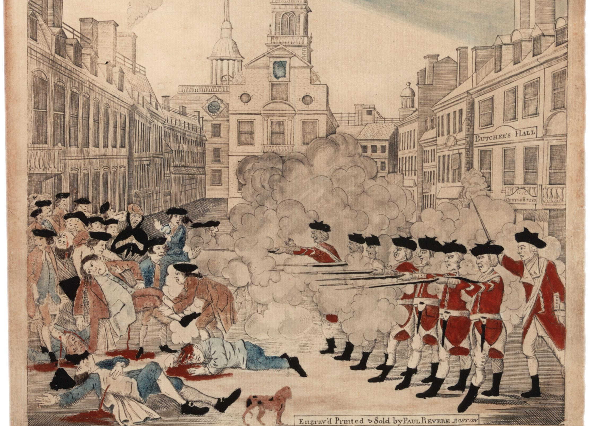
From here it only gets worse…
Boston Massacre.
More acts (like the Tea Act) lead to more events (like the Boston Tea Party).
The passage of the Intolerable Acts further angers colonists.
This brings us to…

Slide 13
The Second Continental Congress, the Declaration of Independence, and the Revolutionary War

Slide 14
Activity Directions
Turn to the person next to you. Say hello to your new partner.
Take out your packet from yesterday.
You’re going to be given a series of documents from this country’s founding.
Read each document, summarize what it’s saying, and decide which philosopher the document best represents and why.
Tomorrow, you will come in and respond to the question: How did the ideas of the Enlightenment influence the American Revolution and the formation of the American Government?

Slide 15
Exit Question:
Did G.B. have the right to tax the colonists if the French and Indian War was fought for the defense of the colonies??

