Slide 1
The French Revolution
SWBAT: apply information learned in class to a primary source document.
Homework:
Core: None.
CP: France in Turmoil reading and questions
Do Now: What do you feel you have the right to do, have, say, or own no matter what?

Slide 2
Homework Review

Slide 3
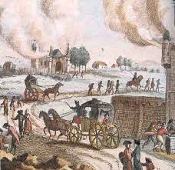
The Great Fear
Peasants believed that the nobles were planning a "famine plot" to starve the population and stop the revolution.
Peasants and town people mobilized in many regions.
Peasants attacked manor houses and monasteries and killed their owners.
Also destroyed possessions and burned documents that documented rents, feudal dues, and other debts.
Many nobles decided to leave the country for their safety aka émigrés.
The Great Fear led to the abolition of feudalism in France by the National Assembly.
But as food shortages worsen, peasants become angrier.

Slide 4
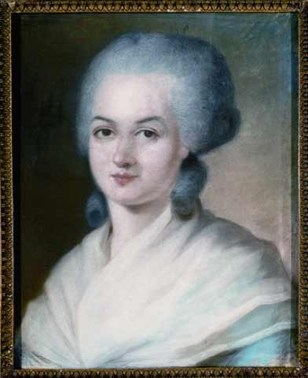
The End of the Old Regime
Following the violence, the Assembly adopted the Declaration of the Rights of Man and Citizen.
Embodied the principles of the revolution: “liberty, equality, and fraternity”.
These rights, however, only applied to men. Olympe de Gouges wrote her own document the Declaration of the Rights of Women and Citizenesses, but was rejected by the Assembly.

Slide 5
Constitution of 1791
The National assembly finally finished writing the Constitution it swore to create in 1791.
What did it do?
Est. a limited constitutional monarchy.
Limited the power of the king.
Could not make/block laws.
Divided the gov’t into three branches: legislative, executive, and judicial.
Dissolved the National Assembly and created the Legislative Assembly.

Slide 6
Old regimes die hard
Some nobles stayed at Versailles and held a feast for the king and queen applauding their reign.
When peasants heard, a crowd led by angry women stormed the palace in an effort to obtain bread and force the high prices of bread down.
Fun fact: working people often spent nearly half of their income on bread.
7,000 women armed with pitch forks, muskets, swords, and crowbars stormed the royal palace.
The king quickly gave in to their demands.
The king and royal family were then forced back to Paris with them.
For the first (but not last time) women, those who the Declaration of Rights did not protect, would be responsible for making revolutionary changes.

Slide 7
Effectiveness of the Constitution
The first constitution of France ultimately proved ineffective.
The executive branch was too weak.
Legislators were chosen by a small percentage of the population.
Led to the division of the Legislative Assembly into three groups:
Conservatives: felt the revolution had gone far enough.
Radicals (Jacobins): wanted more drastic changes.
Radical “Moderates” (Girodins): were either conservative or radical depending on the issue.

Slide 8
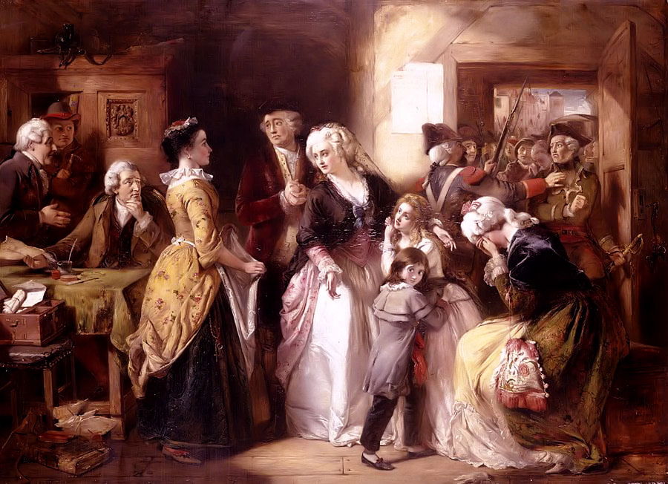
The King makes a mistake…
The king and the rest of the royal family attempted to flee Paris to the eastern frontier to safety.
A postmaster along the way recognized the king and alerted the authorities.
The royal family was captured 31 miles from their targeted location and forced back to Paris.
The credibility of the king as a constitutional monarch had been seriously undermined by the escape attempt.
At this point, saving the monarchy would depend upon a successful foreign intervention.

Slide 9
War
In April 1792, the newly elected Legislative Assembly declared war on Austria and Prussia, where it believed that French émigrés were building counterrevolutionary alliances.
Also hoped to spread its revolutionary ideals across Europe through warfare.
Goal for Prussia and Austria: restore the French monarchy.

Slide 10
Radicals take over
Amidst the confusion, radicals aka jacobins rose up and took over the Commune, Paris’ city government.
Attacked the royal residence in Paris and arrested the king and the royal family.
The following month, Parisian insurrectionists massacred hundreds of accused counterrevolutionaries.
The Legislative Assembly was replaced by the National Convention.
Proclaimed the end of the monarchy and the establishment of the French republic.
Dissolved itself and the Constitution w/plans to create a new one.

Slide 11
But what to do with the king?
With the royal family in jail, the question becomes: what to do with them?
Do you put the king on trial? Do you put the queen on trial? What about their children?
What the National Convention chooses to do combined with war will begin the most radical phase of the French Revolution- the Reign of Terror.

Slide 12
The Declaration of the Rights of Man and Citizen
With the person sitting next to you, begin reading the document. This means it should be silent in here for at least 5 minutes.
When you and your partner are done, begin answering the questions together.
We will go over these answers in ~20 minutes.

