Slide 1
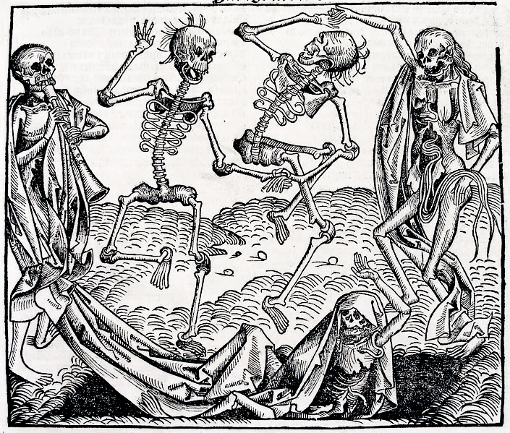
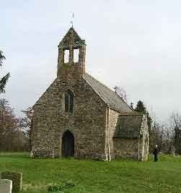
The Middle Ages
SWBAT: Explain what life was like for those living during the Middle Ages and how the Black Plague ushered in the period known as the Renaissance.
Homework: None.
Do Now: Read the Ebola Virus info sheet. Now imagine that the Ebola virus has made its way across the Atlantic. Your parents, your siblings, and your friends are all infected, there isn’t a cure, and few will survive. How would this change the way you live you life? How would this affect your religious beliefs? Answer this under your Ebola fact sheet.

Slide 2
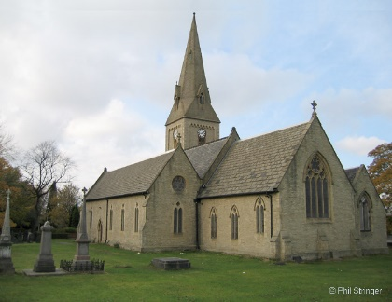
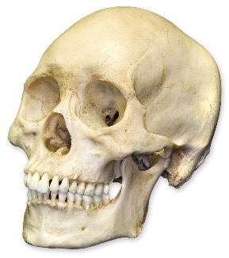
The Middle Ages
~30 CE
476 CE
1300 CE
1492 CE
Jesus dies
Fall of Rome
Renaissance begins
Columbus discovers America

Slide 3
The following slides go in the table on your notes.

Slide 4
Power of the church
Life was dominated by the Catholic Church.
People were obsessed with saving themselves from damnation.
Went to church daily and had faith that this would save them. This gave the church a lot of power.
The church had tons of land and money.
Many higher ups come from wealthy families that have lots of land.
Church becomes wealthy by charging rent.
Tithing from parishioners.
Able to influence the kings and rulers of Europe.

Slide 5
Loss of Knowledge and appreciation of the Arts
Education is limited to wealthy men and priests/monks.
Why wealthy men?
Education is expensive.
Girls learned “womanly” things like needlepoint, singing, etc.
Why priests and monks?
They need to be able to understand the Bible.
Art becomes used mainly for religious purposes.
Loss of refined technique and reality.

Slide 6
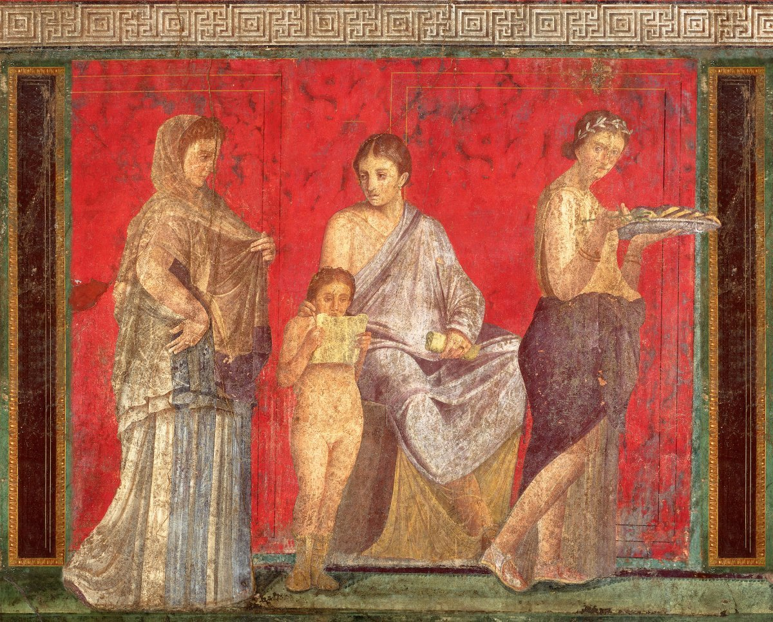
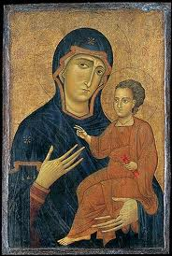
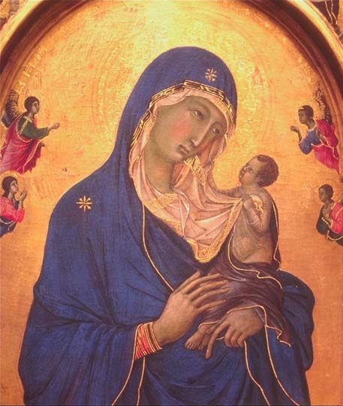
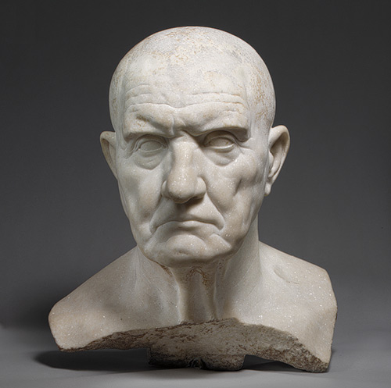
Roman Art
Vs.
Medieval Art

Slide 7
Do Now Review
How would this change the way you live you life? How would this affect your religious beliefs?

Slide 8
The Black Death Documentary
Watch the clip and answer the questions as it runs.
The first two answers come up fast and in quick succession of each other.

Slide 9
How the Disease Spread

Slide 10
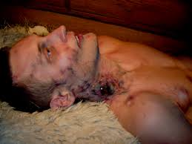
What did it look like?
Black spots
Black, swollen mass where glands are located

Slide 11
Peter Bruegel (the elder) "Triumph of Death“ c. 1562
Notes:
Words to describe the painting?
How would you describe the setting?
What is this saying about the people the plague affects?
What is occurring on the right hand side of the painting? What kind of commentary is the artist trying to make?

Slide 12
Benefits?
Are there any benefits of a disease of this nature?

Slide 13
The Black Death brings new life
When large numbers of people die at once:
Land suddenly becomes available.
Food is no longer scarce.
People are needed for jobs.
Prices drop
Medicine becomes of increased interest.
****Religion is questioned****.

Slide 14
Which ultimately leads us to the…
Renaissance!

