Slide 1
The Slave Trade
SWBAT: identify the terms middle passage and triangular trade and describe the journey a slave made from Africa to the new world.
Homework: Picture Prompt. Avoid reciting the Amistad film clip. Use your imagination for inspiration for your own tale. Make sure you use and underline the words at the bottom.
Do Now: write down anything you know about the slave trade (who it involved, what the journey was like, why they were being brought over, etc.) on the “What you Know” section of your chart.

Slide 2
Film Clip- Amistad
Some questions to keep in mind while watching:
What were Africans looking to receive in exchange for slaves?
What is a priest doing on board a ship ready to set sail across the Atlantic? Why is this slightly ironic?
Fill in the “Question I still Have” section of your chart.
Disclaimer: This is a particularly disturbing video clip. If you need to turn away or put your head down, it’s cool.

Slide 3
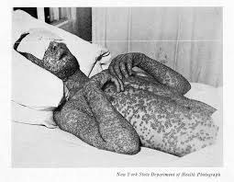
What makes the slave trade necessary?
Disease
Contact with Europeans left Native Americans with no immunity.
Smallpox, the common cold, and flu killed many natives.
Example: In the Bahamas, only a few hundred of what may have been 250,000 natives were left on their island within 60 years of contact.
Natives were their labor force, but when they died, they needed to be replaced.
Result: slave trade.

Slide 4
And so it begins…the triangular trade
Manufactured goods (guns, cannons, and other metal items) would be traded with Africa in exchange for slaves.
Slaves would be traded in the Caribbean for raw materials (sugar, cotton, tobacco).
Raw materials would be traded with Europe for their manufactured goods.

Slide 5
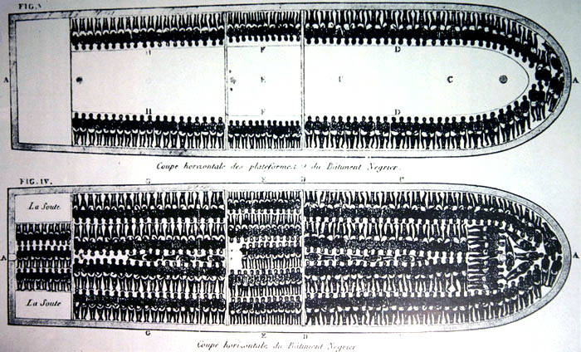
The Middle Passage
The name of the trip slaves made between the west coast of Africa to the New World.
Were chained below decks.
Received little food, little water, and had no access to bathroom facilities.
Est. 15% died each shipment
Est. 12 million slaves survived the journey across the Atlantic.
Largest forced migration in human history.

Slide 6
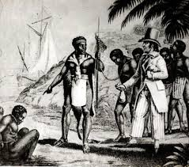
Why would Africans sell other Africans into slavery?
Long history of slavery in Africa.
POWs, debt slaves, criminal slaves.
Were treated like servants, not slaves as we know them in America.
During 1400s large kingdoms began to rise and found they profited from the slave trade.
Wanted to maintain an empire, they needed gold, weapons, and manufactured goods which the slave trade provided them.

Slide 7
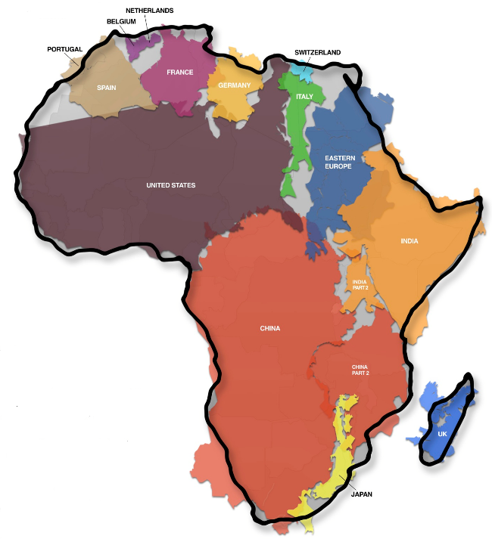
Reason #3: Africa is very large and diverse.
People on raiding parties didn’t see themselves as enslaving their own people.
Often times, slave raiders and slaves had nothing in common except for skin color.
Spoke different languages, had different cultural customs, practiced different religions.

Slide 8
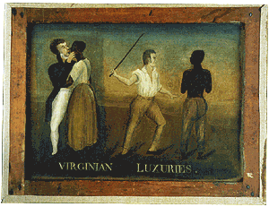
Life as Slaves
Forced to work the mines looking for gold/silver.
Forced to do manual labor i.e. work on sugar, cotton, or tobacco plantations for long hours in extreme heat.
Short life expectancy.
Others worked as house servants cooking, cleaning, and doing laundry.
“Virginian Luxuries”. Found unsigned and undated on the back of another painting.

Slide 9
Almost done…
Using your notes, fill in the “What I Learned” section of your chart.

