Slide 1
The Spread of Protestantism
SWBAT: explain the spread of Protestantism across Europe and the effect it had on those living at the time.
Homework: Fill in the chart for Anglicanism. You will need to use the info sheet.
Do now: Study for the vocab quiz.

Slide 2
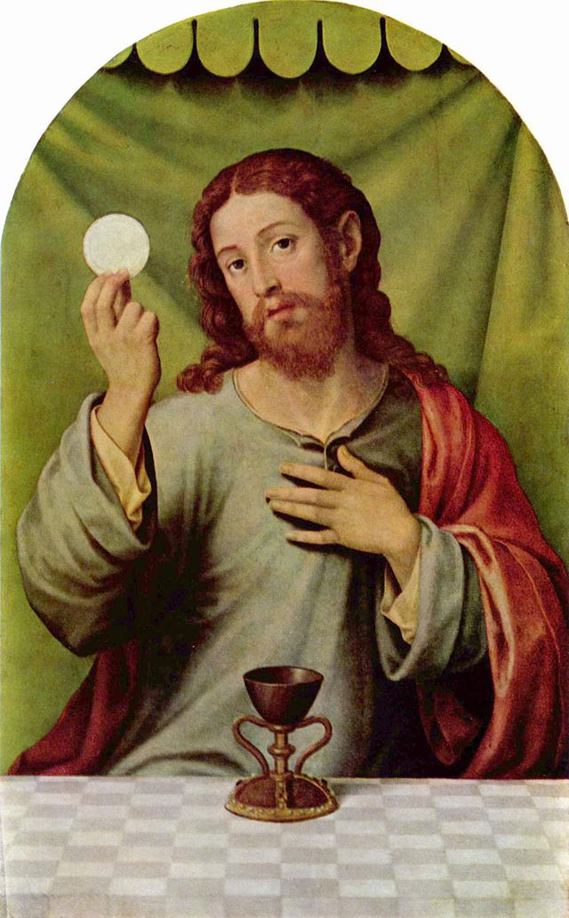
Why is Lutheranism so Popular?
It’s not that different than Catholicism.
Uses the same prayers, like the Apostles and Nicene Creed.
Belief in transubstantiation, or the literal transformation of bread and wine into the body and blood of Christ.
It’s also a little different, which makes people like it more.
Belief that faith alone brings salvation.

Slide 3
Not everyone is happy
Lutheranism spread rapidly throughout Germany, but that didn’t mean that everyone converted, or liked it.
Catholic Holy Roman Emperor Charles V sent his armies into provinces where Princes allowed Protestantism and war broke out.
This is called the 30 Years War.
One of the most devastating wars in European history (8 million casualties).

Slide 4
Acceptance
In 1555, Charles finally reached a compromise with the princes.
The Peace of Augsburg stated that each German ruler had the right to choose the religion for his state.
His subjects had to either accept the ruler's decision or move away.
Almost all the princes of the northern German states chose Lutheranism.
Why do you think so many princes chose Lutheranism?

Slide 5
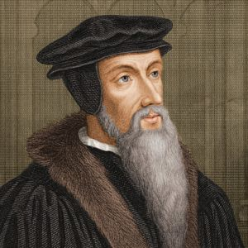
The Rise of Christian Sects
With the acceptance of Lutheranism in Germany, other religious reformers saw their opportunity to make their own churches.
John Calvin, another religious man, created his own branch of Christianity called Calvinism.
Led to further problems for the Catholic Church.

Slide 6
The Rise of Another Christian Group
Begin working on filling in the chart.
You can fill in the boxes on Calvinism by using your notes.
The Anglicanism column is for homework.

