Slide 1
Writers of the Renaissance
SWBAT: Explain the significance of Machiavelli's “the Prince”.
Homework: None
Do Now: Copy the following in the best handwriting in the straightest lines possible. If you mess up, you need to start over. There is no erasing.
Better to eat a dry crust of bread with a peace of mind than have a banquet in a house full of trouble. A shrewd servant will gain authority over a master’s worthless son and receive a part of the inheritance. Gold and silver are tested by fire and a person’s heart is tested by the lord. Evil people listen to evil ideas, and liars listen to lies.

Slide 2
Discussion Questions:
1. So, how did you do?
2. In your opinion, what kinds of book would someone spend time copying by hand?
3. What effect would copying by hand have on the availability of books?
4. Since books are probably scarce, what effect do you think this will have on who owns books?

Slide 3
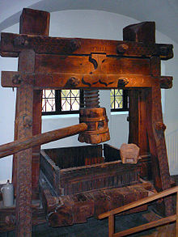
The Printing Press
To recap: before the printing press, monks were often book printers who handwrote religious books (like the Bible).
Europeans were not the first to experiment with faster methods of printing.
11th century Chinese and Koreans were much further advanced.
The problems?
1. Presses couldn’t always press down with equal pressure on a page.
2. Presses would press too long.
3. A lot of stamps (aka types) were needed.
4. Paper took a long time to make and was expensive.

Slide 4
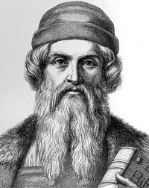
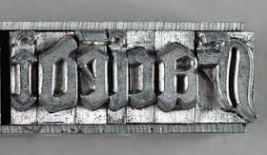
Johannes Gutenberg
Johannes Gutenberg, a goldsmith, began working on improving the presses.
Changes:
1. Created molds to allow for individual letters to be created quickly.
2. Created an oil-based ink that had better staying power.
3. Created higher quality letters through a mix of metals.
At the same time, paper making was made easier.

Slide 5
The Gutenberg Bible
The first book published by Gutenberg was the Bible in 1455.
48 copies, or substantial portions of copies, survive, and they are considered to be among the most valuable books in the world.
How much you ask?

Slide 6
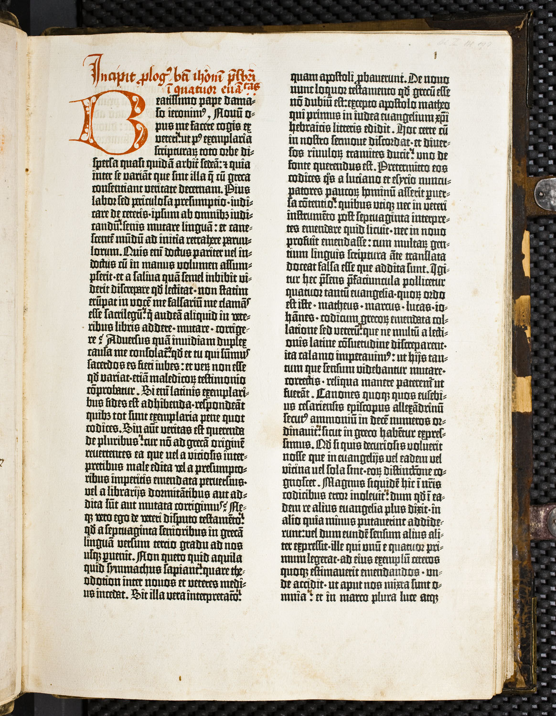
A LOT
Christie's Auction House auctioned in 1987 an incomplete version to a Japanese company for $4.9 million.
In a more up to date sale (2007), a single leaf went on sale for $74,000.

Slide 7
But, why is this so important?
Think for a second. Type up some possible reasons why the printing press is important.
Pair with the person thinking next to you and discuss the ideas you came up with.
Be ready to share with the class.

Slide 8
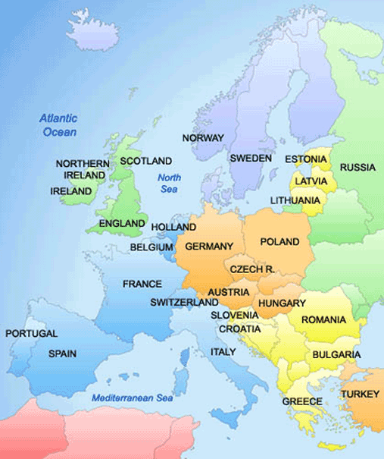
Why the printing press is a big deal
The immediate effect was that it spread information quickly and accurately.
The press helped spread the Italian Renaissance to Northern Europe.
Books become cheaper.
More people can afford to buy them.
This leads to a higher literacy rate.

Slide 9
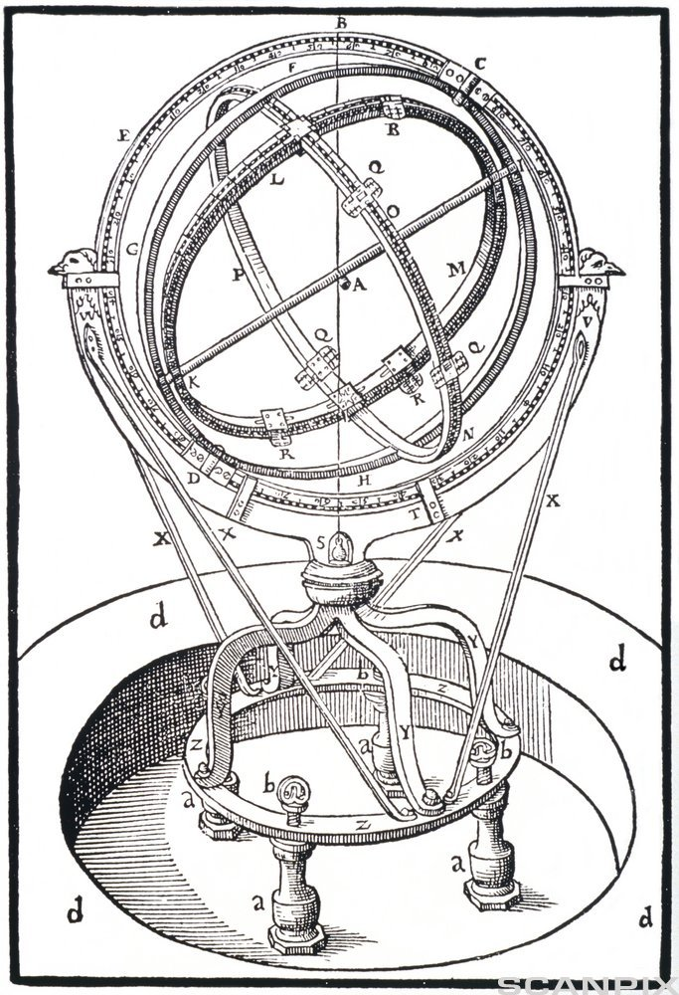
Why the printing press is a big deal 2
More and more non-religious books were printed, especially in the sciences.
Scientists could print the results of their work and share it with a large number of other scientists.
By the 1600s, this process would lead to the Scientific Revolution and the Enlightenment.
It also took book copying out of the hands of the Church and made it much harder for the Church to control or censor what was being written.
Would lead to the breakup of the Catholic Church a few years later.

Slide 10
Famous Writers of the Renaissance

Slide 11
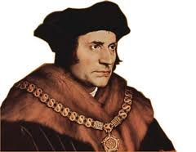
Sir Thomas More
Famous for writing “Utopia” which describes the imaginary island country of Utopia.
Some highlights of the novel include:
communal ownership of land where private property does not exist
men and women are educated alike
almost complete religious toleration (does not include atheists)
Why might a work like this get someone in trouble?

Slide 12
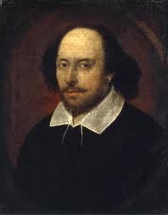
William Shakespeare
In his lifetime, he wrote
38 plays
154 sonnets
2 long narrative poems
His plays have been translated into every major living language and are performed more often than those of any other playwright

Slide 13
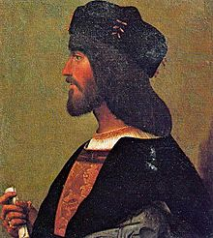
Who is Niccolo Machiavelli?
Italian historian, politician, diplomat, philosopher, humanist, and writer based in Florence.
Became famous for “The Prince”
First piece of modern political philosophy
His work continues to influence politicians to this day.

Slide 14
On the Continuum…
Do you behave better for teachers you fear, or teachers you like?

Slide 15
Activity: Excerpts from “the Prince”
Together, we’re going to read the excerpt from the Prince.
With a partner, answer the questions that follow.

Slide 16
End of class activity
Do you agree with Machiavelli that it is better to be feared than to be loved?

