Slide 1
The Italian Renaissance
SWBAT: Identify the reasons why Italy was the birthplace of the Renaissance.
Homework: Vocabulary
Do Now: Follow the directions on the sheet in the front of your notes.

Slide 2
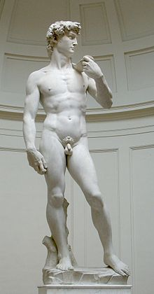
A rebirth of what exactly?
Rebirth of interest in:
Art
Literature
Science
Ancient Greek and Roman literature and life
Emphasized human reasoning and logic.

Slide 3
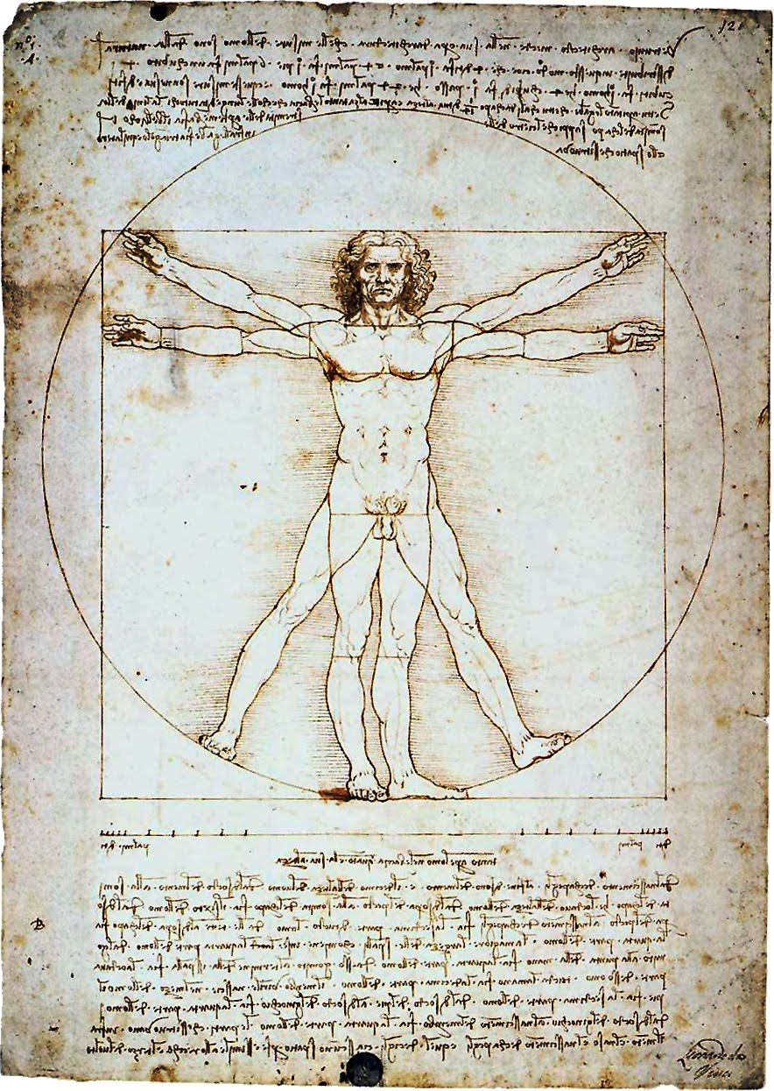
What exactly did people do that made them different than before?
Italian scholars turned to old school Greek and Roman literature to study grammar, history, and poetry.
These studies are called the humanities and people who specialized in them were called humanists.
As humanists studied, they realized:
Thinking critically was important.
Religion may not have all the answers.
Knowing how things work is cool.

Slide 4
Where does the Renaissance start?
Florence, Italy

Slide 5
But why Italy?
Here’s where you start filling out the table

Slide 6
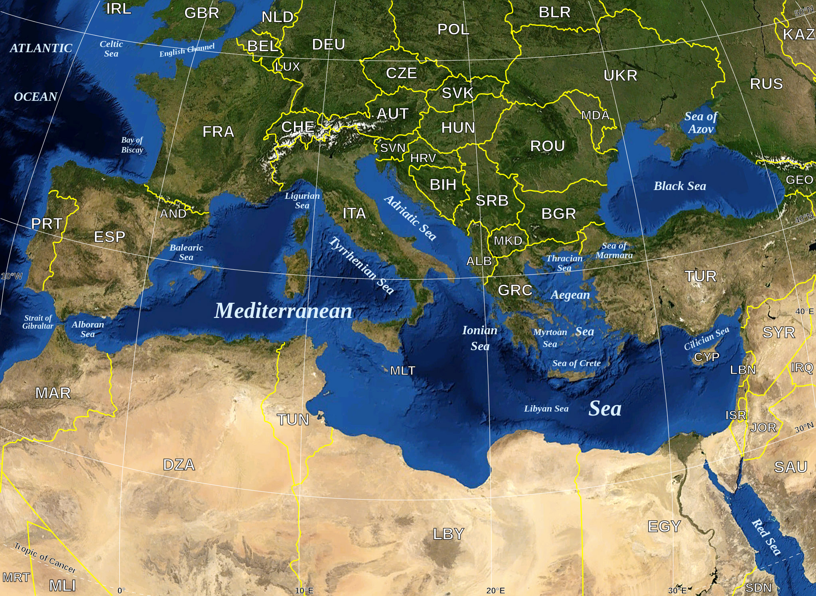
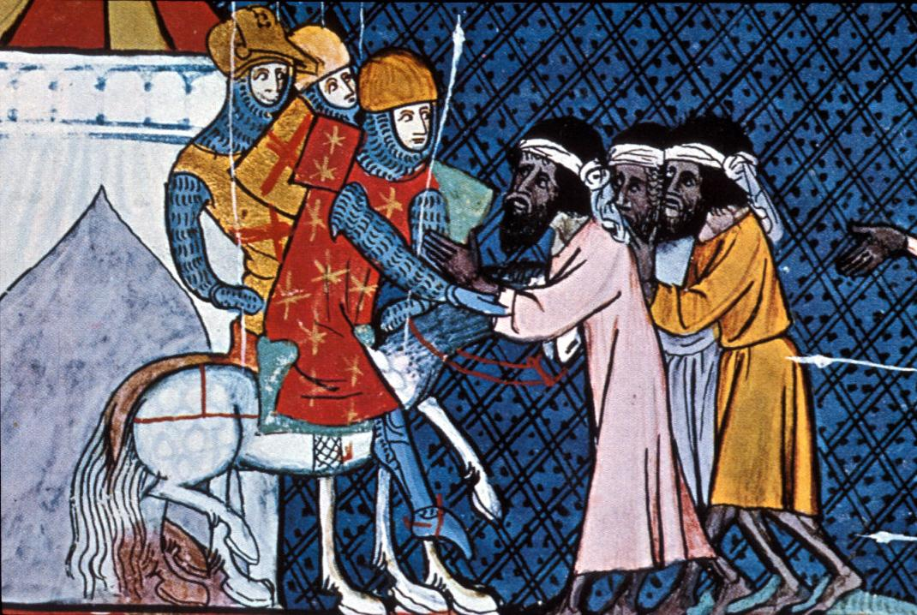
Trade
Italy is in a perfect position to trade with others.
While Europe is in the middle of the Middle Ages, other areas are flourishing.
Spain
Byzantium (Turkey)
People not only traded goods, but also spread new ideas and advancements in science, mathematics, and medicine.

Slide 7
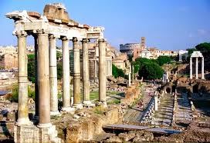
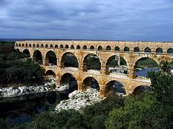
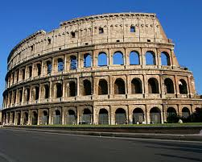
Classical Heritage
Many Italian cities sit on top of or next to ancient Roman ruins.
Served as an inspiration for artists working in Italy and abroad.

Slide 8
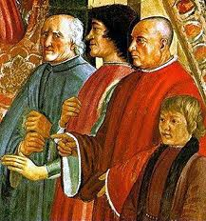
Wealth
Several Italian families became extremely wealthy from trade.
The Medici, a banking family, became the most powerful family in all of Europe.
Allowed them and others to fund the arts.
Provided money for artists like:
Michelangelo
Botticelli
Da Vinci
Donatello
Don’t worry about putting this in your notes.

Slide 9
What makes Renaissance art different?
Perspective: gives the illusion of depth on a flat surface.
Ex: objects in the back smaller than objects in the front.
Idealism: The representation of things in a near perfect form.
Ex: impossibly muscular bodes and perfect, beautiful faces.
Ignores flaws like wrinkles, freckles, etc.

