Slide 1
China and Europeans
SWBAT: explain how the relationship between China and European powers changed between the arrival of the Portuguese and the end of the Opium War.
Homework: None.
Do Now: What kind of problems would a society expect to face if a large portion of the population is doing drugs?

Slide 2
First contact- the Portuguese
Originally, things were good.
Jesuit missionaries helped the Chinese with astronomy which was essential in creating the Chinese calendar.
This led to Jesuits being appointed to high-ranking positions in the palace.
Led to economic, political, and religious influence.
Suspicions began about Jesuit influence and the Chinese disliked Catholic allegiance to the Pope.
Led to the denouncement of Christianity and the deportation of monks. Christian numbers dwindled.

Slide 3
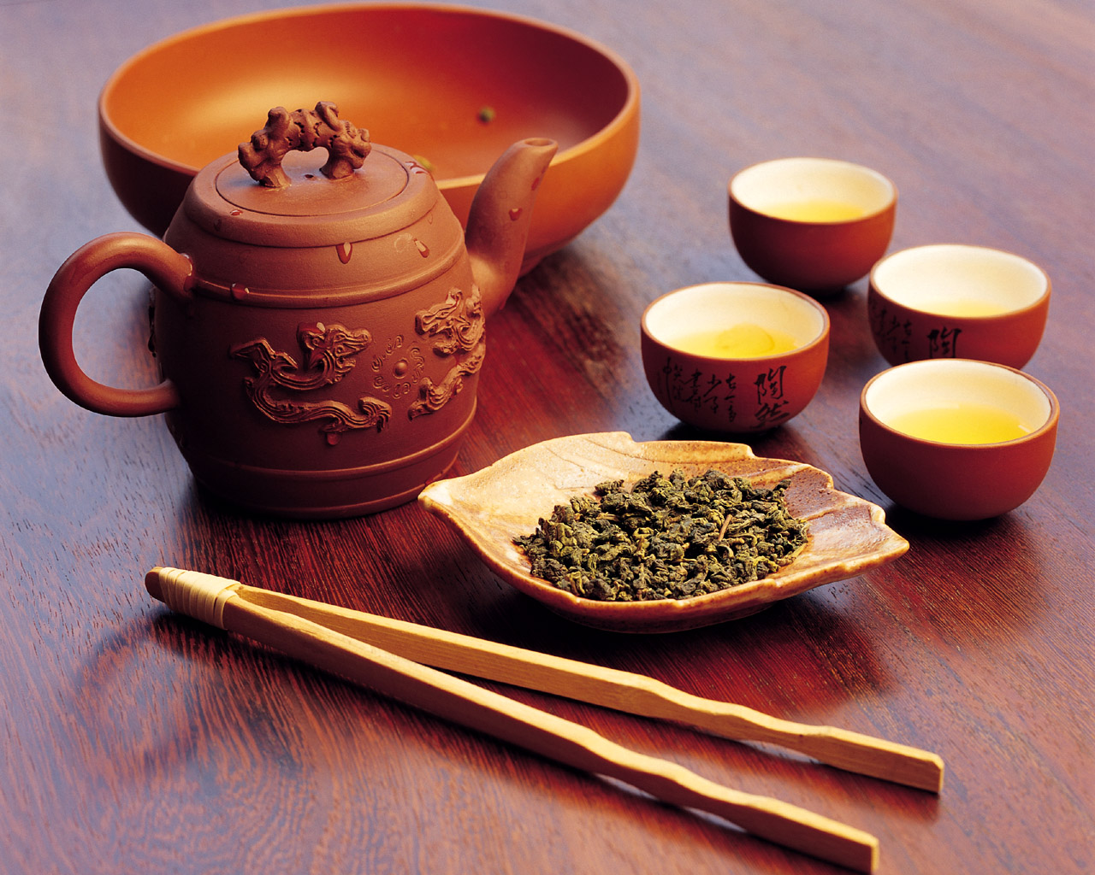
The British
Tea was a huge commodity in Great Britain, but the best tea came from China.
China agreed to trade with the British East India Company under a certain provisions:
Ships could only dock in one port.
Company representatives had to stay outside the city in designated homes.
Company could only trade with certain tea merchants.
For a while, this works.

Slide 4
What changed??
Free trade: belief that governments should not interfere with or restrict international trade.
The British did not like trade restrictions placed on them by China.
Opium

Slide 5
Why are the British selling it?
The British had a problem.
They wanted to buy Chinese goods, but didn’t have anything to trade the Chinese wanted.
They also didn’t have the silver to buy the goods outright.
The British would sell opium for silver and they could then use the silver to buy tea

Slide 6
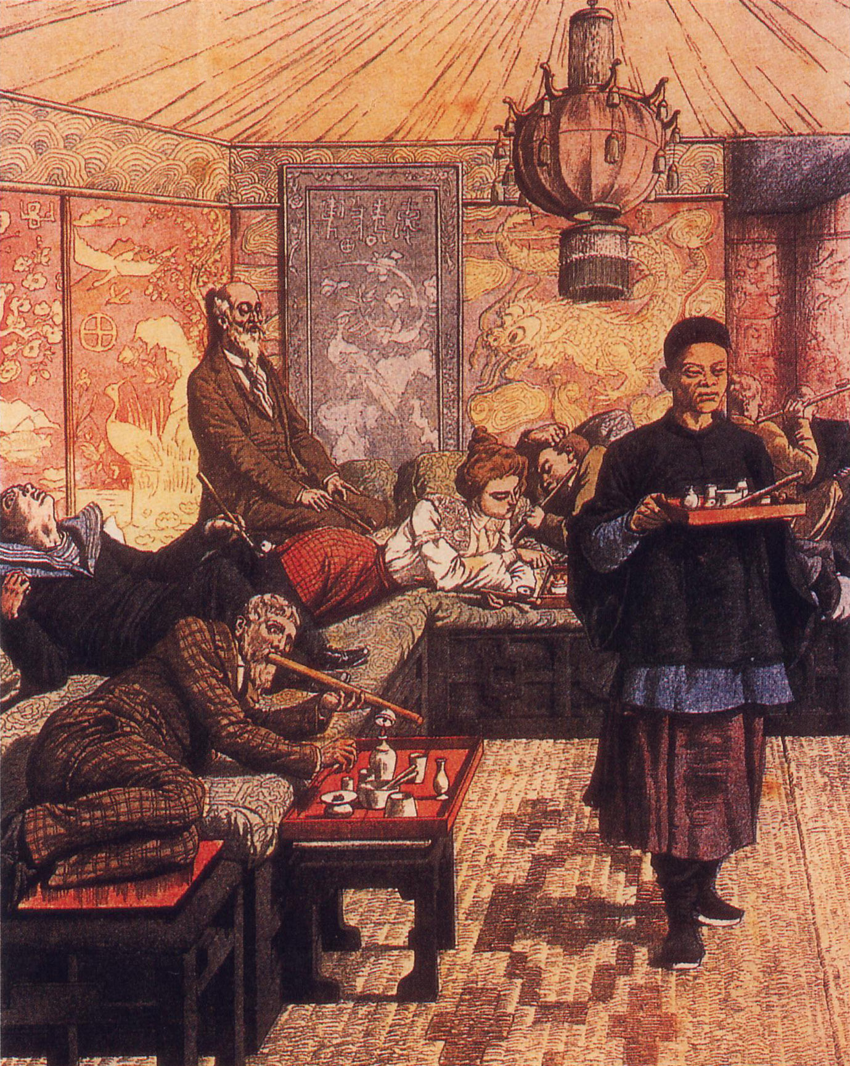
What is opium?
is the dried latex obtained from the opium poppy.
When taken, a user get a rush of euphoria following a drowsy, sleep-like state due to the suppression of the central nervous system.
Used today for prescription pain killers such as morphine, codeine, hydrocodone, and oxycodone.
Also used to make heroin.
Very addictive.

Slide 7
Remember this scene from the Wizard of Oz?

Slide 8
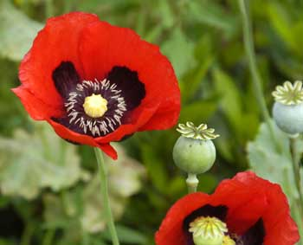
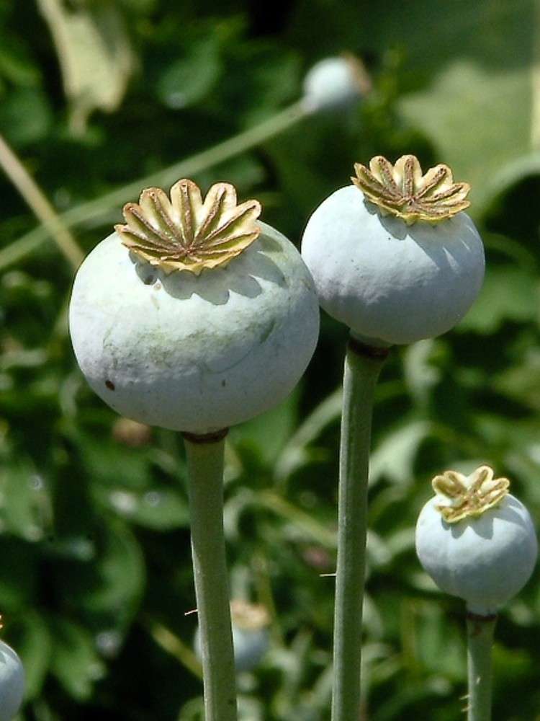
The Chinese Ban the Trade
Opium began causing social problems due to its addictive qualities.
As a result, the Chinese banned the selling of opium in the country.
This did not go over well with the British.

Slide 9
Primary Source Analysis
Read the letter from Lin Zexu to Queen Victoria of England and answer the questions that follow.

Slide 10
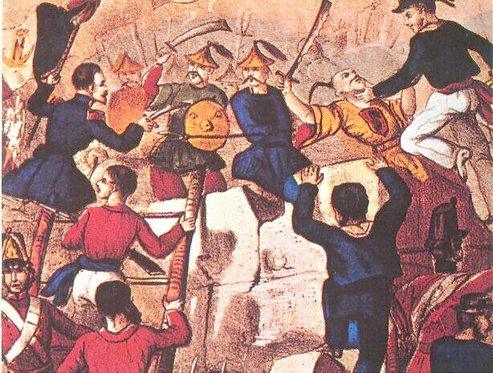
War
Ultimately, the British declare war on China.
Because the Chinese had been cut off for so long from the now more advanced West, they were outmatched.
The British quickly gained the upper hand and defeated the Chinese.
The end of the war is marked by the signing of the Treaty of Nanjing, the first of unequal treaties.

Slide 11
Terms
Opened up ports for trade.
China owed G.B. $12 million + $6 million for the opium that had been confiscated.
China loses the rights to Hong Kong (lasts until 1997).
Europeans lived in their own sections and were subject not to Chinese laws but to their own laws, a practice known as extraterritoriality.

Slide 12
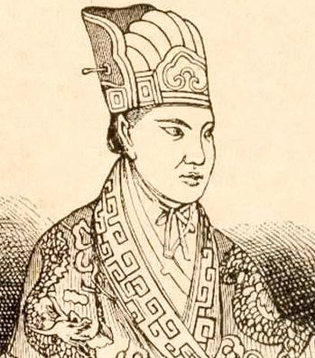
What made this even worse?
Taiping Rebellion
Hong Xiuquan believed he was the younger brother of Jesus and looked to create a new dynasty.
Had many followers.
Rebellion last 14 years before it could be put down by the Qing dynasty.
Millions were killed.
Allowed European powers to capitalize on China’s weakness by opening more ports and influence in political and economic affairs.

Slide 13
Exit Discussion
Many Chinese consider the signing of the Treaty of Nanking the beginning of the century of humiliation. Explain why this is.

