Slide 1
Constitutional Monarchy in England
SWBAT: identify the causes of the Glorious Revolution in England.
Homework: None. Yay!
Do Now: Imagine you are the son of Charles I in England. He has just been executed by Parliament after a long civil war. What are some things you might do differently since you are now in power?

Slide 2
Let’s Review some Vocab
Cavaliers v. Roundheads
Whigs v. Tories
Loyalists v. Patriots

Slide 3
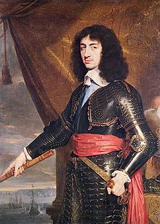
Charles II
Son of Charles I
Was made king of England after Cromwell’s death aka the Restoration.
Learned from his father’s mistakes and ruled cautiously.
Was responsible for a rebirth of English culture.
Charles II loved entertainment.
Removed Puritan restrictions on the theater, he made entertainment and the arts more available to the people of England.
Problem: he’s childless and his younger brother, James, is Catholic.

Slide 4
Political parties develop
Two political parties developed with differing views about the royal succession
Tories | Whigs
Those who believed James, Charles II’s brother, had the hereditary right to rule England. | Claimed the right to deny the throne to James.
Were willing to accept a Catholic monarch despite the fact that many of them were Protestants. | Wanted a strong Parliament and a Protestant ruler.

Slide 5
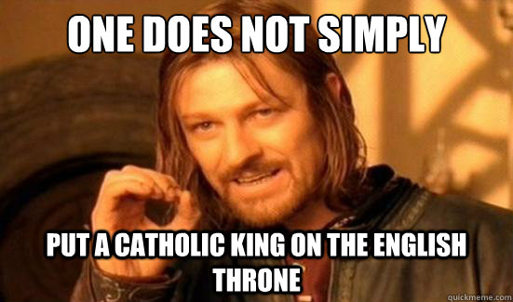
James II
When Charles II died, his brother did end up on the throne.
Like Charles I, he too believed in absolute rule and divine right.
Was very disliked- both for political reasons and religious.

Slide 6
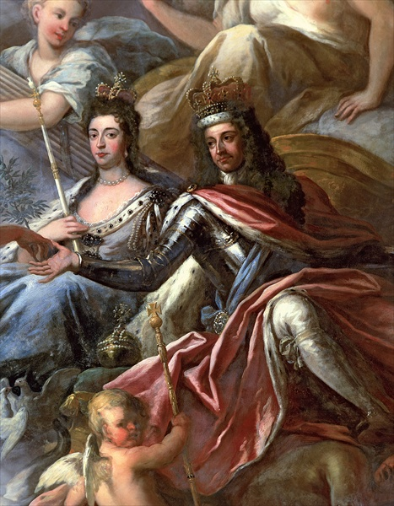
A solution to the royal problem
James II also had 2 daughters who were raised Protestant and married Protestants. However, James remarried after the death of his wife, had a son and was raised Catholic.
By rule of succession, the Catholic son would rule, not his older sisters.
Parliament invited Mary, and her Dutch husband William of Orange to replace James.
Upon arrival with the Dutch army, James fled to France and William and Mary took the throne.
This bloodless change in power is known as the Glorious Revolution.

Slide 7
Changes made to limit the crown’s power
The Writ of Habeas Corpus: those arrested could demand to see a judge who would decide if they were arrested for good reason.
English Bill of Rights: we’re getting to it.
Toleration Act: granted some religious freedoms to Protestants not part of the Anglican Church.
Did not apply to Catholics or Jews.
The English Civil War and the events that followed also changed the ways people thought about government.
That will be Monday.

Slide 8
So is this a monarchy, or something else?
Absolute rule had shifted to a limited constitutional monarchy:
Monarch acts as head of state.
Parliament has much of the power.
Monarchs must consult Parliament over issues.
This is the end of divine right and absolutism in England.

Slide 9
Activity
You are going to read portions of the English Bill of Rights.
In your own words, explain what that section is saying.
You cannot fill out the third column because we have not gotten there yet. This means you cannot lose this sheet because we will be using it again.
We will go over this at the end of class.

Slide 10
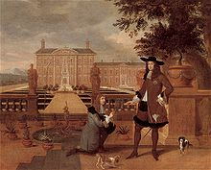
This is Charlie, my Cavalier King Charles spaniel, a breed of dog named for King Charles II of England who supposedly owned many.

