Slide 1
Europe faces Revolutions
SWBAT: define liberal and conservative and apply the terms to 19th century Europe.
Homework: None.
Do Now: Turn to the last page of your notes packet and read the blurb on liberalism v. conservativism. Using what you know about each group, how do you think each would respond to raising minimum wage? Or providing free healthcare? Write down your answer on the back of the sheet.

Slide 2
Let’s Review
When Napoleon began conquering Europe, he brought with him French customs, language, and beliefs which often times varied considerably from the conquered country.
I.e. think back to when Napoleon put his French brother on the throne of Spain.
He also brought with him the revolutionary spirit that had driven the French Revolution.
By Napoleon’s defeat at Waterloo, other European countries were nervous that this nationalistic zeal mixed with the spread of revolutionary spirit would alter the existing state of affairs in Europe, violently if necessary.

Slide 3
The Congress of Vienna
Following the defeat of Napoleon, the major European powers met at the Congress of Vienna to discuss restoring the balance of power and to prevent nationalistic revolutions.
Headed by Austria's Prince Metternich, a conservative, the Congress of Vienna attempted to stem the tide of nationalism sweeping across Europe.
Metternich believed nationalism created disorder because it fostered violent revolution.
The Congress of Vienna worked for several years, but it couldn’t stop nationalistic movements from gaining momentum.
Nationalistic movements would eventually lead to the formation of many current-day European countries.

Slide 4
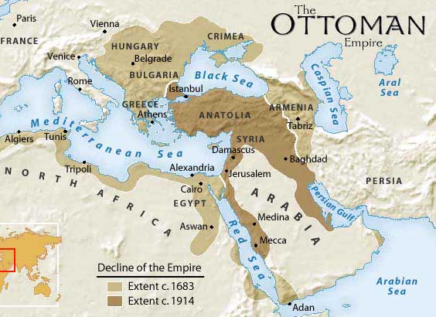
Greece
For several centuries the Ottoman empire had controlled the Balkans.
Greece in particular had maintained a lot of the qualities that made it different than the Ottoman Empire.
Spoke a different language.
Were Orthodox Christians.
Had a long, ancient history that they were proud of.
In 1821, the Greeks revolted and because of the Congress of Vienna and the attempt at stopping nationalism, the rest of Europe did nothing to help.

Slide 5
Greeks win Independence
After the Ottoman Empire massacred hundreds on various Greek islands, European powers became more involved.
In 1827, a combined British, French, and Russian fleet defeated the Ottoman fleet and by 1830, Greece was declared a free country.
Greek independence was the first European domino to fall in a long train of uprisings that spread throughout the continent.

Slide 6
1830s Uprisings
Greek independence in addition to liberals throughout Europe remained a constant threat to the old order.
1830: Poles rise up and revolt against Russian rule.
1830: Belgium revolts against the Netherlands and declare independence.
This would be the only successful movement of this decade.
1831: Italians mobilize to unite the independent states making up the peninsula.
The failure of the Poles and Italians would only spur more revolutions in the years to come.

Slide 7
Springtime of the Peoples
Nationalist liberals would again try to rise up and make democratic changes in 1848.
Sicily revolts against Bourbon rule.
Hungary looks towards independence.
Ireland fight for independence from Great Britain.
Czechs in Prague demand Bohemian independence.
All of these would ultimately (initially) fail due to conservative's power, but it showed conservatives how threatening nationalism could be.

Slide 8
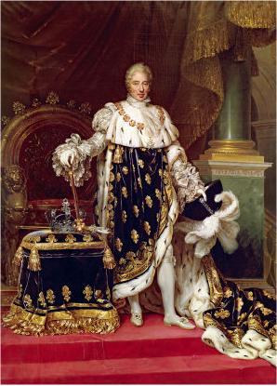
Revolution of 1848 in France
The revolution of 1848 in France was different than other European nations in that its demand for democratic government was the main goal of the revolution.
In 1830 France’s King Charles X tried to stage a return to absolute monarchy.
Riots forced him to flee and he was replaced by Louis-Philippe, who supported liberalism within France.

Slide 9
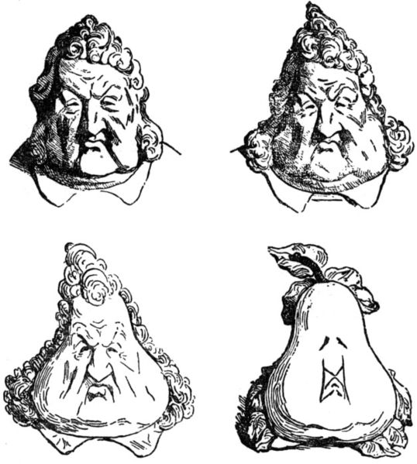
The Problems of Louis-Philippe
In 1848, after 18 years of ruling, Louis-Philippe fell out of favor with the people.
Louis-Philippe was often caricatured in the press as a pear due to the shape of his head.

Slide 10
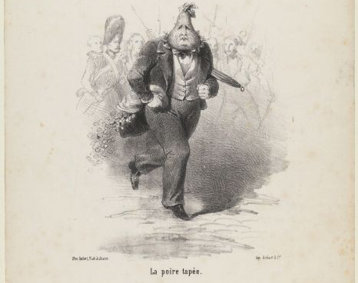
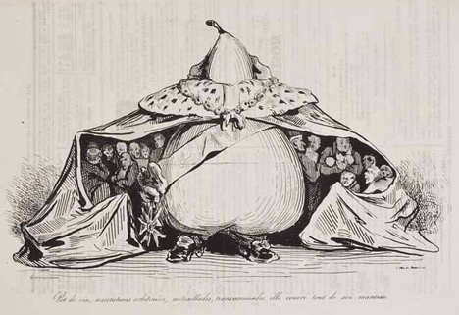
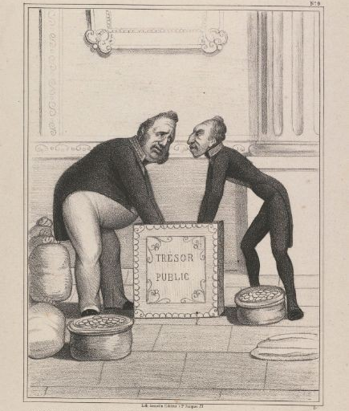
Why did people hate him?

Slide 11
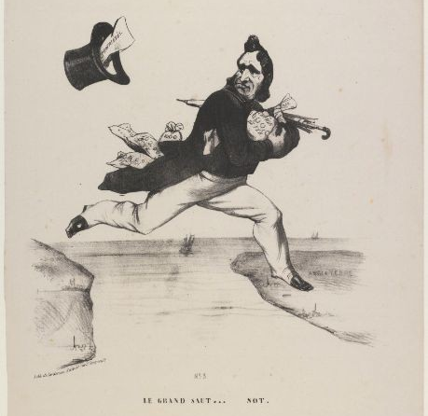
The end of Louis-Philippe
Riots ensued and the monarchy was again overturned and was replaced by a republic.
The new gov’t began to fall apart almost immediately as two radical groups formed- one wanted political changes and the other wanting social and economic changes.
Violence broke out in the streets.
Eventually a constitution was drafted calling for elections.
Louis-Philippe is pictured jumping over the Channel from France to England. The title is a play on words, which can be read "the big leap" or "the big fool."

Slide 12
Napoleon III
In Dec. 1848, Louis-Napoleon, the nephew of Napoleon Bonaparte, won the presidential election.
For 4 years he took the title Emperor Napoleon III and was a strong ruler.
The French accepted this because again, they were tired of chaos and instability.
Louis-Napoleon encouraged industrialization and his policies led to a decrease in unemployment.
France finally was experiencing real prosperity and political and economic stability.

Slide 13
Closing Question:
Review question: what made the French Revolution of 1848 different than other European areas revolting at the same time?

