Slide 1
Beginnings of a Revolution
CP 1
SWBAT: identify with the Third Estate in the period before the French Revolution.
Homework: Vocab
Do Now: Begin working on the vocab you picked up from the back of the room.

Slide 2
Beginnings of a Revolution
Core 1
SWBAT: identify with the Third Estate in the period before the French Revolution.
Homework: None.
Do Now: What is a revolution? What words come to mind?

Slide 3
Reflect
Take a few minutes to reflect upon what just happened. What side were you on? How did that make you feel? What would you have done in order to eat some of the popcorn?

Slide 4
Let’s Discuss
People at the table, how did you feel?
People sitting at your desk, how do you feel?
What would you have been willing to do in order to eat some of the popcorn?

Slide 5
Project Distribution

Slide 6
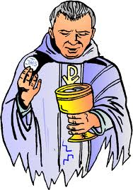
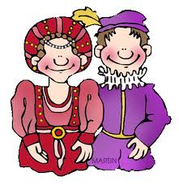
The Three Estates (social classes) of France
First Estate
Second Estate
Third Estate
Everybody else
% of population: 97%
Richest of the 97% are the bourgeoisie.
Clergy
% of population: 1%
Nobility
% of population: 2%
Notes:
Similar to current day problems?

Slide 7
Causes of a Revolution
The feelings of anger and despair of the Third Estate are just one cause of the French Revolution.
In groups, you are going to read primary and secondary source documents to examine what those other causes are.
As a group, you will work on reading and answering the questions together.
This does not mean you each take a source and share answers.
Be prepared to respond to the following question: What were the causes of the French Revolution?
If you can work cooperatively, you might get rewarded upon the completion of the activity tomorrow.

Slide 8
Beginnings of a Revolution
2
SWBAT: identify the causes of the French Revolution.
Homework: Essays are due tomorrow. You are completing them on the separate sheet of paper.
Do Now: Describe the estate system in France. Who is in which? What are some of the problems we’ve already discussed?

