Slide 1
Hinduism
SWBAT: identify beliefs of Hinduism.
Homework: None.
Do Now: Have you ever had an experience where you met someone or went somewhere and felt like you either met them or been there before? Or do you have an irrational fear you can’t explain or feel a connection to a particular time period? Explain.

Slide 2
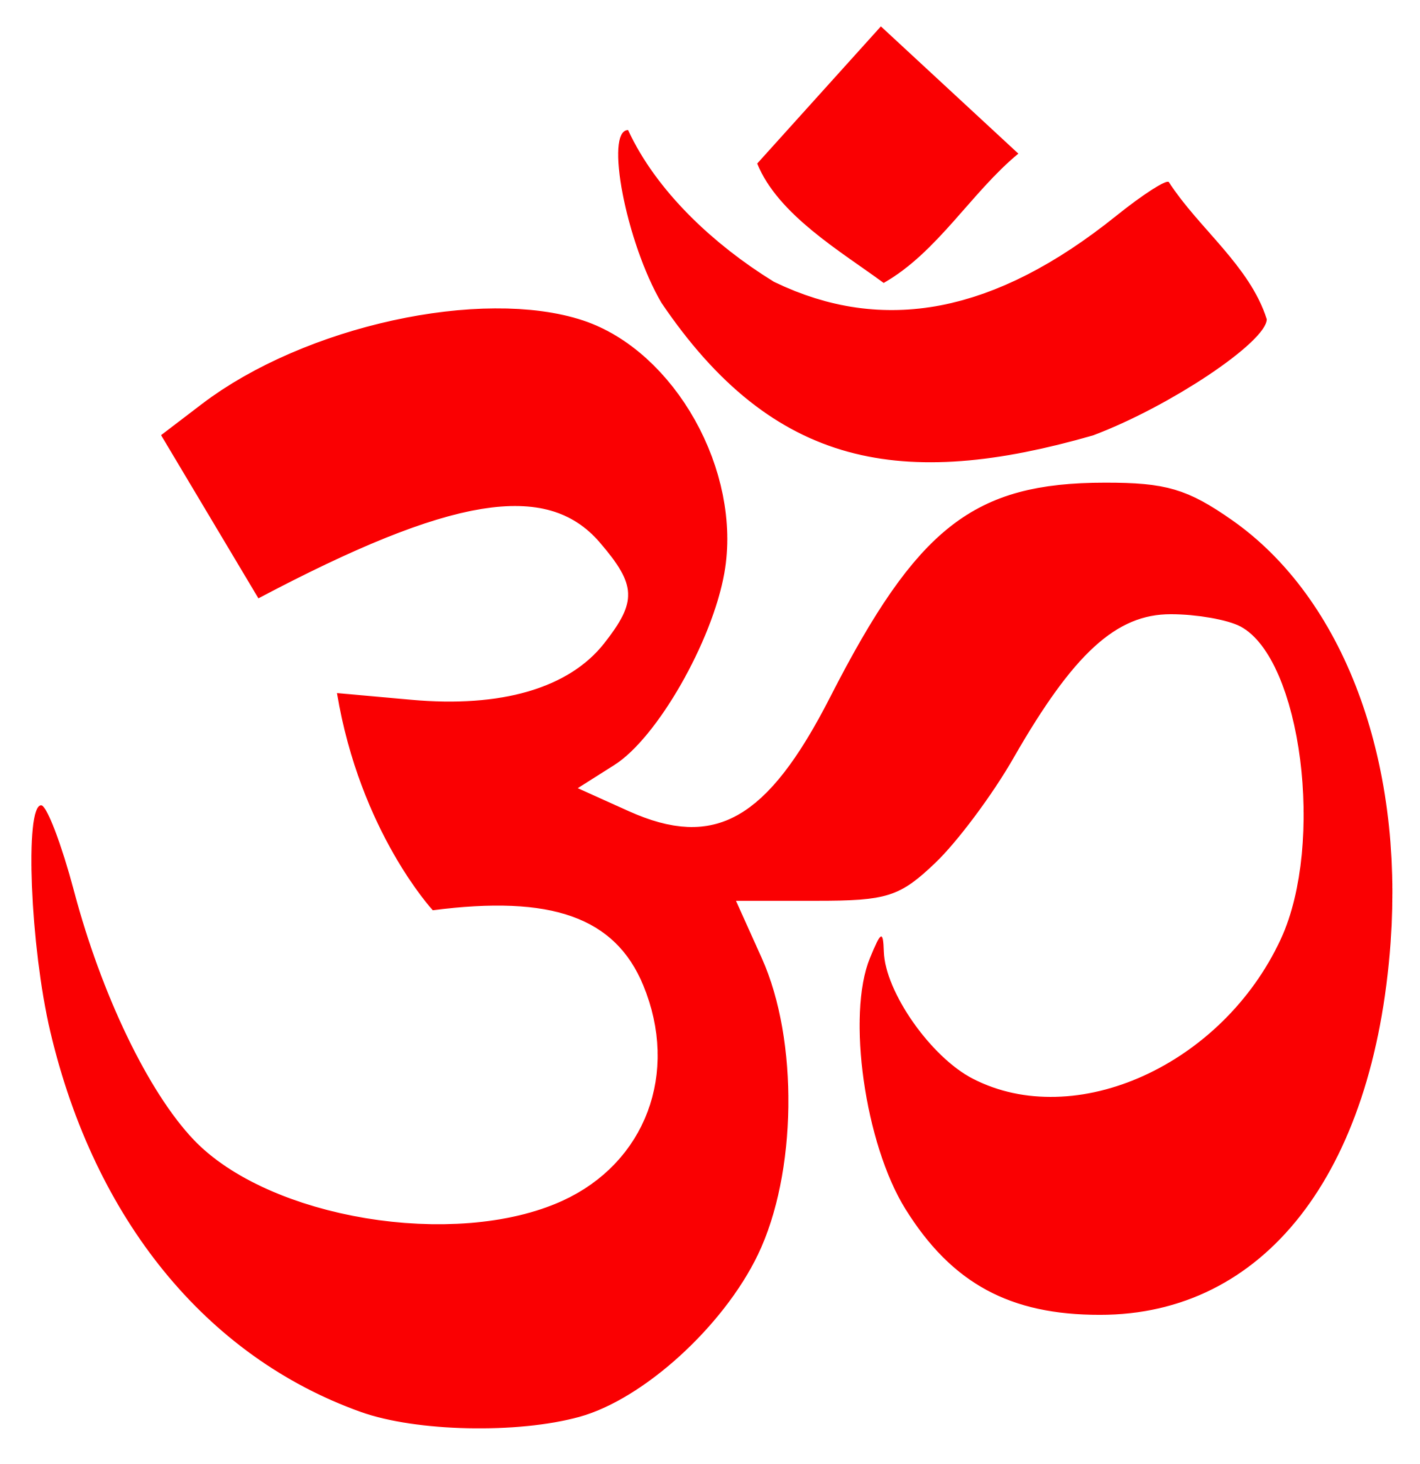
Hinduism at a Glance
Hinduism is the third largest religion in the world, with approximately 1 billion followers.
A majority of followers live in India and Nepal.
It is also the oldest known religion in the world today.
Unlike most other religions, Hinduism has no single founder, no single scripture, and no commonly agreed set of teachings.
For these reasons, writers often refer to Hinduism as 'a way of life' or 'a family of religions' rather than a single religion.

Slide 3
Holy Texts
The Vedas are considered to be the most holy text for Hindus.
Hindus believe that the texts were received by scholars direct from God and passed on to the next generations by word of mouth.
The Vedas are made up of four compositions, and each veda in turn has four parts which are arranged chronologically.
The Samhitas are the most ancient part of the Vedas, consisting of hymns of praise to God.
The Brahmanas are rituals and prayers to guide the priests in their duties.
The Aranyakas concern worship and meditation.
The Upanishads consist of the mystical and philosophical teachings of Hinduism.

Slide 4
Worship
Hindu worship, or puja, involves images (murtis) and prayers (mantras).
Central to Hindu worship is the image, or icon, which can be worshipped either at home or in the temple.
Hindu worship is primarily an individual act rather than a communal one, as it involves making personal offerings to the deity.
Worshippers repeat the names of their favorite gods and goddesses, and repeat mantras.
Water, fruit, flowers and incense are offered to god.
The majority of Hindu homes have a shrine where offerings are made and prayers are said.
A shrine can be anything: a room, a small altar or simply pictures or statues of the deity.
Family members often worship together.
Rituals should strictly speaking be performed three times a day.

Slide 5
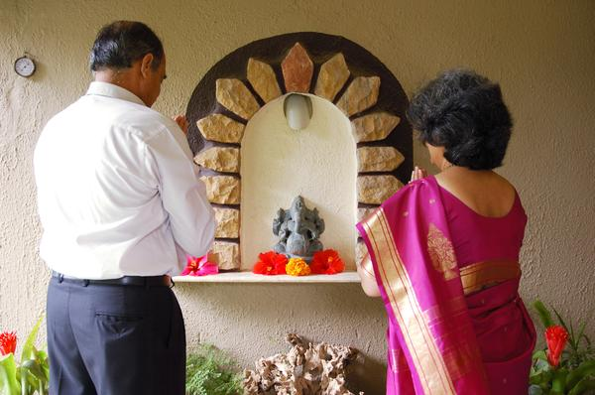
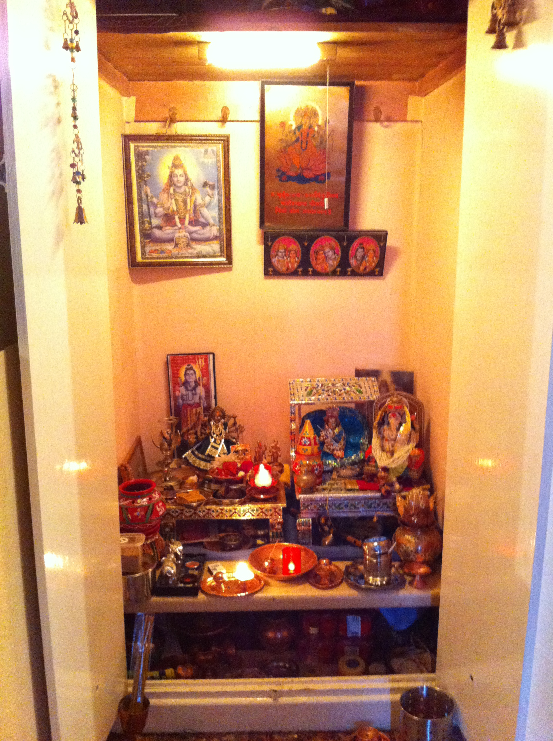
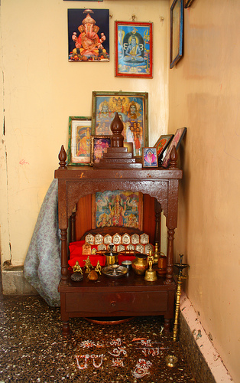
Examples of Shrines

Slide 6
Class System
Unlike other religions, Hinduism promotes a class system that first occurs in the oldest Hindu text, the Rig Veda, and still exists to some extent today.
Society is broken up into 4 castes, or social groups. Which group you belong in will decide for you who you can marry, what kind of education you receive, and what kind of jobs are available to you.
The four classes are:
Brahmans or Brahmins - the intellectuals and the priestly class who perform religious rituals
Kshatriya (nobles or warriors) - who traditionally had power
Vaishyas (commoners or merchants) - ordinary people who produce, farm, trade and earn a living
Shudras (workers) - who traditionally served the higher classes, including labourers, artists, musicians, and clerks.

Slide 7
The Untouchables
A fifth Veda, the Untouchables (Dalit), also exists.
These are people who generally perform jobs that involve coming into contact with filth, making them unclean (scavengers, trash men, restroom cleaners, butchers, etc.).
More than 160 million people in India are considered "Untouchable"—people tainted by their birth into a caste system that deems them impure, less than human.
Socially, Dalits are not allowed to drink from the same wells, attend the same temples, wear shoes in the presence of an upper caste, or drink from the same cups.
Why are they treated so poorly?
They must have done something in a previous life to deserve the treatment they get in this one.
While it’s technically illegal to persecute these people in India, it doesn’t stop caste purists from treating them as unequals.

Slide 8
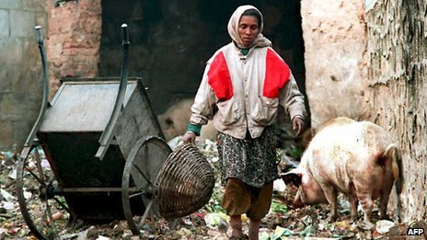
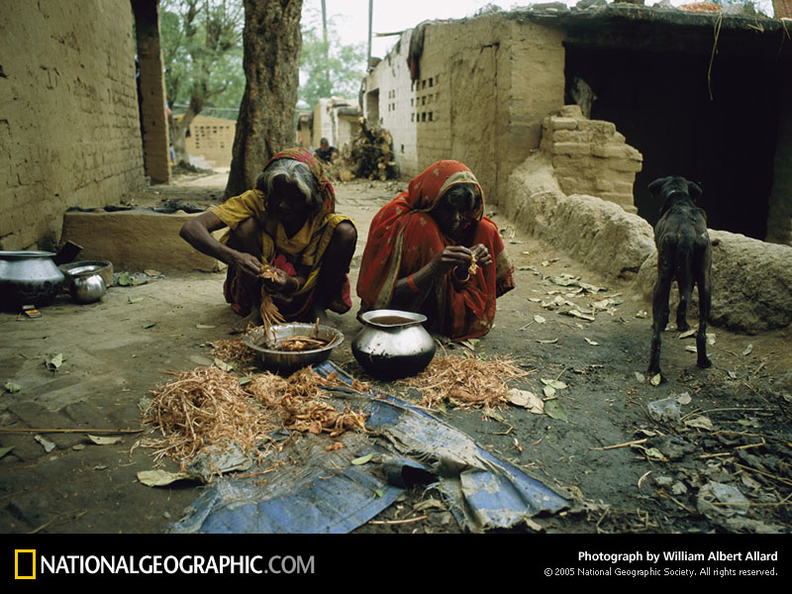
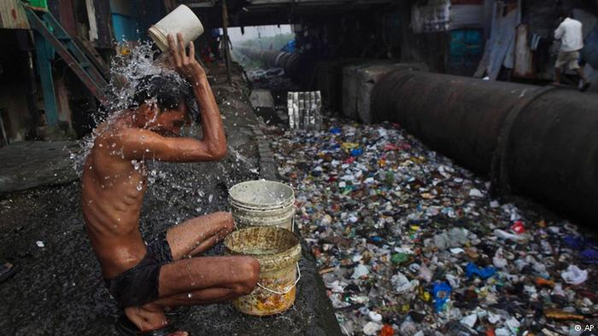
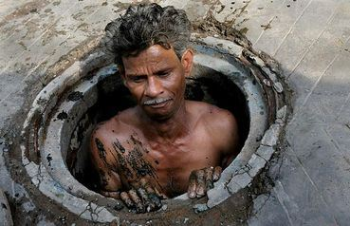

Slide 9
Gods and Goddesses
Unlike Christianity and Islam, Hinduism is polytheistic.
The supreme God is Brahman, a force present within all things.
Below that is the triumvirate, which consists of three gods who are responsible for the creation, upkeep and destruction of the world.
Brahma
Vishnu
Shiva
There are also a number of lesser gods like Shiva's sons Ganesha and Kartikeya that are worshipped.
It is also possible for gods to take on "incarnations,” which is a deliberate descent of a deity to Earth.
Hindus can also worships these avatars. For example, an incarnation of Vishnu is Krishna.
The particular deities worshipped are a matter of individual preference.

Slide 10
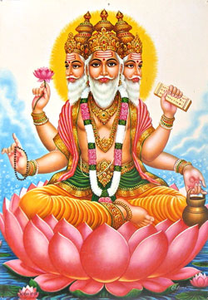
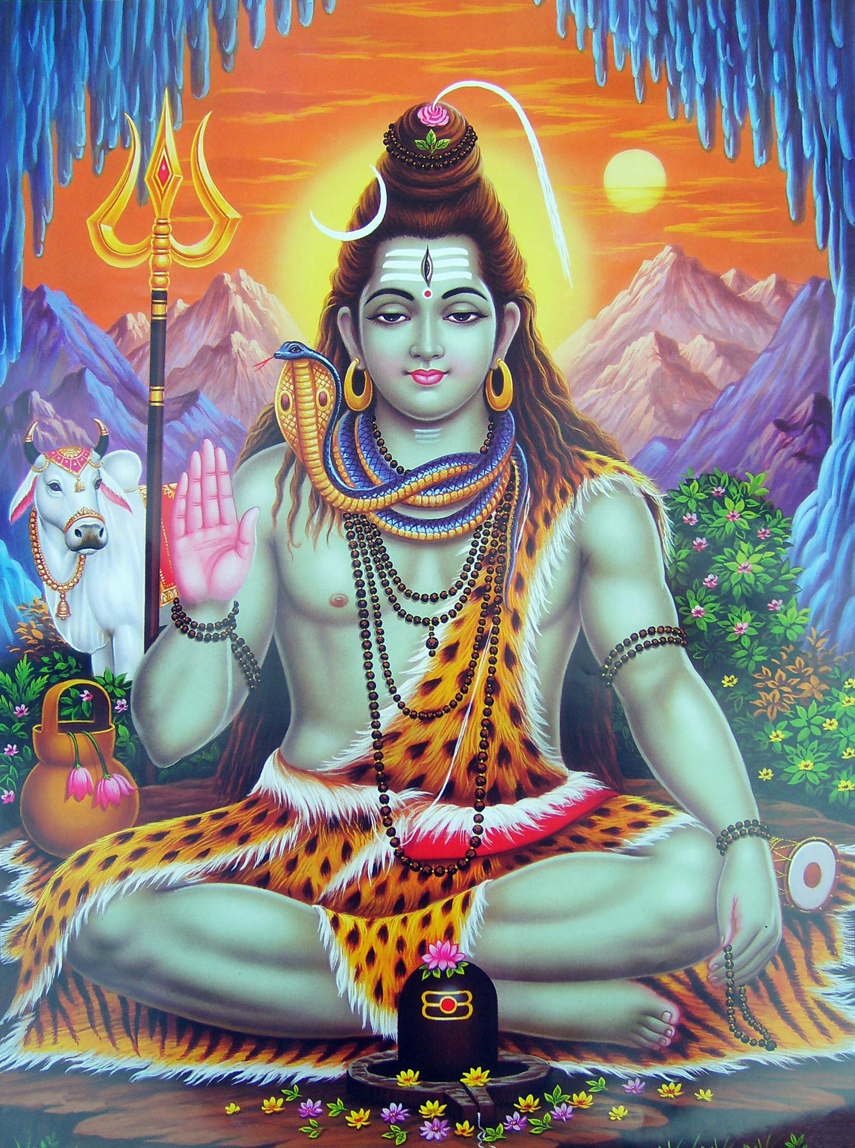
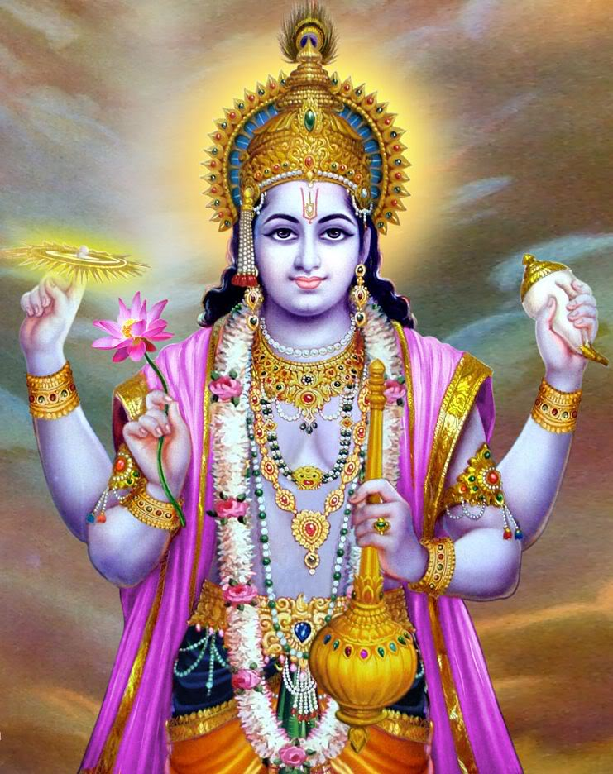
Brahma
Vishnu
Shiva

Slide 11
Samsara
Unlike Islam or Christianity, death is not final and the soul is not immediately given salvation or damned to hell.
Instead, the soul is reborn time after time in a process called reincarnation or samsara.
At death many Hindus believe the soul is carried into a new physical body which can be a human or non-human form.
This means you can be born as anything- a tree, a dog, or an insect.
What you become in the next life is based on Karma.
Good or virtuous actions will put you in good standing for a good life in the next.
The goal of reincarnation is liberation (moksha), or to make us free from this cycle of rebirth.

Slide 12
Is Reincarnation Possible?
And is there proof?
Watch the following video clip and be ready to discuss.

