Slide 1
Protestant Reformation
SWBAT: identify the causes of the Protestant Reformation and the impact Martin Luther’s 95 Theses had on religion in Europe.
Homework: Study for vocab quiz.
Do Now: How many denominations of Christianity can you name? Example: Greek Orthodox, Presbyterians, etc. You can do this on the back of your Martin Luther reading.

Slide 2
The ONE Church
Until 1517, there was only ONE church- the Catholic Church.
You can get in trouble for belonging to other churches.
So how do we get from 1 Christian Church to ~40,000 Christian churches?
Answer: the Reformation.

Slide 3
Martin Luther- Leader of the Reformation
Read through the info sheet on Martin Luther. Highlight important information as you read.
Answer the questions. You do NOT need to write in complete sentences.

Slide 4
Let’s Review Part 1
1. Describe Luther: What is his occupation, where is he from?
Occupation: _____________________
Where is he from: _________________________
2. What 2 factors lead Luther to read the Bible?

Slide 5
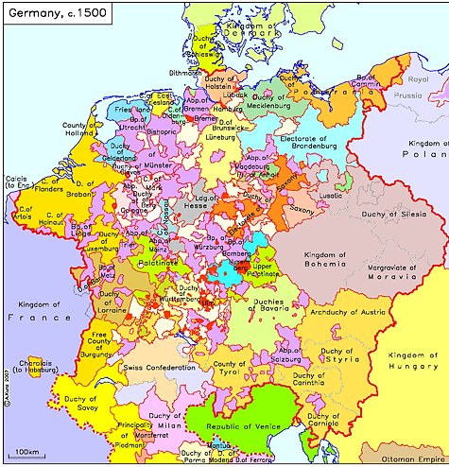
The beginnings of the Reformation
Martin Luther was a monk.
Germany in the 1500s is very different than Germany today.
Luther is in constant fear of damnation.
Felt that the Catholic Church did nothing to help overcoming sin which gave him no comfort.

Slide 6
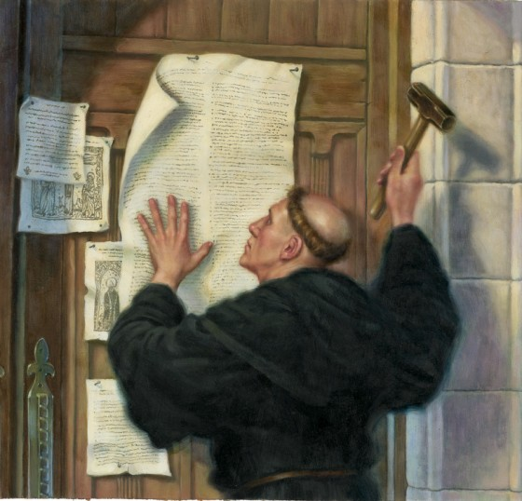
95 Theses
In 1517 Luther wrote the 95 Theses (statements) which outlined his problems w/the church.
Posted them on a door of a church.
Church leaders condemn him b/c he challenged the church.

Slide 7
Examples of the 95: What do they mean?
45. Christians should be taught that he who sees a needy person, but passes him by although he gives money for indulgences, gains no benefit from the pope's pardon, but only incurs the wrath of God.

Slide 8
Let’s Review Part 2
3. What new technology allows Luther’s views to spread? How long before all of Europe could read Luther’s 95 Theses?

Slide 9
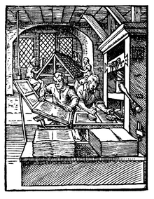
The Printing Press
Printing press made it much easier for materials to be printed and machines could produce 3,600 pages per workday.
Allowed books to be accessed by anyone and information and knowledge spread much faster.

Slide 10
Let’s Review Part 3
4. Using google define the following words:
Heresy:
Excommunication

Slide 11
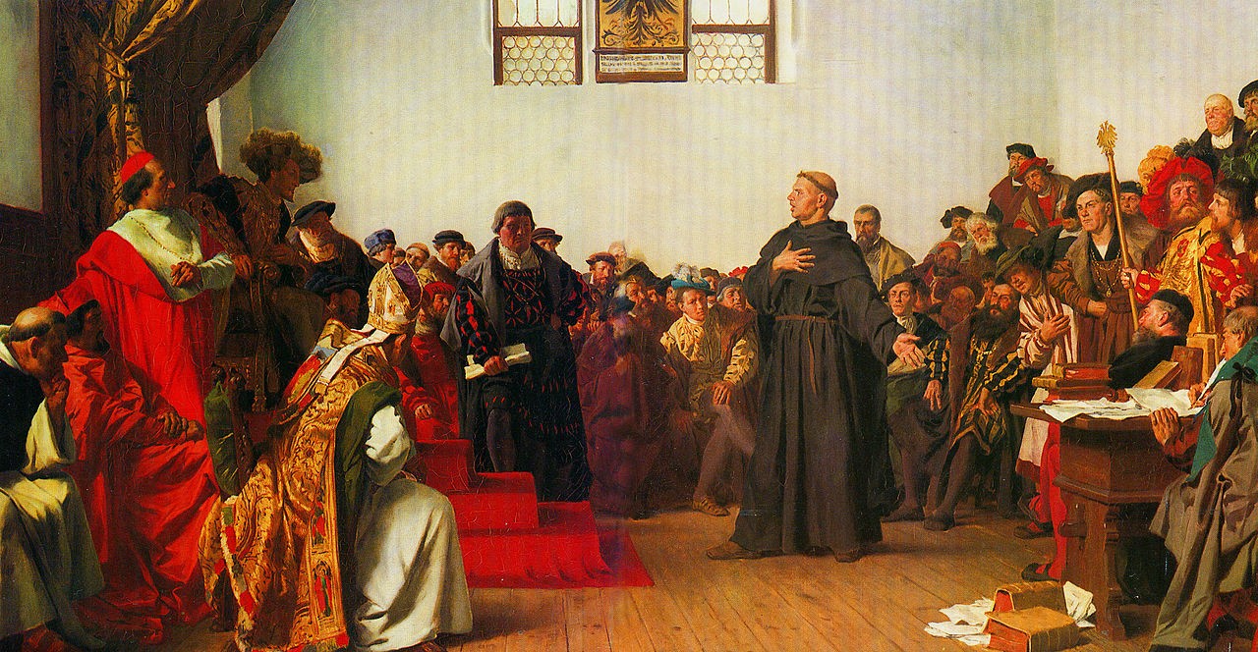
Catholics in Charge are PISSED
Holy Roman Emperor Charles V called Luther to a meeting.
Aka the Diet of Worms
Diet (meeting) of Worms (a city in Germany).
Charles accuses Luther of heresy.
Demand Luther abandon his beliefs and the printing of his ideas.
However, because of 300+ German states, he couldn’t really enforce it.

Slide 12
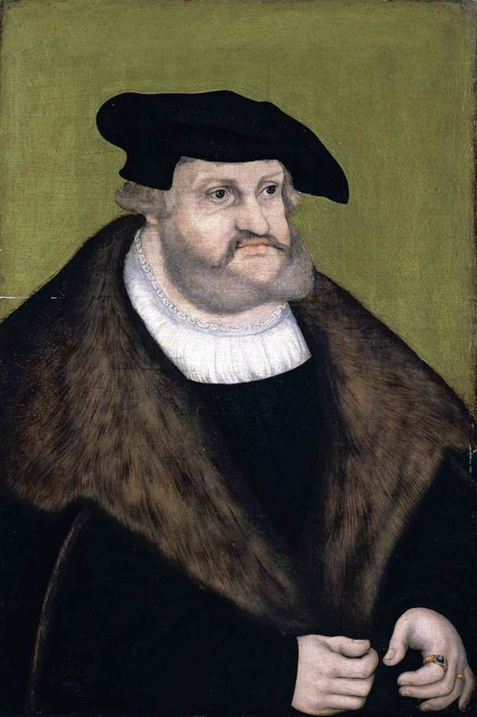
Frederick the Wise
Meanwhile, Frederick the Wise whisked Luther away and gave him a safe place to stay.
While there, Luther translated the Bible in German (previously was in Latin).
Now all literate Germans could read the Bible for themselves.
Why is this significant?

Slide 13
The end result:
Luther is excommunicated by the Catholic Church.
The creation of a new form of Christianity called Protestantism.
Followers in Luther’s church in particular became known as Lutherans and it became the most popular religion in Northern Germany.
Eventually, Christianity would break up into dozens of sects, all with slightly differing beliefs.
And the Catholic Church? The Catholic Church has their own plan to get the church back together.

Slide 14
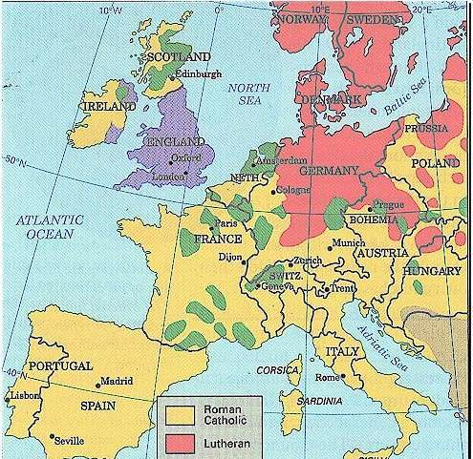
Exit Slip/Discussion
Looking at the map to the right, what conclusion can you make about how geography helped shape the results of the Protestant Reformation?

