Slide 1
Roots of Revolution
SWBAT: identify the 3 estates of France
Homework: Sequence chart.
Do Now: "Out of a population of twenty millions of people . . . there are nineteen millions more wretched [poor], more accursed in every circumstance of human existence, than the most conspicuously wretched individual of the whole United States.“
Thomas Jefferson, 1780s
What is Thomas Jefferson saying about the conditions within France during the later part of the 18th century?

Slide 2
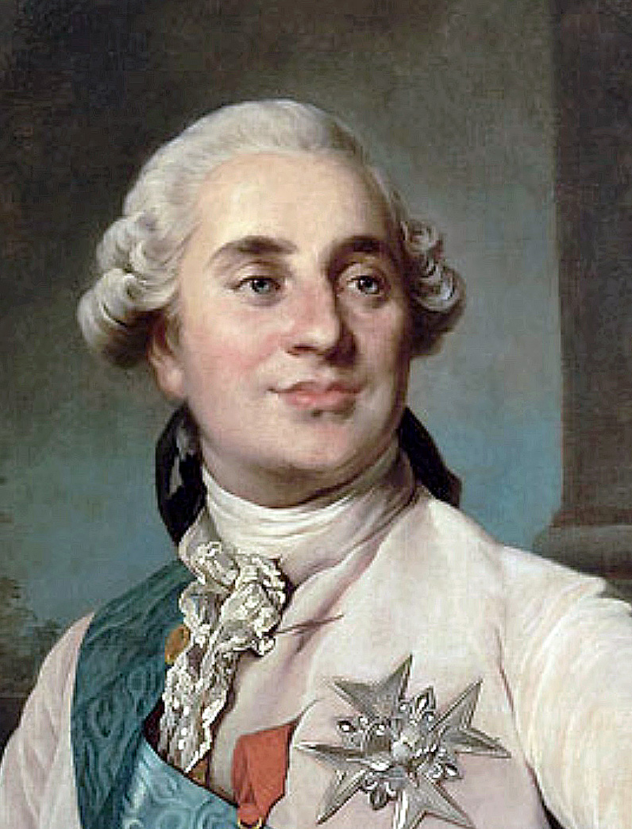
Some background…
For 100 years before the revolution (1789) France was one of the largest and most powerful countries in Europe.
Kings claimed absolute power and that God had chosen them to rule.
Starting in July, 1789, however, things were going to start to change dramatically.
Within months, the king would lose all power.
The lowest class would rise up and take control.
But why?
King Louis XVI

Slide 3
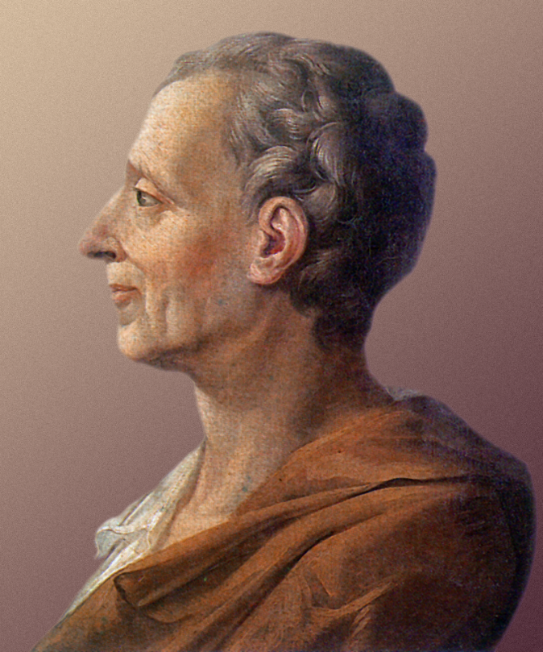
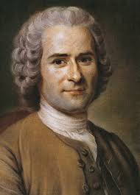
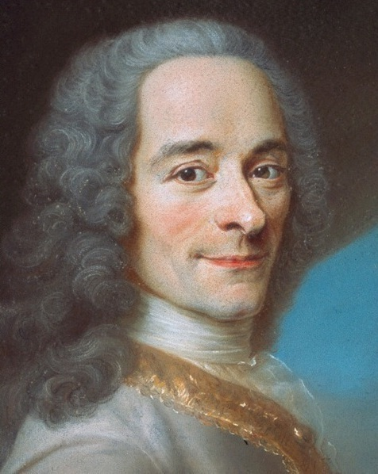
Enlightenment Ideals Spread
Many of the great philosophers we discussed in class were French.
Montesquieu
Rousseau
Voltaire
The French helped the Americans in their quest for independence from Great Britain.
Were fighting for Enlightenment ideals with the colonists despite these ideals not existing yet in France.
But this was all soon going to change.

Slide 4
Economic Problems within France
Economic: kings of France had been overspending and been fighting wars on and off for the past 50 years.
The palace of Versailles (in today’s money) cost millions of dollars.
French and Indian War was expensive and came at a loss.
The American Revolution while a win, was extremely costly.
Famine
Poor harvests led to a decline in food production.
What happens to prices when demand stays high and production goes down?
Unfair taxation among social classes.

Slide 5
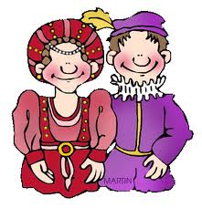
The Three Estates (social classes) of France
First Estate
Second Estate
Third Estate
Clergy
% of population: 1%
Paid no tax
Taxed those living on their land.
Nobility
% of population: 2%
Paid no tax
Taxed those living on their land.
Everybody else
% of population: 97%
Taxed heavily.
Notes:
Similar to current day problems?

Slide 6
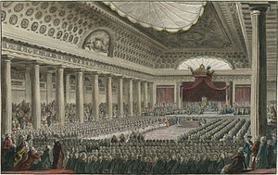
Political Inequality
In 18th century France, laws and legislation were created by the Estates General. This is like Congress here in the U.S.
Traditionally, each estate met separately to cast their votes.
Each estate gets one vote in the Estates General.
Given what you know about the three estates why might this be unfair?

Slide 7
Financial Crisis- the Beginning
By 1789, France’s costly involvement in the American Revolution and extravagant spending by King Louis XVI and his predecessors had left the country on the brink of bankruptcy.
Many were upset because despite heavy taxes, there was no relief from hunger and poverty caused by poor harvests and heavy taxes.
In 1786, changes were proposed that included a universal land tax from which the privileged classes would no longer be exempt.
To gain support for these measures and stop the 1st and 2nd Estates from revolting, the king summoned the Estates-General

Slide 8
The Meeting of the Estates General
At the meeting called by the king, the king declared that voting would be the way it had always been done- separately.
At the meeting, the Third Estate demands better representation, removal of the veto power held by the first two estates, and to meet at the same time as the other estates.
King does not respond.
In response, the Third Estate breaks away creating the National Assembly.

Slide 9
The Tennis Court Oath
After the 3rd Estate declared themselves the National Assembly, they attempted to meet, but found the doors to be locked.
In response, they met at a nearby indoor tennis court.
This leads to the Tennis Court Oath.
The deputies pledged to continue to meet until a new constitution had been written.
The oath was both a revolutionary act, and an assertion that political authority derived from the people and their representatives rather than from the monarch.
Within a week, most of the clerical deputies and 47 liberal nobles had joined them, and on June 27 Louis XVI grudgingly absorbed all three orders into the new assembly.

Slide 10
"The Tennis Court Oath at Versailles” by Jacques–Louis David
Unfinished.

Slide 11
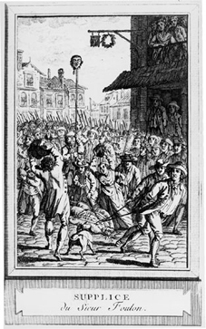
The Beginning of a Revolution
King Louis allowed the Estates General to meet together, but in the meantime moved troops into Paris and Versailles.
Fearing Louis was going to drive out the National Assembly by force, the people of Paris took action.
On July 14, 1789, Parisians captured the Bastille prison, a symbol of royal oppression.
Most prisoners there were imprisoned without a trial under direct orders of the king.
The crowd looted the prison and then destroyed it, beginning the French Revolution.
What message would destroying the Bastille (and killing the head of the prison) send to Louis XVI?

Slide 12
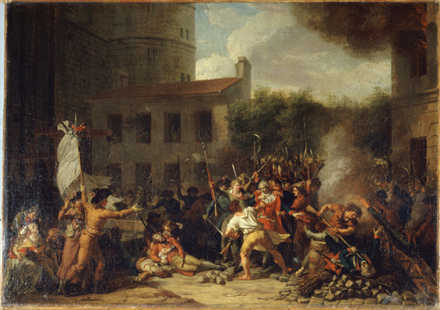
Charles Thévenin
Prise de la Bastille le 14 Juillet 1789
1793
Notes:
http://chnm.gmu.edu/revolution/imaging/essays/cameron3.html

Slide 13
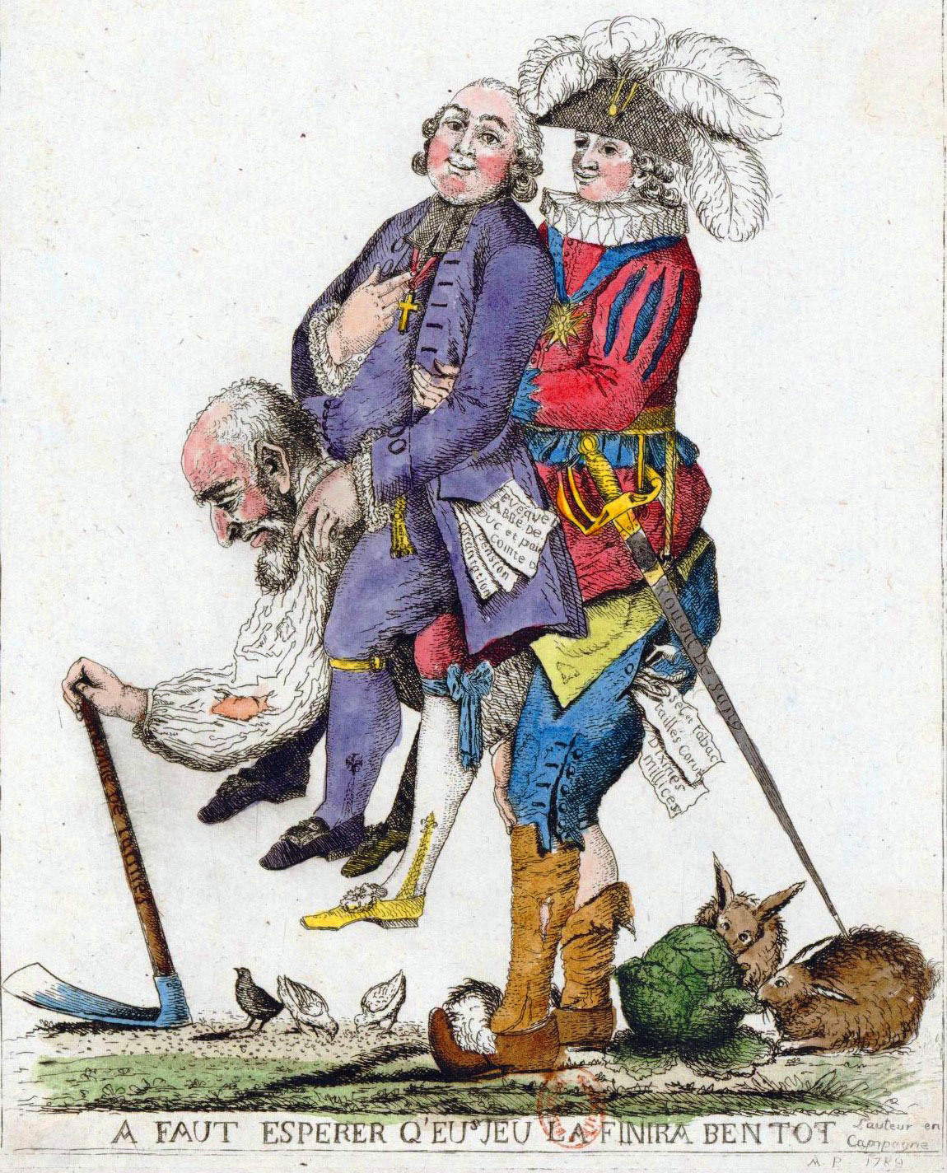
Activity
On your sequence chart, fill in the significance for the Enlightenment, American Revolution, creation of the National Assembly, and storming of the Bastille. This should be between 2-4 sentences.
"You should hope that this game will be over soon."

