Slide 1
Scientific Revolution
SWBAT: identify the major contributors to the scientific revolution.
Homework: Vocab
Do Now: Think about the test you took yesterday. Did you think the test was easy or hard? How do you think you did? What will you do differently next time?

Slide 2
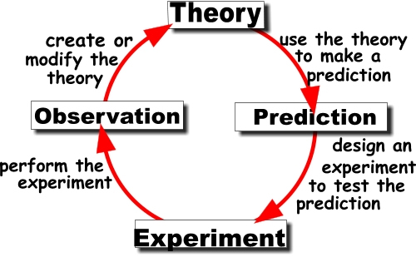
Scientific Method

Slide 3
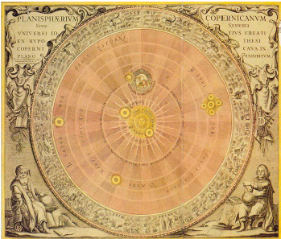
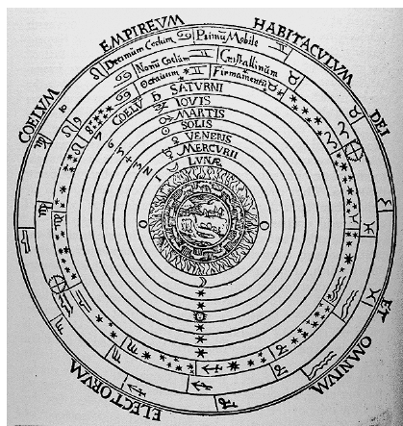
What kind of Great advancements?

Slide 4
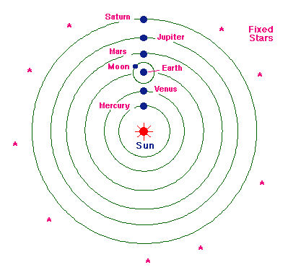
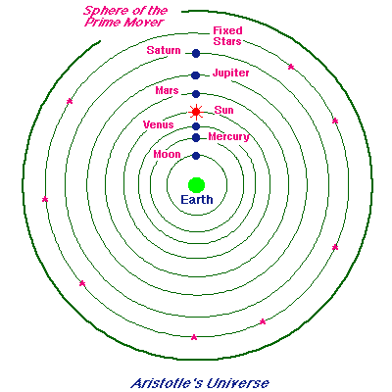
Two Systems of the Universe
Heliocentric Theory
Geocentric Theory

Slide 5
More Scientists, more Advancements
Fill in the chart using your online textbook. Make sure you answer the questions that follow as well in complete sentences.

