Slide 1
The Enlightenment
SWBAT: identify and explain the contribution of enlightenment philosophers.
Homework: None.
Do Now: Review Question: how did absolutist kings and queens act while in power? What kind of attitude did they have?

Slide 2
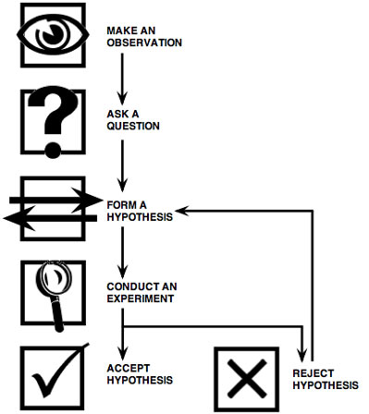
Scientific Revolution leads to Enlightenment
1500-1700: European scientists used reason to discover laws of nature.
Very successful: Scientific method allows for discoveries regarding planetary movements, gravity, etc.
By the 1700s, people began looking at everyday life from a scientific standpoint.

Slide 3
Science’s Influences
Belief in Progress
The successes of the Scientific Revolution gave philosophes the confidence that human reason could solve social problems.
More secular Perspective
Scientists made discoveries that contradicted & challenged religious teachings.
Importance of the Individual
People turned away from the Church & royalty for guidance - looked to themselves.
Encouraged to use their own abilities & reason to problem solve.

Slide 4
What is the Age of Enlightenment?
The Enlightenment was a period that used that same emphasis of logic, experimentation, and reason and applied it to non-science areas.
Spanning from 1650 to 1790, philosophers questioned everything from Absolutism to the theory of divine right to rule.
Began in Western Europe (primarily France and England) and eventually spread to North America.
It produced numerous books, essays, inventions, scientific discoveries, laws, wars, and revolutions.
The American and French Revolutions were directly inspired by Enlightenment ideals.

Slide 5
But who were these intellectuals?

Slide 6
Philosopher Group Work Mods 13-14, 17-18
Turn to the person next to you; say hello to your new partner.
You will be assigned a philosopher.
We’re going to go over the directions.
All philosopher info sheets can be found in the document shared with you on your drive.
Follow the timeline provided.

Slide 7
Exit Question
How would each philosopher feel about the form of government we have in the U.S. today?

