Slide 1
The Industrial Factory
SWBAT: explain how the industrial revolution impacted factory workers.
Homework: Complete the Interview organizer and short essay response.
Do Now: Fill in the second column of the chart. Be honest. Leave the third column blank for now.

Slide 2
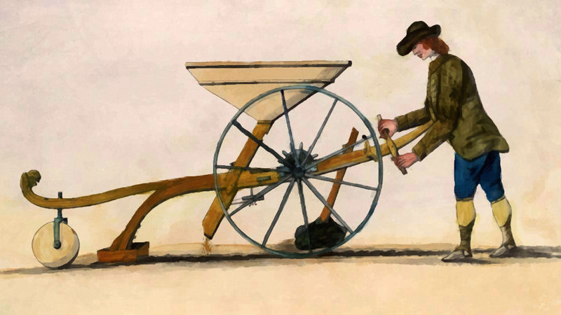
Movement to the cities
Let’s Review:
There were a lot of changes occurring with the Agricultural Revolution.
Inventions and innovations changed the way people farmed and inventions made the work easier and made people less necessary.
Additionally, some of these improvements were very expensive. Only wealthy farmers could afford them.
By the 1800s many farm workers, replaced by machines and forced off the land, were moving to the cities. They formed a huge labor force.

Slide 3
Rise of Factories
Let’s Review:
Mechanization, inventions, and innovations also changed the way products were produced.
New inventions, appearing first in the garment industry, meant that mass production was finally possible.
These new inventions needed a lot of space and needed many hands to work them.
As a result, new factories sprang up all over England.

Slide 4
The Factory System affects who works
Mechanization changed the face of the workforce is unprecedented ways.
Why? Because it made tasks easier to do.
Instead of spending years learning a trade as an apprentice, a person could learn to perform a task or operate a machine in a few days.
Employers now wanted people who could learn a few simple tasks.
They soon discovered that women and children could operate machines as efficiently as men.
The best part? Women and children would also accept wages lower than men’s.

Slide 5
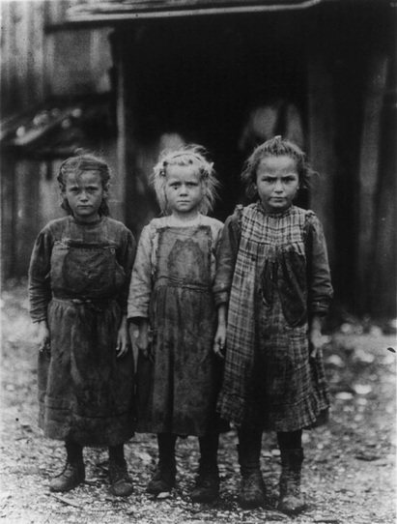
More effects…
Employers preferred to hire young men and women rather than older, skilled people.
Why? Hiring young people meant they didn’t have to pay them as much because of their lack of experience.
Were also moldable and not set in their ways. Open to new ways of doing things.
Because older workers were no longer needed, they found themselves unemployed.
As a result, they often sent their small children to find work instead.

Slide 6
The Wage System
Wages were determined in a number of ways.
Way 1: Set wages in relation to other costs of production.
i.e. if the cost of land or capital wages .
Way 2: The # of available workers.
An oversupply of workers meant lower wages.
An undersupply of workers meant higher wages.
Way 3: Gender.
Men were considered the breadwinners, and women were thought to work to bring home a little extra.

Slide 7
Changes to how goods are made
Industrialization changed the way people worked.
Prior to industrialization, artisans would produce a specific good and be in control of every part of the process.
Time-consuming process and the goods would be expensive.
Factory owners changed that by dividing the manufacturing process into steps. This is called the division of labor.
They hired unskilled labor and assigned a step to each worker, which increased production.
The lowered cost of production made more profit for the owners.
This eventually led to the assembly line.

Slide 8
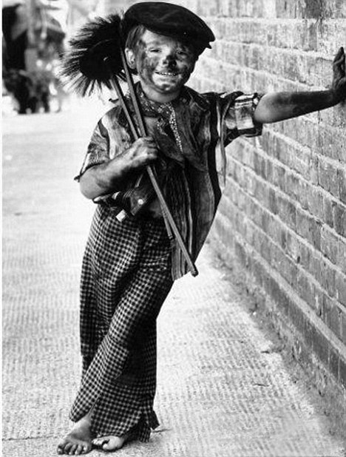
In the Factories
Keep in mind this is before regulations and rules were created by the gov’t to protect workers and worker’s rights.
As a result, working in the factories was difficult and dangerous.
Large machinery and unskilled/young workers often meant accidents leaving workers maimed or dead.
Because so many people needed jobs and workers were disposable, they were treated as such.

Slide 9
Lives of Factory Workers
CP: open “examination of workers” and “examination of workers chart” and begin working.
Read the interviews with the factory workers and fill in the chart. When complete, begin answering the short response paragraph.
Note: you need to pull from the text to complete the paragraph.
Whatever is left unfinished is for homework.

