Slide 1
The Ming and Qing (Ching) Dynasties
SWBAT: identify the reasons why the Ming and Qing dynasties failed to expand.
Homework: None
Do Now: Start the Great Wall reading and answer the questions.

Slide 2
What is a Dynasty?
A series of rulers who passed the kingship to their heirs until a contender (usually forcibly) removed the last king in the dynasty from power.
There are roughly 26 dynasties beginning in 2070 BC and ending in 1911 with the Chinese Revolution and the establishment of the Republic of China.
The Ming and Qing dynasties will be the last 2 of these respectively.

Slide 3
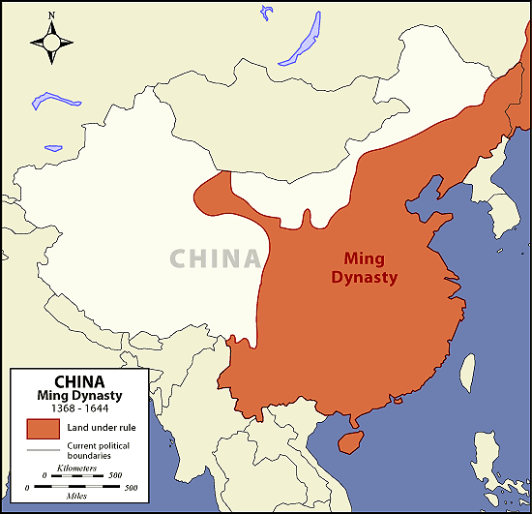
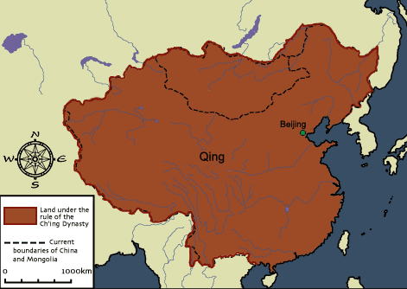
The Two Empires
Ming Empire
Qing Empire

Slide 4
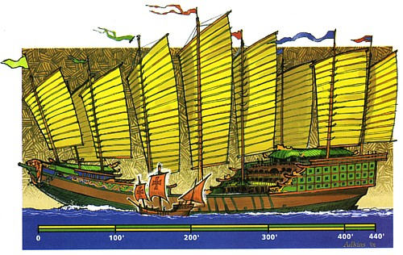
Early Ming Dynasty
Between 1300-1400, the Ming were probably the best skilled sailors in the world.
Used ships called junks: 400 feet long.
~1100, China had invented and used the compass.
By 1405, a Chinese fleet sailed across the Indian Ocean and reached the Arabian Peninsula.
How did this compare to Europeans?
The Chinese had the potential to be the leading sea power in the world.
And then suddenly, it all stopped. But, why?
Chinese junks compared to European sailing vessels.

Slide 5
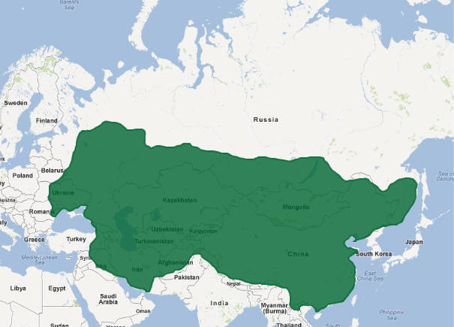
The Northern Frontier
Why was the wall reinforced during the Ming Dynasty?
Ming emperors wanted to make sure that no central Asian people ever conquered China again.
What to do to ensure that?
Fortify the Great Wall of China.
Send soldiers to live on the frontier.
Give gifts to nomadic people living on the frontier so they don’t unite and fight the Ming Dynasty
This all costs money.
Chinese can’t afford to explore overseas and protect the interior. They choose to protect the interior.
http://upload.wikimedia.org/wikipedia/commons/e/ea/Mongol_Empire_map.gif

Slide 7
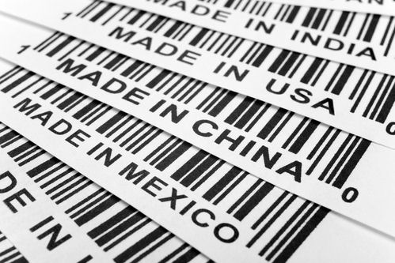
Negative Attitudes towards Trade
Ming emperors wanted to be self-sufficient.
Didn’t want to have to rely on foreign trade as a source of government revenue.
Didn’t think there were enough benefits.
How does this differ than European systems?

Slide 8
The end of a Dynasty
The Ming Empire lasted about 270 years and then collapsed mainly from within as rival groups carved up sections of the empire for themselves and fought for supremacy.
Natural disasters, famine and economic chaos convinced many people that the Ming had lost the Mandate of Heaven.
An ancient political idea that Heaven selects an emperor and that an emperor's failure as a god spells disaster for his empire.
Question #2: was the expansion of the wall effective at keeping invaders out?

Slide 9
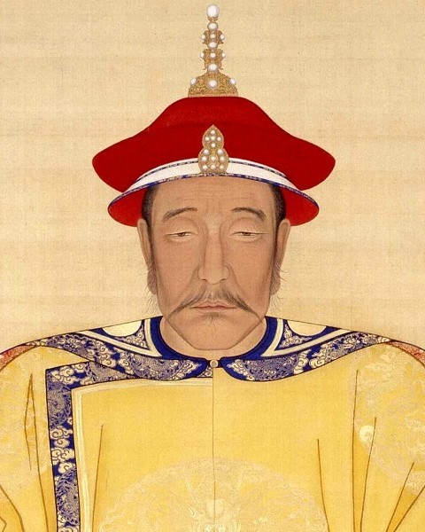
Qing Dynasty
Despite Ming attempts at blocking outside invasions, they failed.
Tribes united in Manchuria and managed to retake Beijing; called themselves the Manchu.
The Qing emperors were not Chinese, but they adopted Chinese ways.

Slide 10
Economy in Qing China
Despite not being able to trade overseas, the economy did well.
Used rivers to trade throughout the country.
Farming was a huge industry planting crops such as: rice, wheat, and tea.

Slide 11
Problems of the Qing Dynasty
Population grew rapidly under the Qing rulers: swelled to over 400 million people by the mid-1800s.
Put a lot of pressure on the government:
Corruption in courts made them inefficient.
Bureaucrats demanded bribes in return for gov’t service.
Peasant farmers found it difficult to sustain their farms and in turn, their families.
Floods and famine in various parts of China made it worse.
Western pressure to gain economic control intensified.

Slide 12
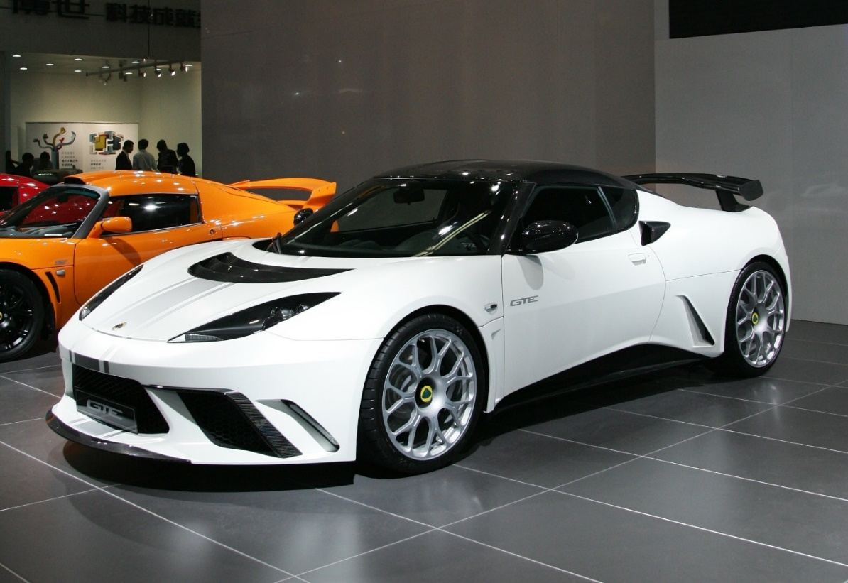
White Lotus Rebellion
In 1796 discontent over increased taxes and growing government inefficiency led to a peasant rebellion.
Members of a Buddhist cult called the White Lotus Society led the revolt, which was called the White Lotus Rebellion.
Despite restoring order, the Qing government was seriously weakened.
It appeared that the Qing may have lost the mandate from heaven as well.

Slide 13
Exit Discussion
If the Chinese had “discovered” and settled in the United States rather than Europeans how would your life be different? (Consider: religiously, culturally, economically, etc.)

