Slide 1
Tokugawa Shoguns in Japan
SWBAT: identify the reasons for the rise and fall of the Tokugawa Shogunate.
Homework:
CP: Study guide (shared on your drive).
Core: None
Do Now: How is being an island nation beneficial? How is it disadvantageous?

Slide 2
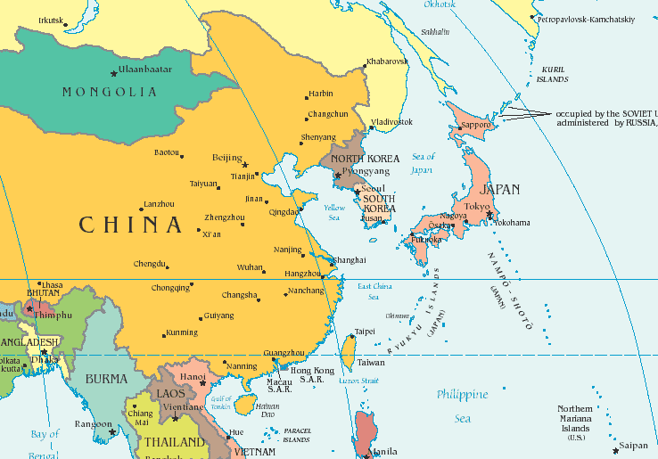
Where is Japan?

Slide 3
Vocab to know
Shogun: hereditary military dictators of Japan from 1192 to 1867. Shoguns were appointed by the emperor. The emperor has power similar the queen of England today whereas the Shogun has power similar to the Prime Minister.
Daimyo: were the powerful territorial lords who ruled most of the country from their vast, hereditary land holdings. Subordinate only to the shogun, daimyo were the most powerful feudal rulers from the 10th century to the middle 19th century in Japan.
Shogunate: a feudal Japanese military government which existed between 1600 and 1868
Feudalism: a system for structuring society around lords who lend out their land to peasants in exchange for food and labor.

Slide 4
Before the shoguns
After 100 years of fighting, a series of three men established themselves as overlords of Japan
Credited with centralizing the feudal system in Japan.
Oda Nobunaga
Toyotomi Hideyoshi
Togugawa Ieyasu

Slide 5
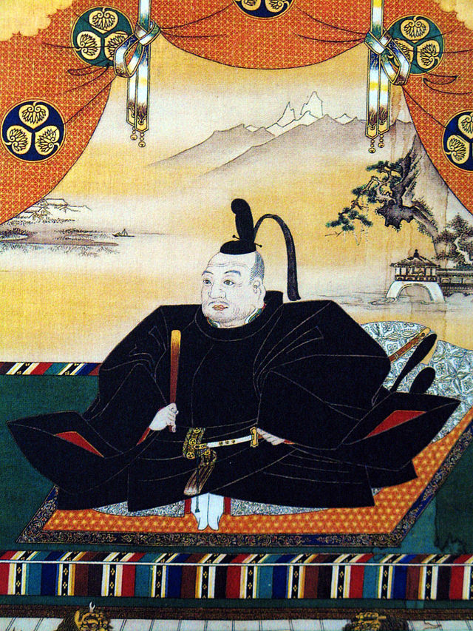
Tokugawa Ieysau
Ieyasu seized power in 1600, received appointment as shogun in 1603.
Moved the capital to Tokyo.
The Tokugawa family would keep the title of shogun for more than 250 years. They established a government known as the Tokugawa shogunate.

Slide 6
Tokugawa Rule
The political system established by the Tokugawa shogunate was a cross between feudalism and a central monarchy.
Within his domain, each daimyo governed as an almost absolute ruler.
Local peasants paid taxes to support the daimyo and those who served him, such as the samurai.
The Tokugawa family had its own private domain, which included roughly one fourth of the nation's resources.
Thus the Tokugawa did not rule the entire country directly.

Slide 7
Consolidating Power
Because of their wealth and military power, however, the Tokugawa had considerable influence over the daimyo.
They used this influence to ensure that they could never rise up and take power away from the Shogun.
To do this they:
Prohibited the daimyo from making alliances with one another.
Forced the daimyo to spend every other year in the capital. When they returned to their own domains, the daimyo left their families in Tokyo as hostages.
Maintaining two residences—one in Tokyo and one in the provinces—proved very expensive for the daimyo and drained their financial resources.
Living in Tokyo transformed many daimyo from warriors to courtiers, so they didn’t have the skills to wage wars.
Strong central government gave 200 years of stability to Japan.

Slide 8
Isolationism Begins
The Tokugawa firmly believed that to ensure complete power and control, the needed to separate themselves from the outside world.
Like China, Japan set trade restrictions and limited contact with foreigners.
By doing so, they achieved almost complete isolation from Europe by 1650.
Their desire for isolation was in response to contact with foreigners that had occurred beginning in the 1500s.

Slide 9
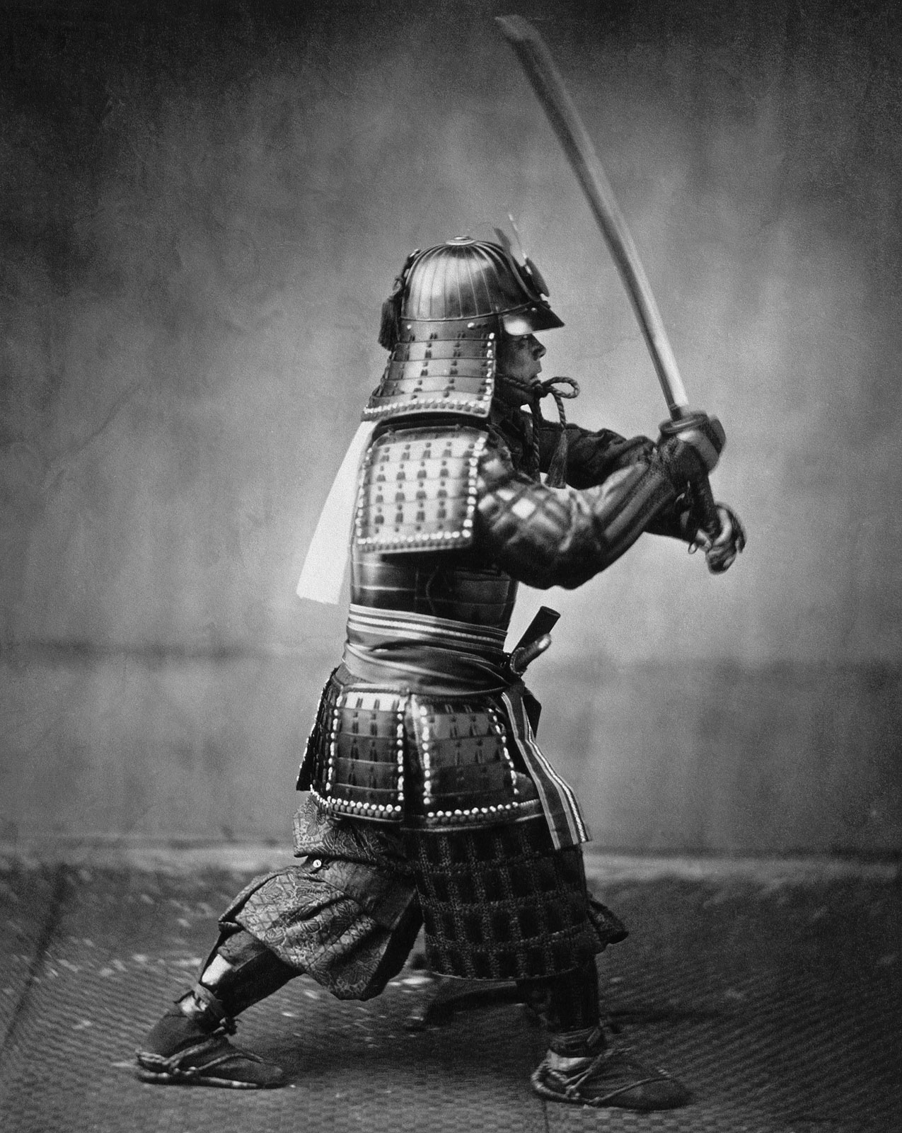
Which Europeans?
Like in China, the Portuguese also made an impact on Japan.
Traders brought with them muskets and Christianity.
Samurai disliked muskets b/c it didn’t need skill.
Jesuits were seen as a threat to rulers due to allegiance to the pope.
The response?
Kick the Portuguese out
Prohibit international trade
Prohibit traveling abroad.
Island geography allowed Japan to stay isolated.

Slide 10
End of Isolationism

Slide 11
The Americans want in…
Read the letter from President Fillmore to the emperor of Japan and answer the questions that follow.

Slide 12
A Treaty is Signed
Led to the Treaty of Kanagawa.
Opened 2 Japanese ports to United States trade.
Guaranteed the safety of shipwrecked US sailors.
Created a permanent consul in Shimoda.
The arrival of the fleet would trigger the end of Japan's 200 year policy of seclusion.
Soon after, other Europeans countries signed similar treaties.
Future treaties continued the tradition of unequal treaties:
Extraterritoriality for foreigners and minimal import taxes for foreign goods.

Slide 13
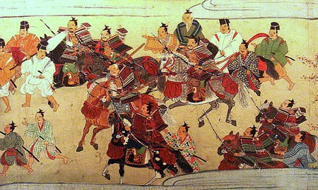
The end of the shoguns
Opening up to the West led to major disagreements and eventually Civil War.
The Tokugawa Shogunate came to an official end in 1868, with the resignation of the 15th Tokugawa Shogun.
Began the "restoration" of imperial rule.
Despite this, the establishment of the Tokugawa shogunate brought Japan the longest period of peace and stability in its history, lasting over 200 years.

